Slide 1
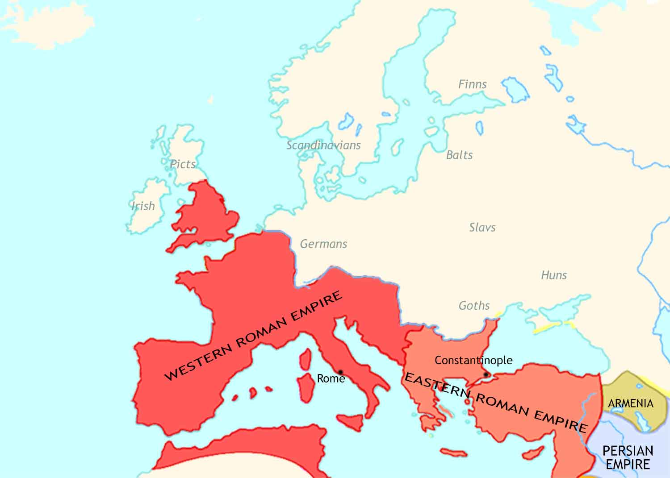
Medieval Europe: 400 CE

Slide 2
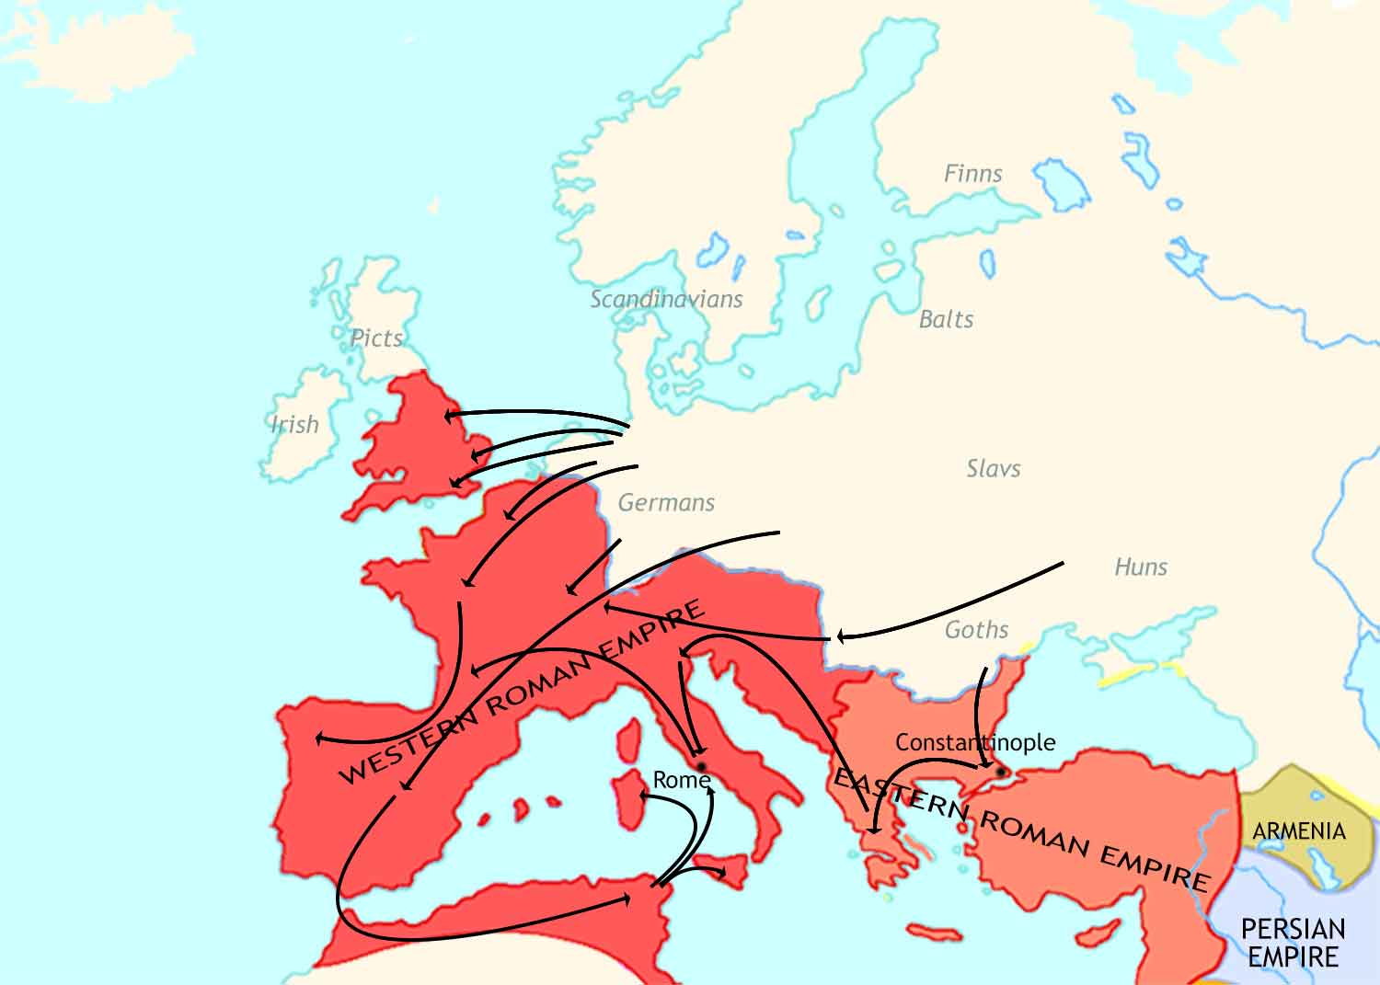
Medieval Europe: 400-500 CE
Angles, Saxons, Jutes
Franks
Suebi
Vandals
Huns
Goths

Slide 3
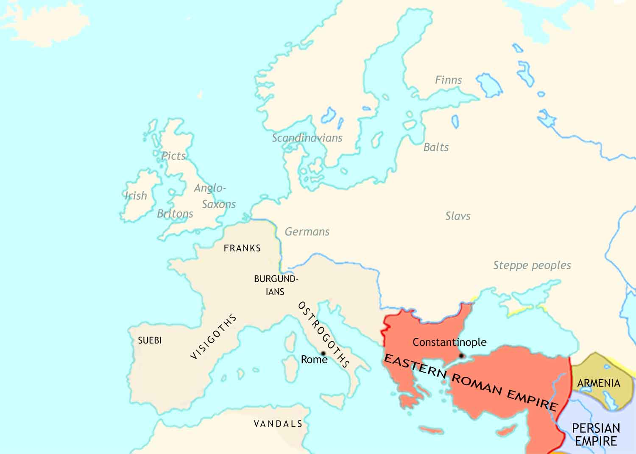
Medieval Europe: 500 CE

Slide 4
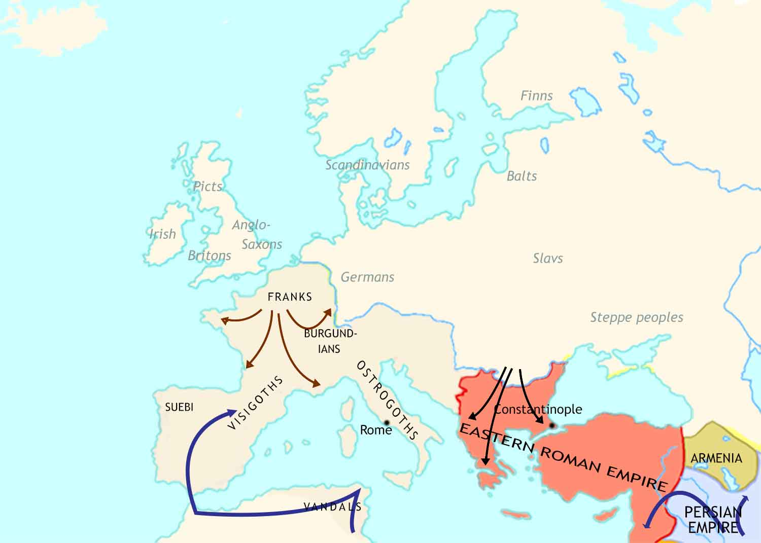
Medieval Europe: 500-711 CE

Slide 5
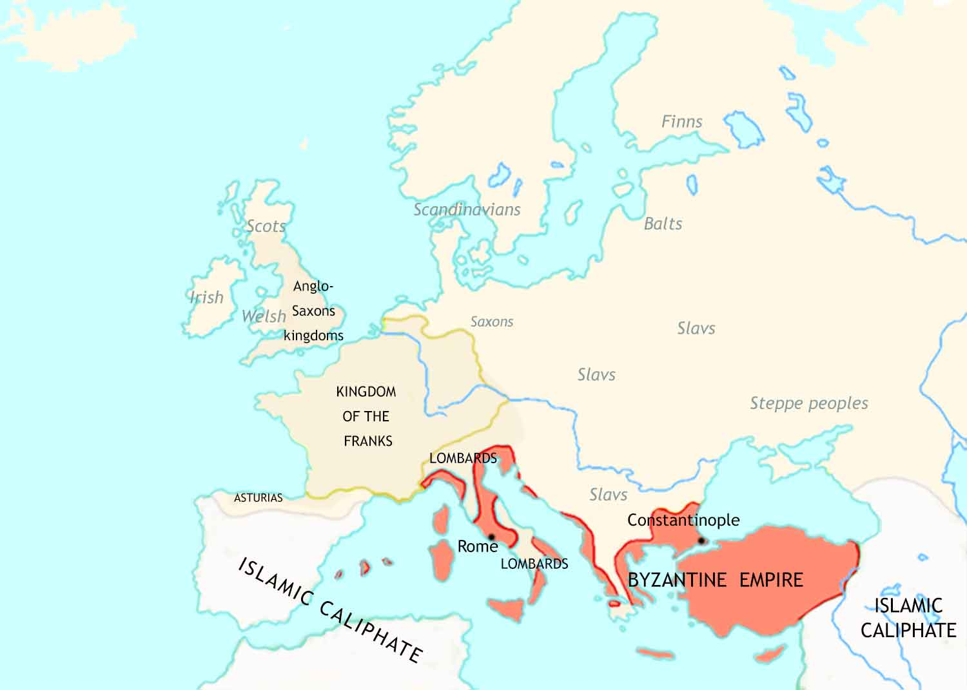
Medieval Europe: 711 CE

Slide 6
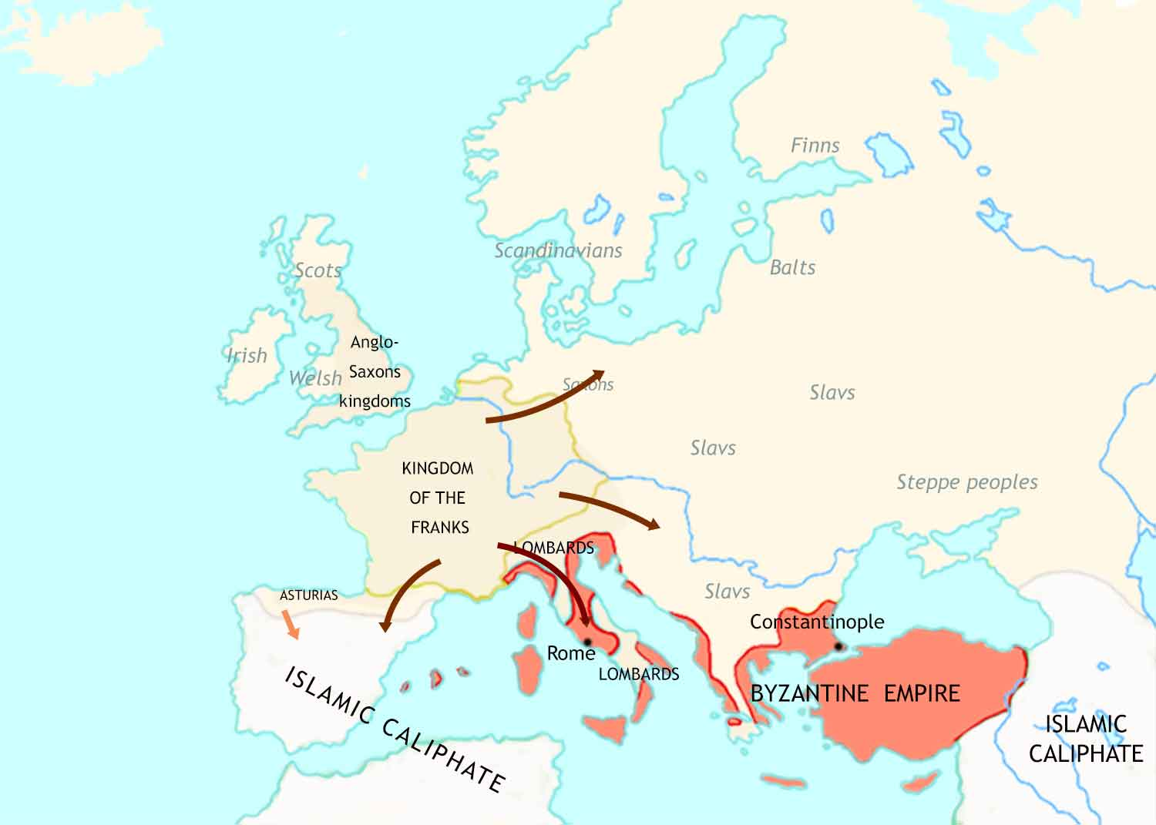
Medieval Europe: 711-814 CE

Slide 7
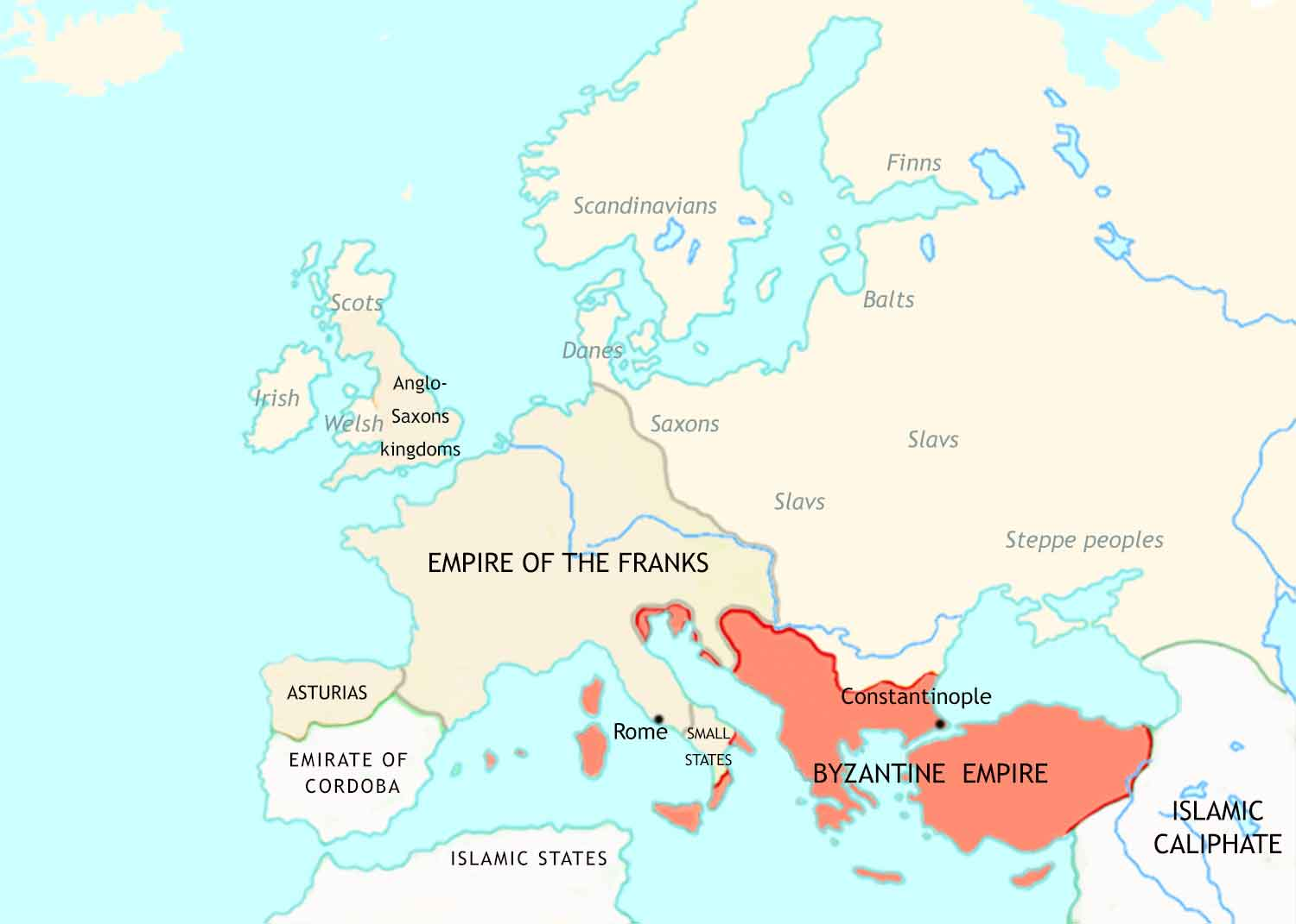
Medieval Europe: 814 CE

Slide 8
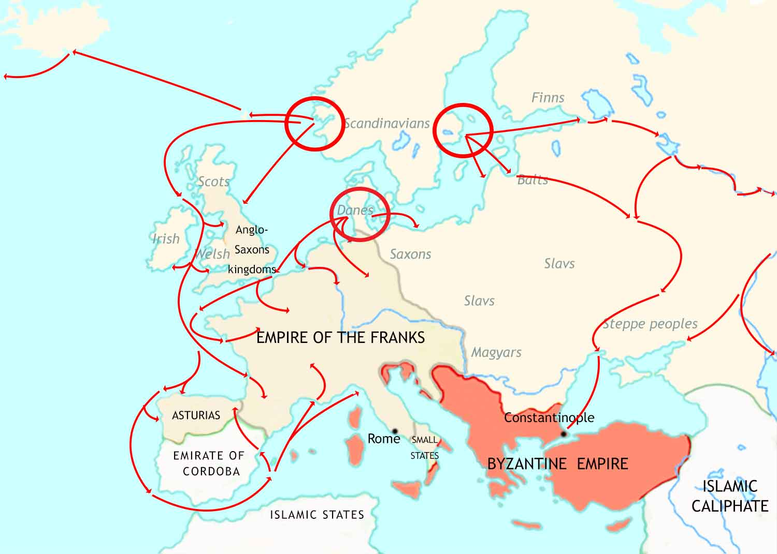
Medieval Europe: 814-962 CE- I
Norwegians
Swedes
Danes

Slide 9
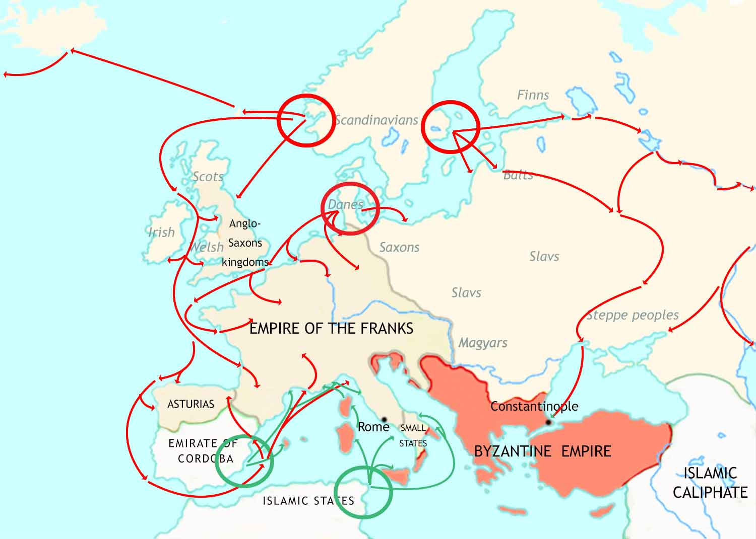
Medieval Europe: 814-962 CE - II
Norwegians
Swedes
Danes

Slide 10
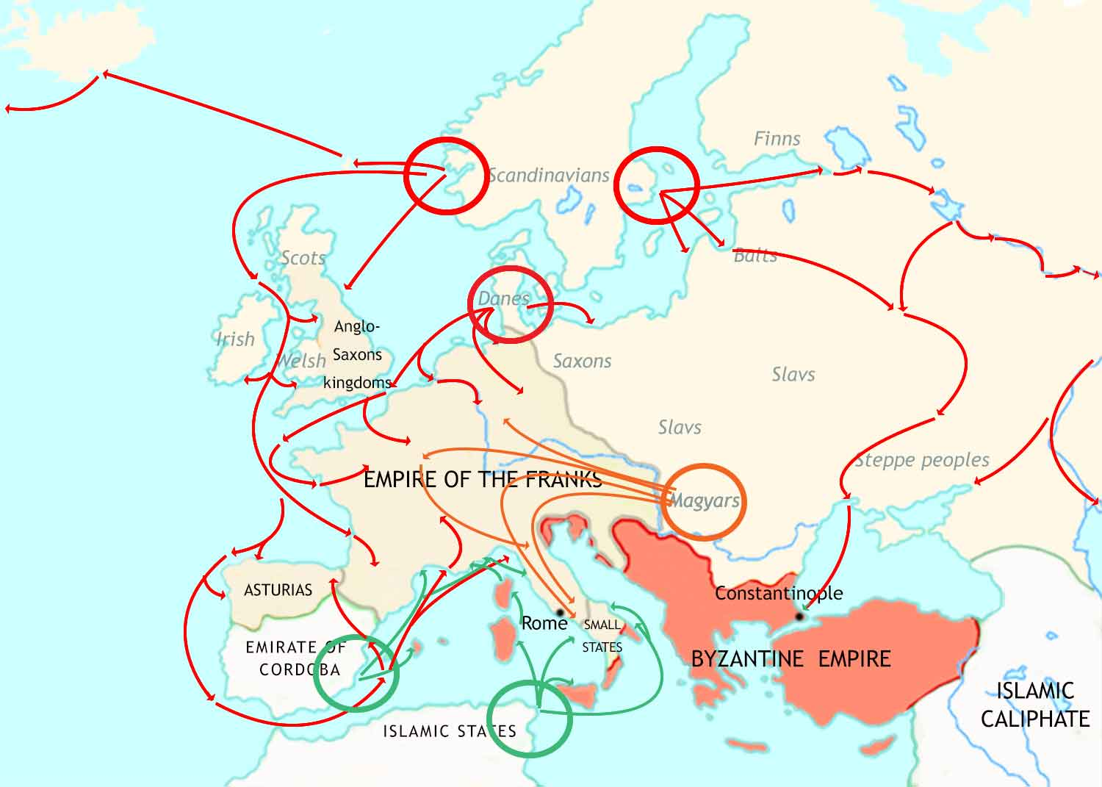
Medieval Europe: 814-962 CE - III
Norwegians
Swedes
Danes

Slide 11
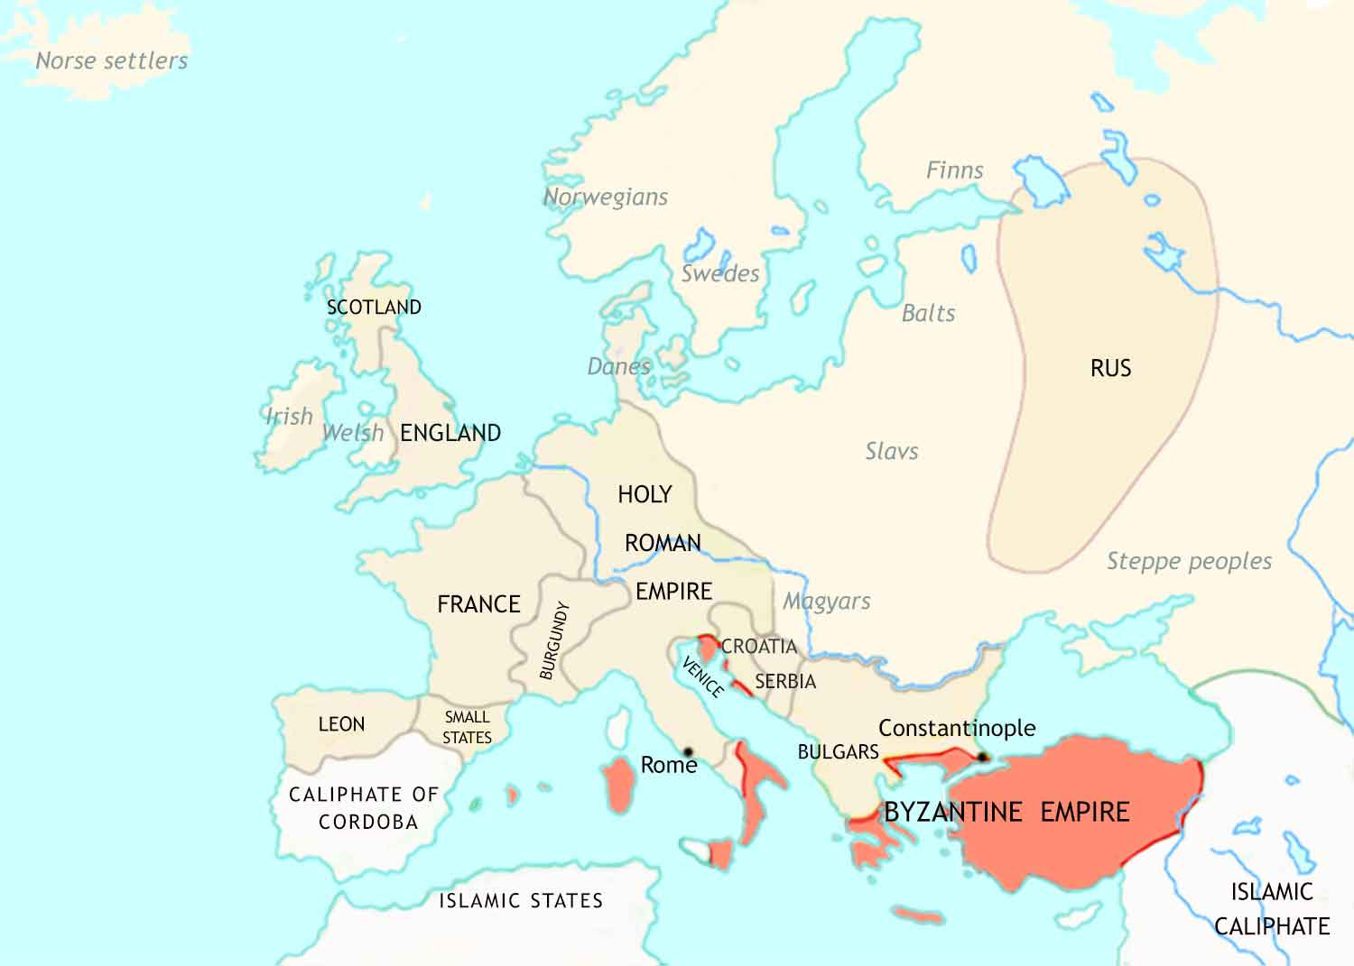
Medieval Europe: 962 CE

Slide 12
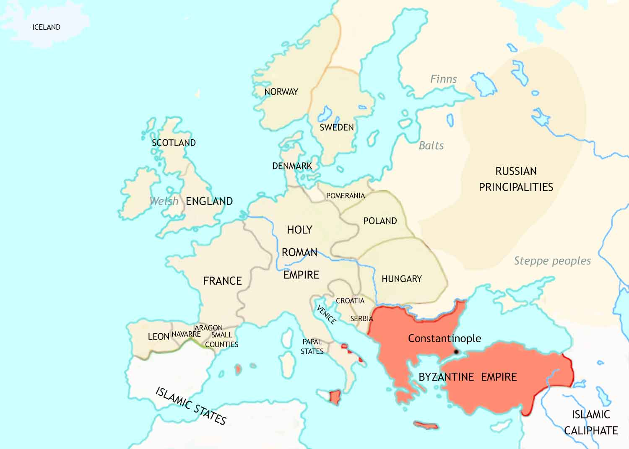
Medieval Europe: 962-1066 CE

Slide 13
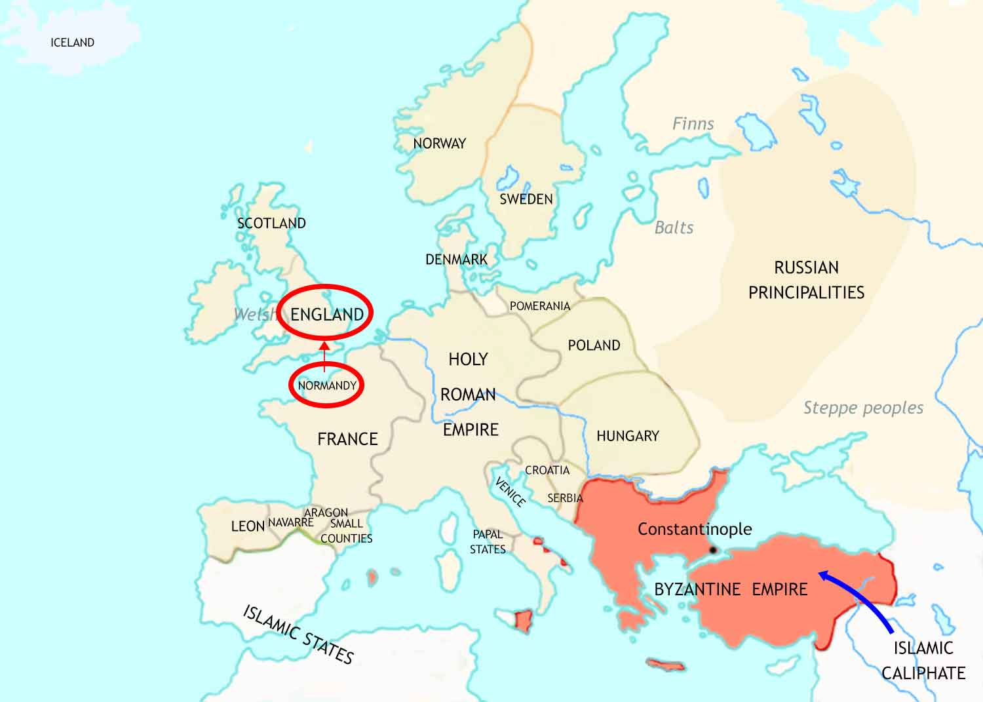
Medieval Europe: 1066-1215 CE - I

Slide 14
Medieval Europe: 1066-1215 CE- II

Slide 15
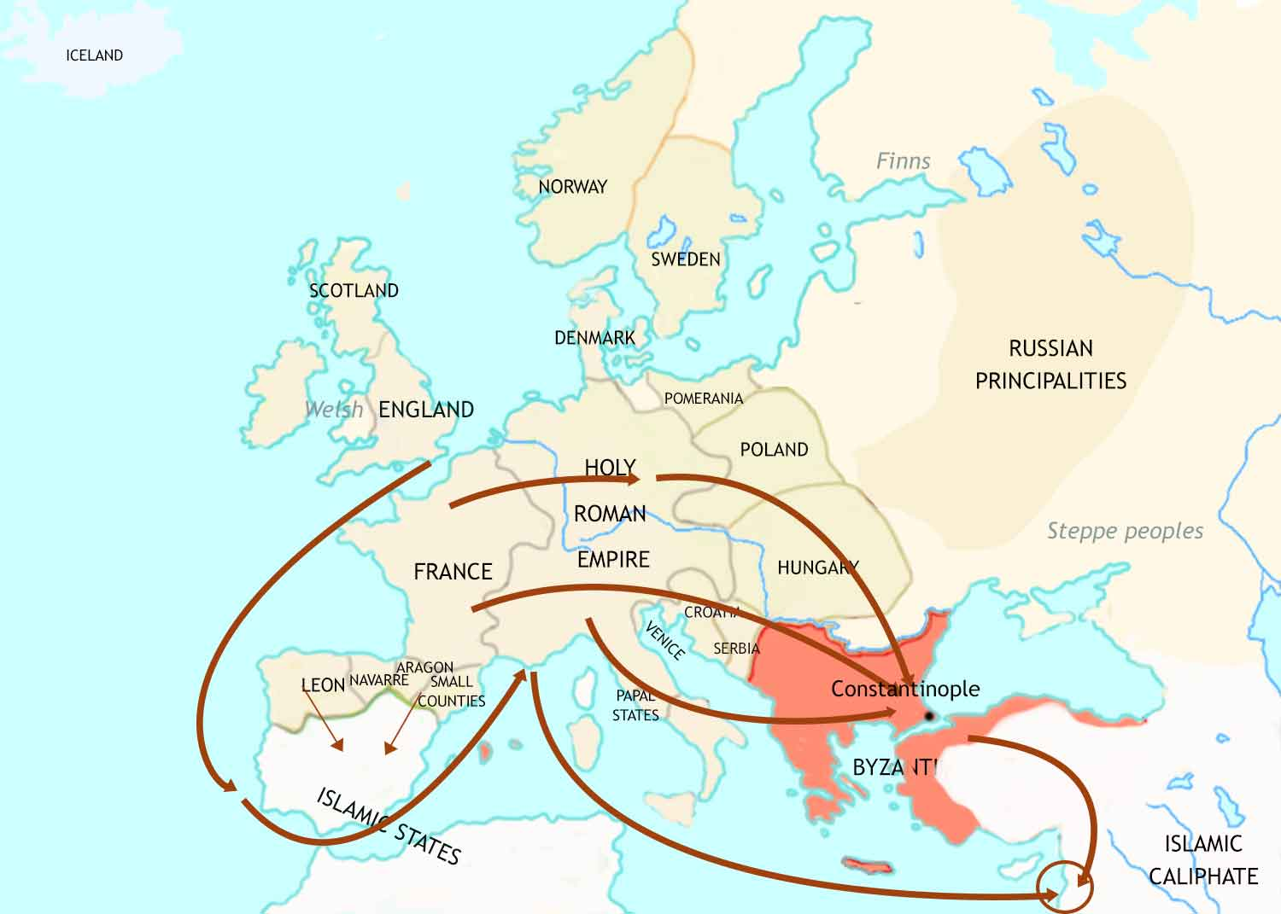
Medieval Europe: 1066-1215 CE - III
Jerusalem

Slide 16
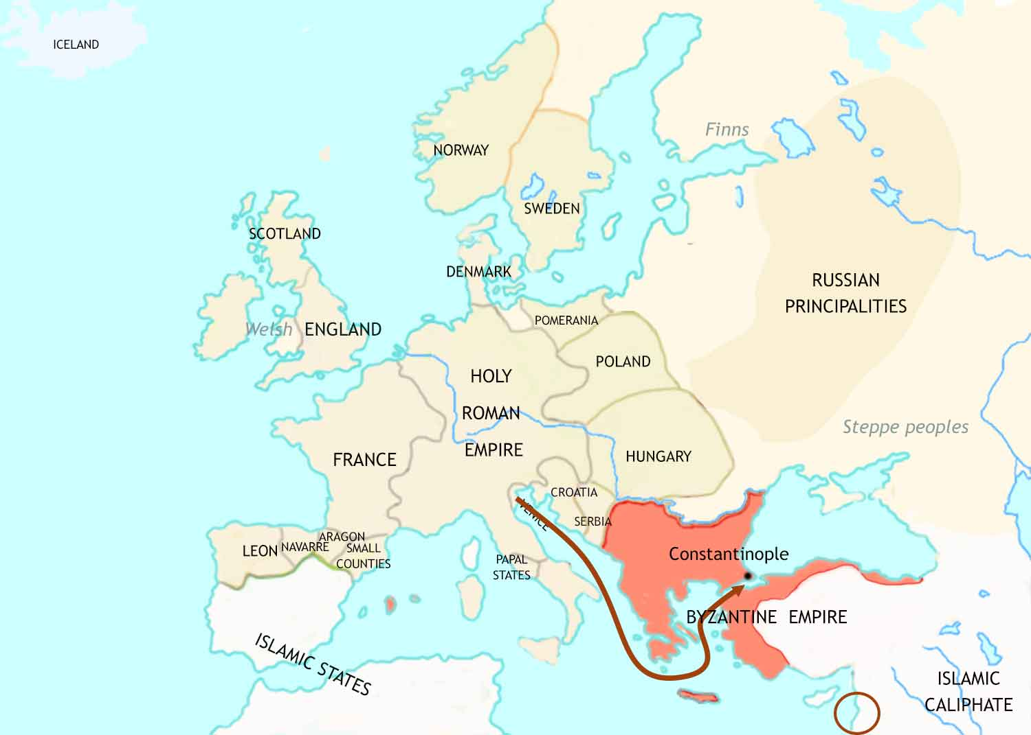
Medieval Europe: 1066-1215 CE - IV
Instead of fighting the Muslims, in 1204 the
4th Crusade attacks the
Byzantine (and Christian) city of Constantinople.
Jerusalem

Slide 17
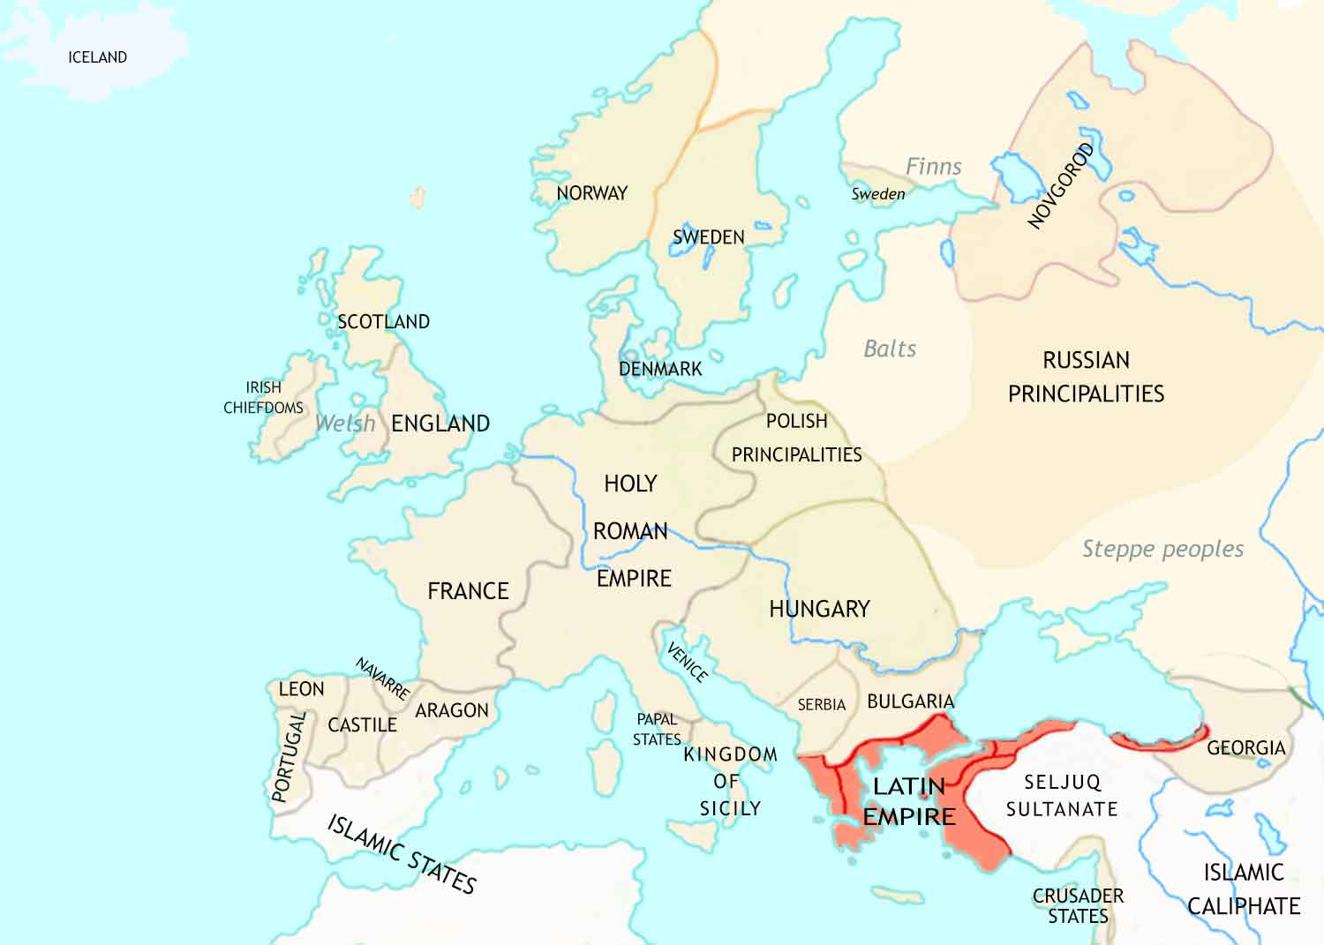
Medieval Europe: 1215 CE

Slide 18
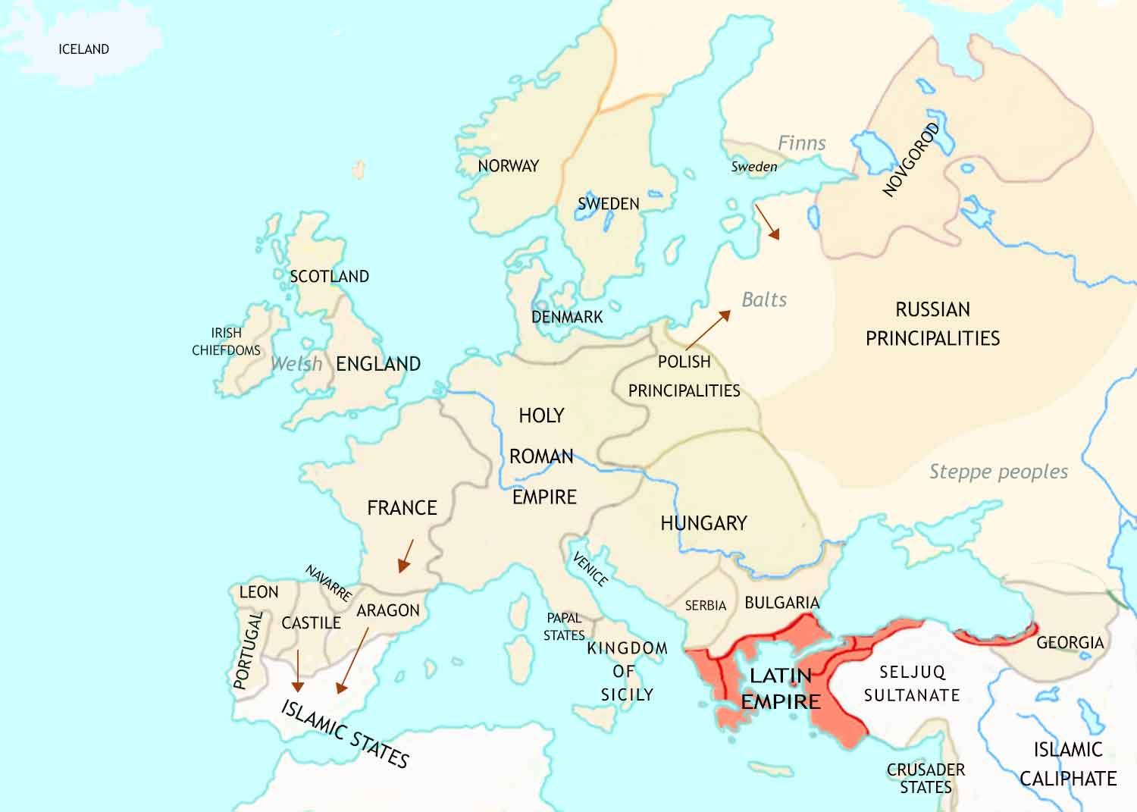
Medieval Europe: 1215-1347 CE - I

Slide 19
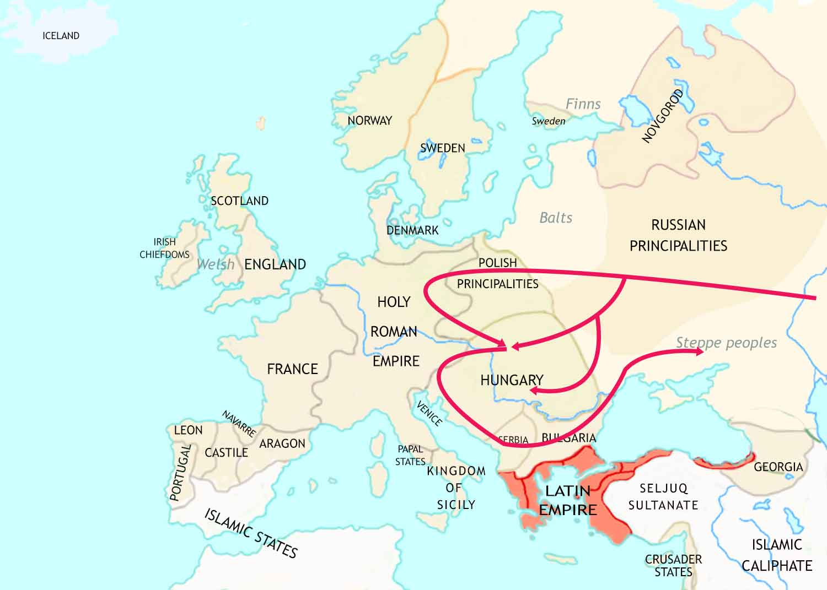
Medieval Europe: 1215-1347 CE - II

Slide 20
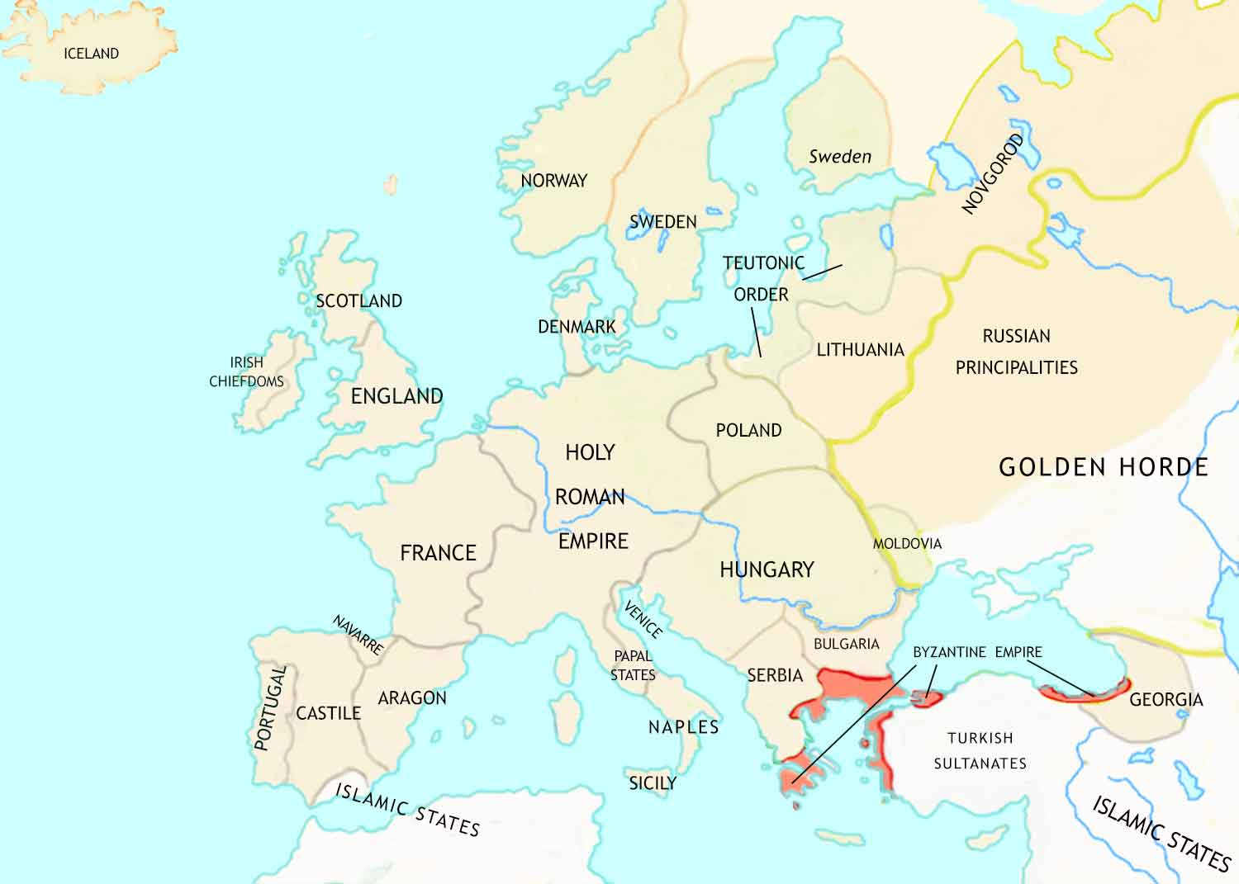
Medieval Europe: 1347 CE

Slide 21
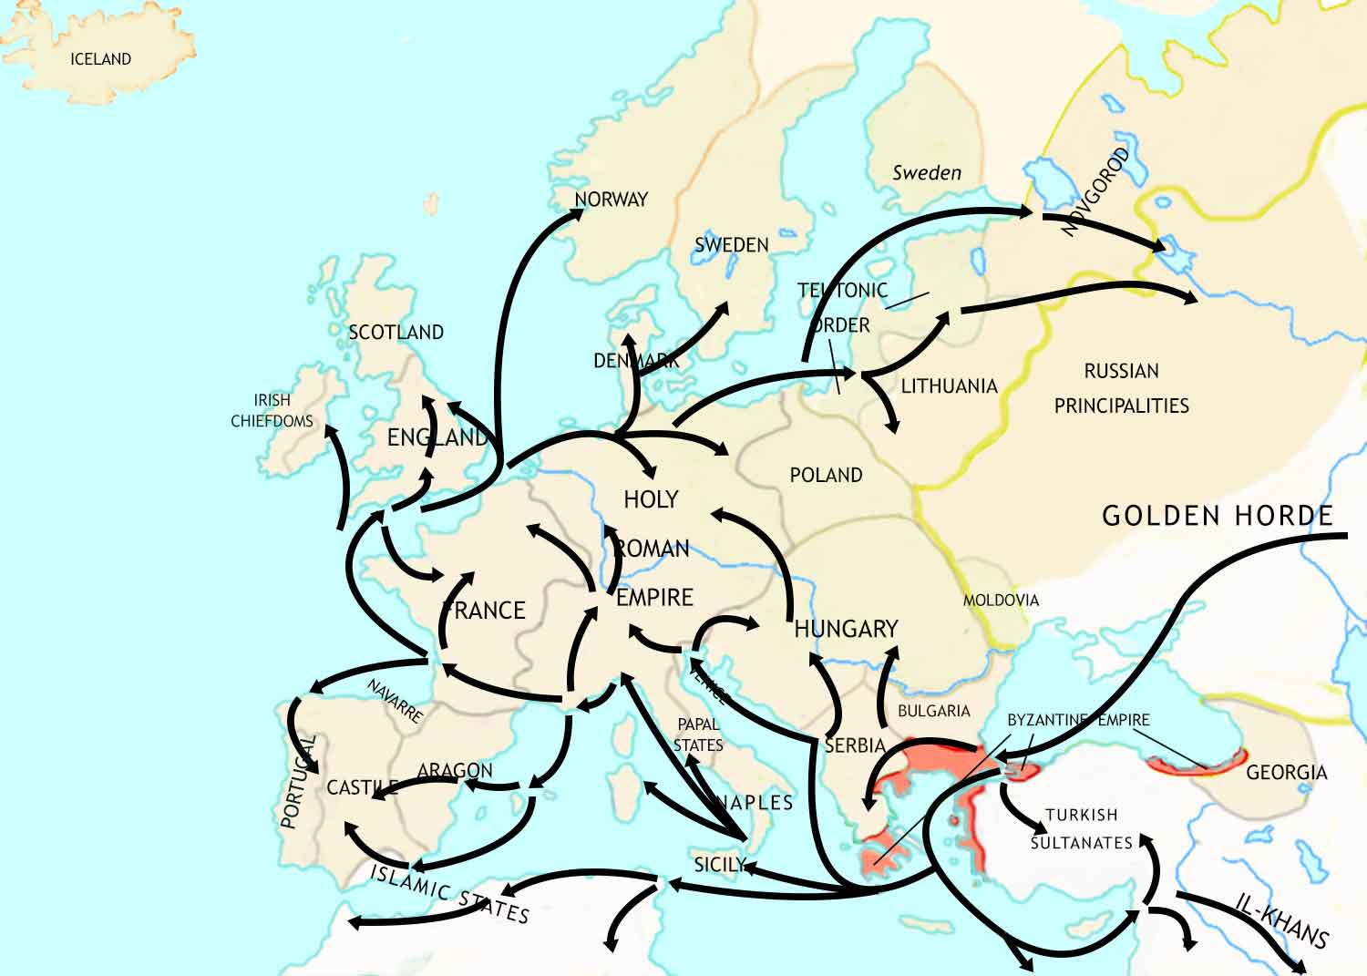
Medieval Europe: 1347-1352 CE

Slide 22
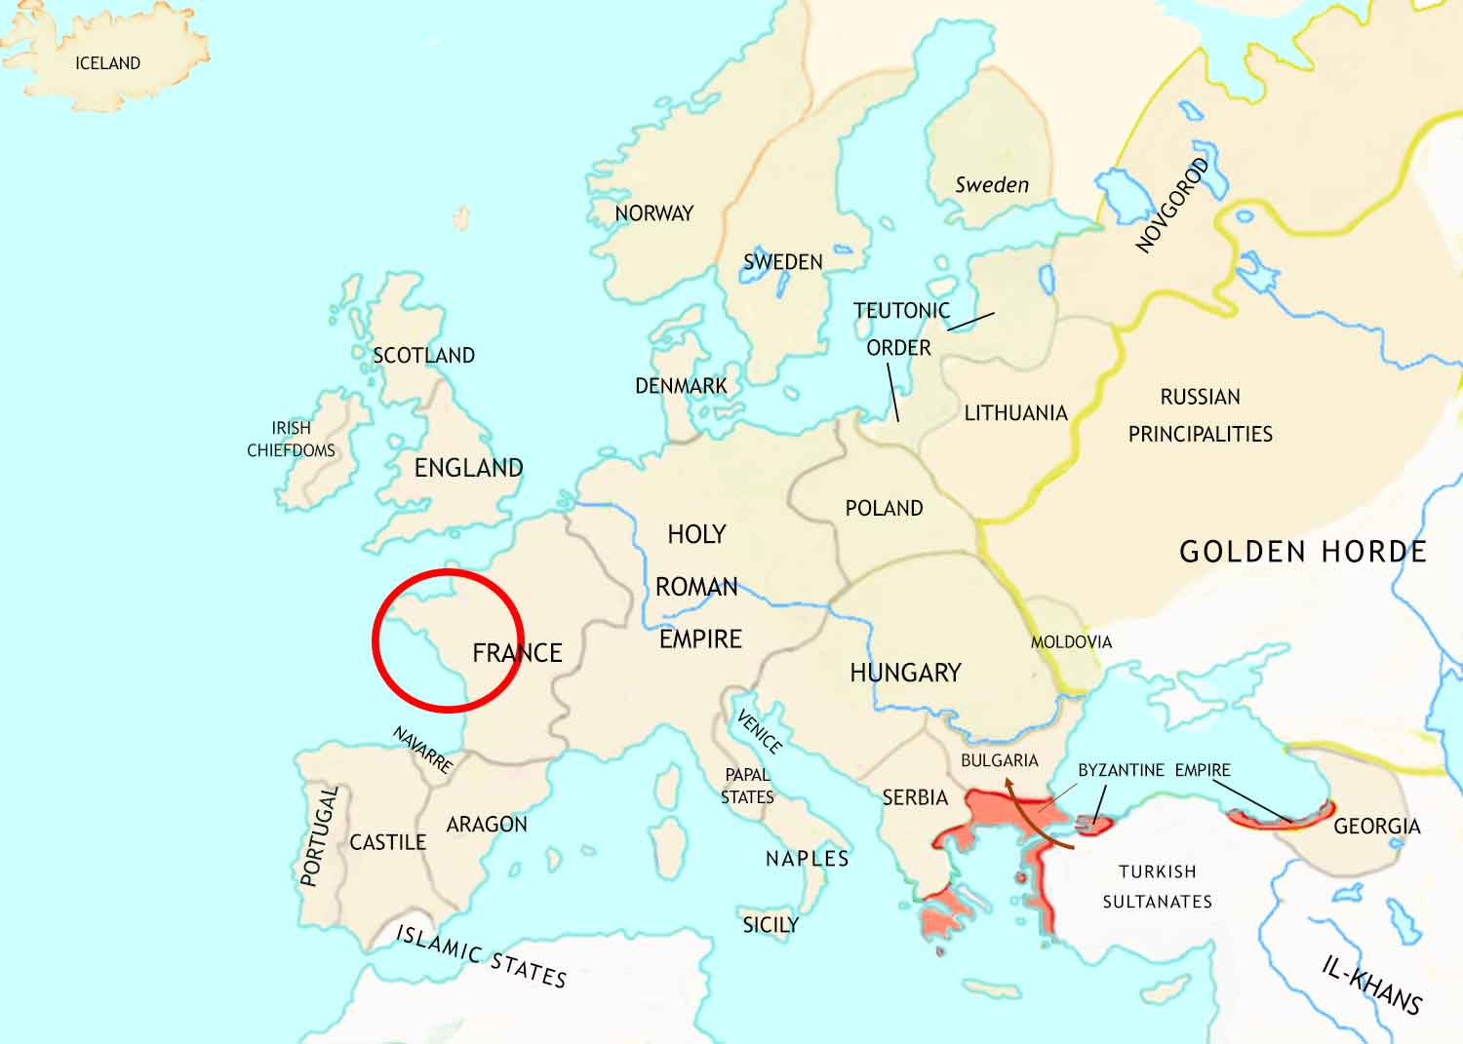
Medieval Europe: 1352-1450 CE

Slide 23
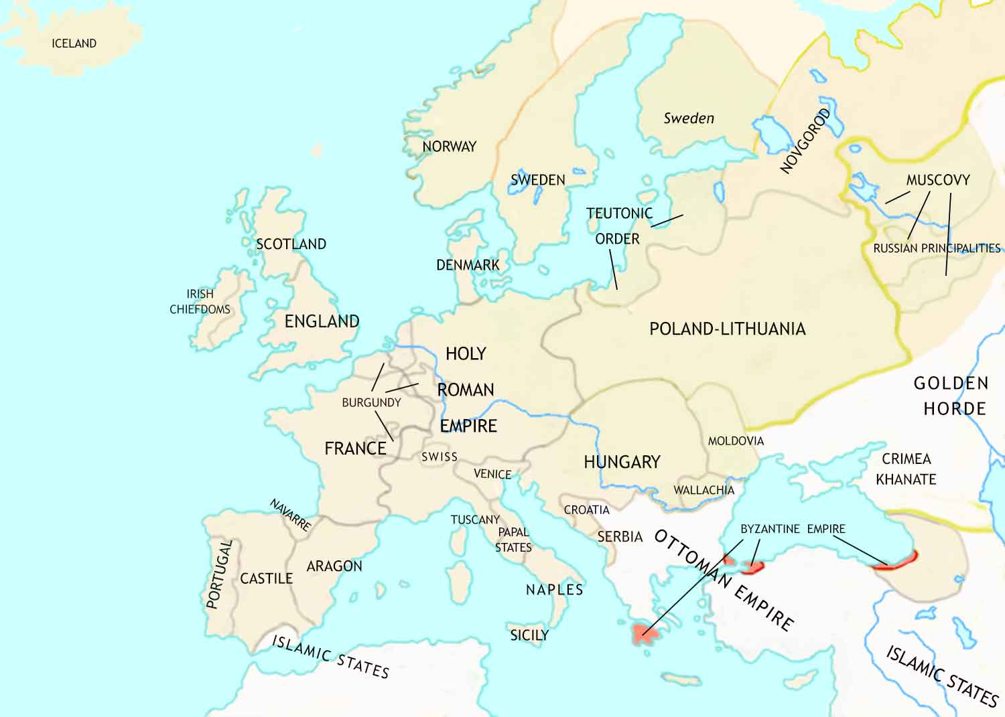
Medieval Europe: 1450 CE

