Slide 1
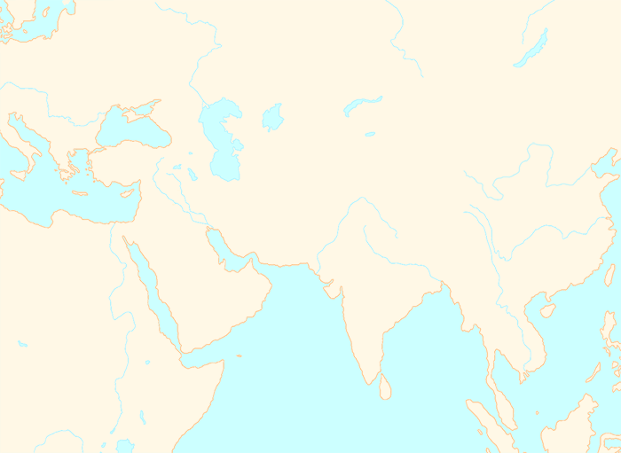
Central Asian Steppes
Gobi Desert
Tibetan Plateau
Yellow River
The Mediterranean Sea
Tigris
Euphrates
Hindu Kush
Himalayas
Nile
The Gulf
Indus
Yangtze
Ganges
Arabian Desert
The Red Sea
Sahara Desert
The Indian Ocean
RIVERS
LANDSCAPES
SEAS AND OCEANS

