Slide 1
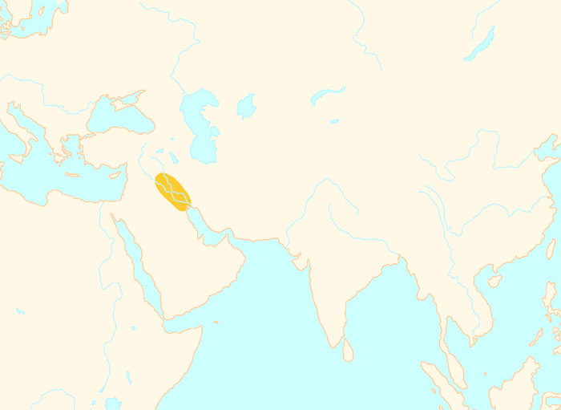
3500 BCE
Warlijke pharaohs expand
Egypt’s borders
The Zhou dynasty has
replaced the Shang dynasty
Hammurabi has issued
his famous Law Code
Traders spread the
alphabet from here
Mesopotamian
civilization
Well-laid out streets,
drains and sewers
The earliest cities in world
history are appearing here
Pyramids of Giza
are being built
A great palace has
been built at Knossos
The Buddha is
teaching now
4000 BCE
1 CE
The Olympic games are
now held every 4 years
The Zhou dynasty has
replaced the Shang dynasty
Athens has becomes
a democracy
Oracle bones
are in use
Cyrus the Great
has conquered
a huge empire
Confucius is
teaching now
King Nebuchadnezzar
reigns
The Vedas are
being composed

Slide 2
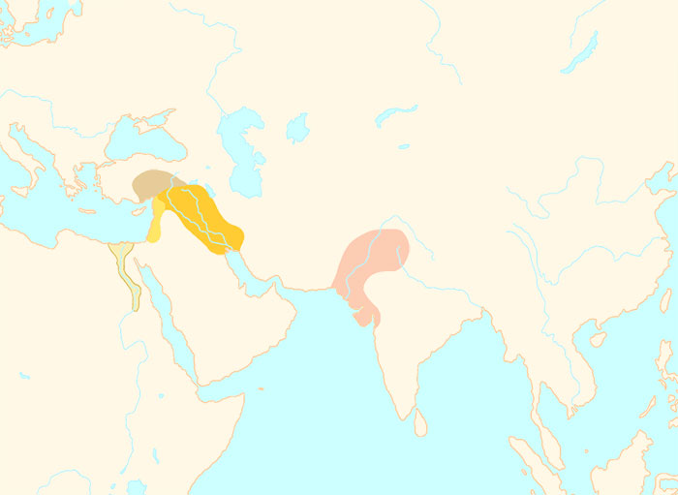
2500 BCE
Warlijke pharaohs expand
Egypt’s borders
The Zhou dynasty has
replaced the Shang dynasty
Hammurabi has issued
his famous Law Code
Mesopotamian
civilization
Traders spread the
alphabet from here
Indus Valley
civilization
Well-laid out streets,
drains and sewers
Egyptian
civilization
The earliest cities
are appearing
Pyramids of Giza
are being built
A great palace has
been built at Knossos
The Buddha is
teaching now
4000 BCE
1 CE
The Olympic games are
now held every 4 years
The Zhou dynasty has
replaced the Shang dynasty
Athens has becomes
a democracy
Oracle bones
are in use
Cyrus the Great has conquered
a huge empire
Confucius is
teaching now
King Nebuchadnezzar
reigns
The Vedas are
being composed
Civilization is appearing here
again after 1000 years

Slide 3
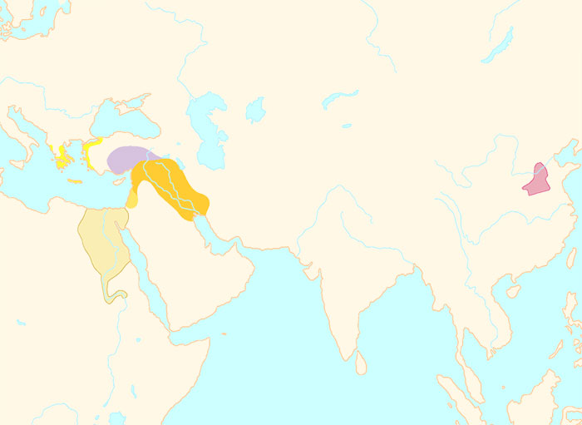
1500 BCE
Warlijke pharaohs expand
Egypt’s borders
The Zhou dynasty has
replaced the Shang dynasty
Hammurabi has issued
his famous Law Code
Hittite
civilization
Minoan
civilization
Chinese
civilization
Traders spread the
alphabet from here
Mesopotamian
civilization
Well-laid out streets,
drains and sewers
Egyptian
civilization
The earliest cities
are appearing
Pyramids of Giza
are being built
A great palace has
been built at Knossos
The Buddha is
teaching now
4000 BCE
1 CE
The Olympic games are
now held every 4 years
The Zhou dynasty has
replaced the Shang dynasty
Athens has becomes
a democracy
Oracle bones
are in use
Cyrus the Great
has conquered
a huge empire
Confucius is
teaching now
King Nebuchadnezzar
reigns
The Vedas are
being composed

Slide 4
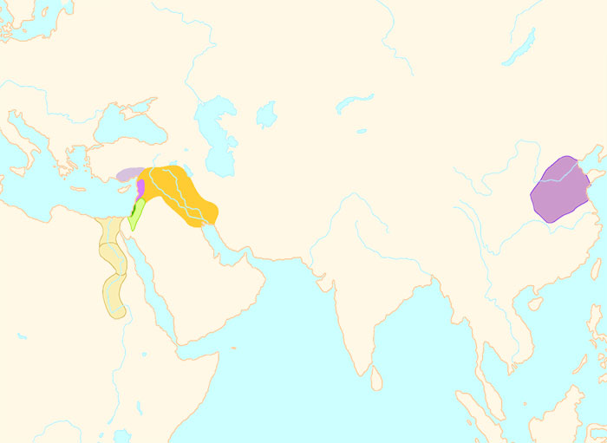
1000 BCE
Warlijke pharaohs expand
Egypt’s borders
The Zhou dynasty has
replaced the Shang dynasty
Hammurabi has issued
his famous Law Code
Phoenician
civilization
Traders spread the
alphabet from here
Mesopotamian
civilization
Chinese
civilization
Kingdom
of Israel
Well-laid out streets,
drains and sewers
Egyptian
civilization
The earliest cities
are appearing
Pyramids of Giza
are being built
A great palace has
been built at Knossos
The Buddha is
teaching now
4000 BCE
1 CE
The Olympic games are
now held every 4 years
The Zhou dynasty has
replaced the Shang dynasty
Athens has becomes
a democracy
Oracle bones
are in use
Cyrus the Great
has conquered
a huge empire
Confucius is
teaching now
King Nebuchadnezzar
reigns
The Vedas are
being composed

Slide 5
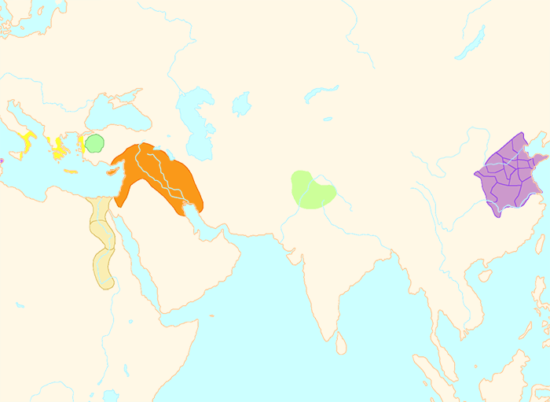
700 BCE
Warlijke pharaohs expand
Egypt’s borders
The Zhou dynasty has
replaced the Shang dynasty
Hammurabi has issued
his famous Law Code
Greek
civilization
Traders spread the
alphabet from here
Assyrian
Empire
Chinese
civilization
Aryan
Civilization
Well-laid out streets,
drains and sewers
Egyptian
civilization
The earliest cities
are appearing
Pyramids of Giza
are being built
A great palace has
been built at Knossos
The Buddha is
teaching now
4000 BCE
1 CE
The Olympic games are
now held every 4 years
The Zhou dynasty has
replaced the Shang dynasty
Athens has becomes
a democracy
Oracle bones
are in use
Cyrus the Great
has conquered
a huge empire
Confucius is
teaching now
King Nebuchadnezzar
reigns
The Vedas are
being composed

Slide 6
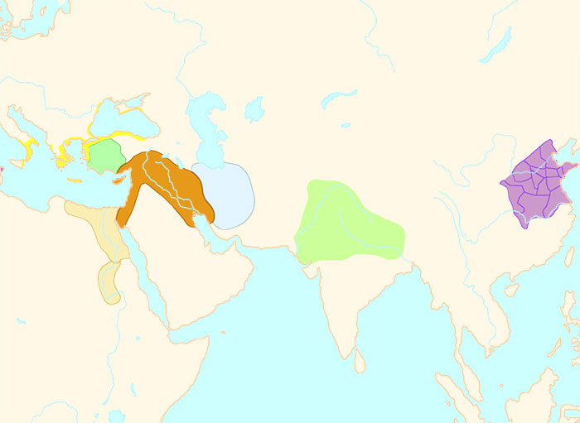
600 BCE
Warlijke pharaohs expand
Egypt’s borders
The Zhou dynasty has
replaced the Shang dynasty
Hammurabi has issued
his famous Law Code
Greek
civilization
Traders spread the
alphabet from here
Assyrian
Empire
Chinese
civilization
Aryan
Civilization
Well-laid out streets,
drains and sewers
Egyptian
civilization
The earliest cities
are appearing
Pyramids of Giza
are being built
A great palace has
been built at Knossos
The Buddha is
teaching now
4000 BCE
1 CE
The Olympic games are
now held every 4 years
The Zhou dynasty has
replaced the Shang dynasty
Athens has becomes
a democracy
Oracle bones
are in use
Cyrus the Great
has conquered
a huge empire
Confucius is
teaching now
King Nebuchadnezzar
reigns
The Vedas are
being composed

Slide 7
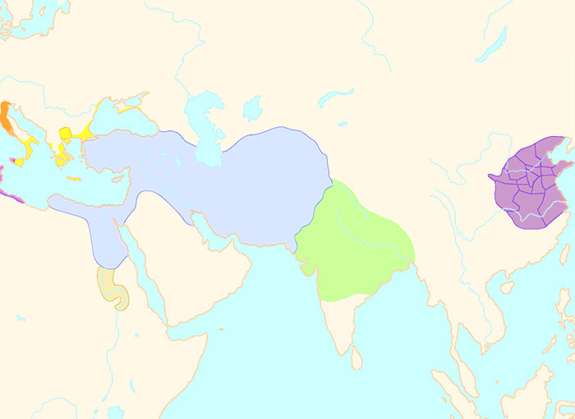
500 BCE
Warlijke pharaohs expand
Egypt’s borders
The Zhou dynasty has
replaced the Shang dynasty
Hammurabi has issued
his famous Law Code
Greek
civilization
Chinese
civilization
Traders spread the
alphabet from here
Persian
Empire
Well-laid out streets,
drains and sewers
Aryan
Civilization
The earliest cities in
history are appearing
Kingdom
of Kush
Pyramids of Giza
are being built
A great palace has
been built at Knossos
The Buddha is
teaching now
4000 BCE
1 CE
The Olympic games are
now held every 4 years
The Zhou dynasty has
replaced the Shang dynasty
Athens has becomes
a democracy
Oracle bones
are in use
Cyrus the Great
has conquered
a huge empire
Confucius is
teaching now
King Nebuchadnezzar
reigns
The Vedas are
being composed

