Slide 1
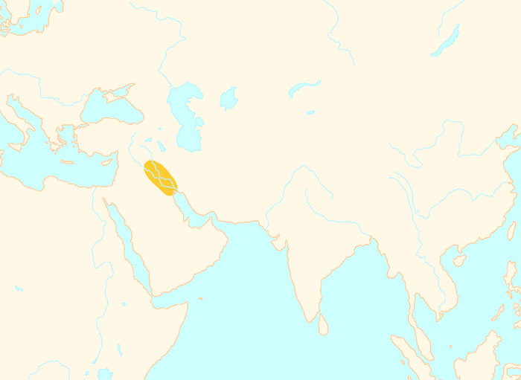
3500 BCE
Mesopotamian
civilization
4000 BCE
1 CE

Slide 2
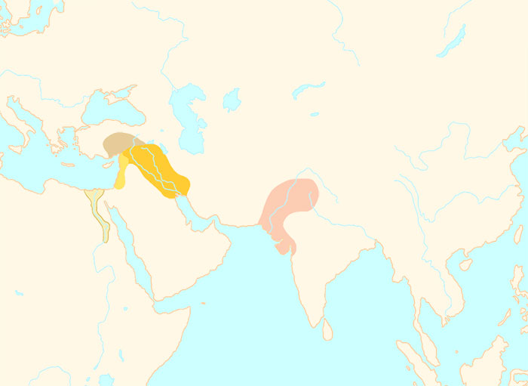
2500 BCE
Mesopotamian
civilization
Indus Valley
civilization
Egyptian
civilization
4000 BCE
1 CE

Slide 3
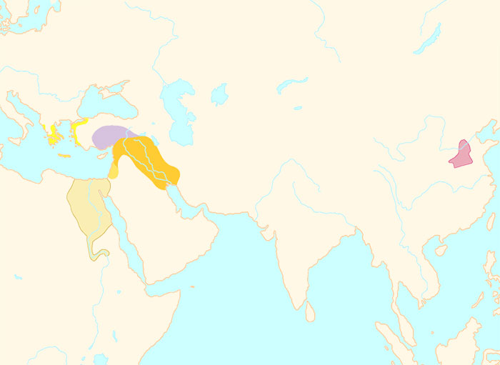
1500 BCE
Hittite
civilization
Minoan
civilization
Chinese
civilization
Mesopotamian
civilization
Egyptian
civilization
4000 BCE
1 CE

Slide 4
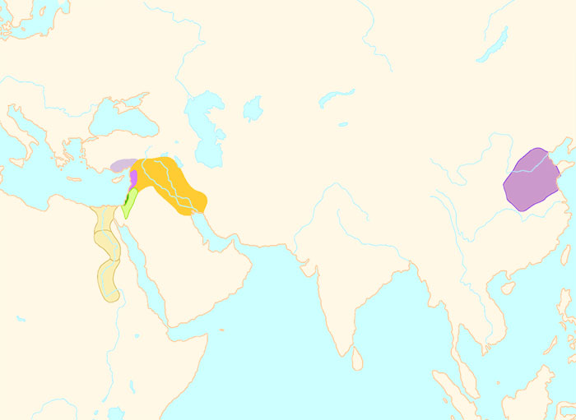
1000 BCE
Phoenician
civilization
Mesopotamian
civilization
Chinese
civilization
Kingdom
of Israel
Egyptian
civilization
4000 BCE
1 CE

Slide 5
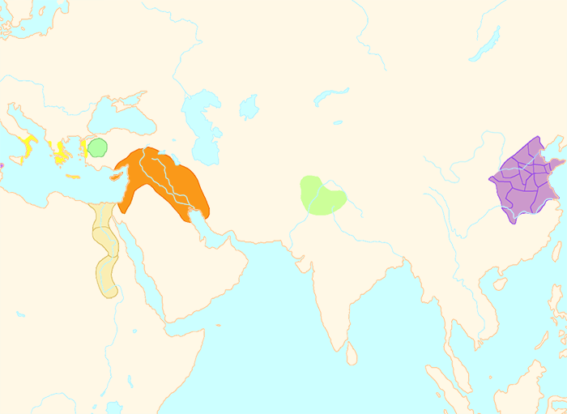
700 BCE
Greek
civilization
Assyrian
Empire
Chinese
civilization
Aryan
Civilization
Egyptian
civilization
4000 BCE
1 CE

Slide 6
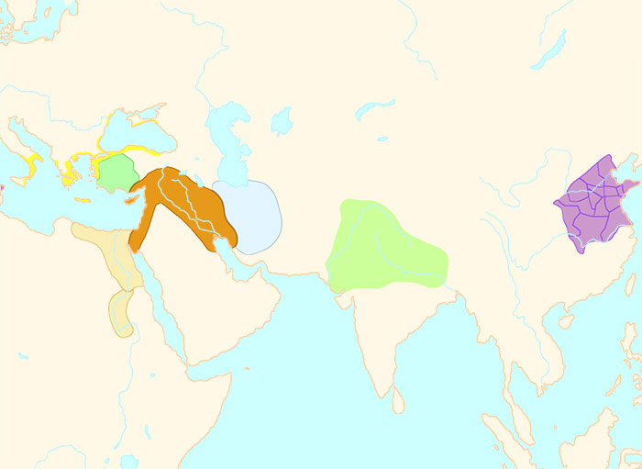
600 BCE
Greek
civilization
Assyrian
Empire
Chinese
civilization
Aryan
Civilization
Egyptian
civilization
4000 BCE
1 CE

Slide 7
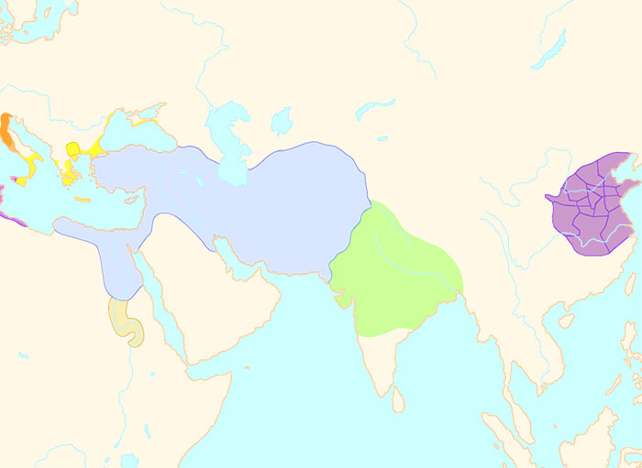
500 BCE
Greek
civilization
Persian
Empire
Chinese
civilization
Aryan
Civilization
Kingdom
of Kush
4000 BCE
1 CE

