Slide 1
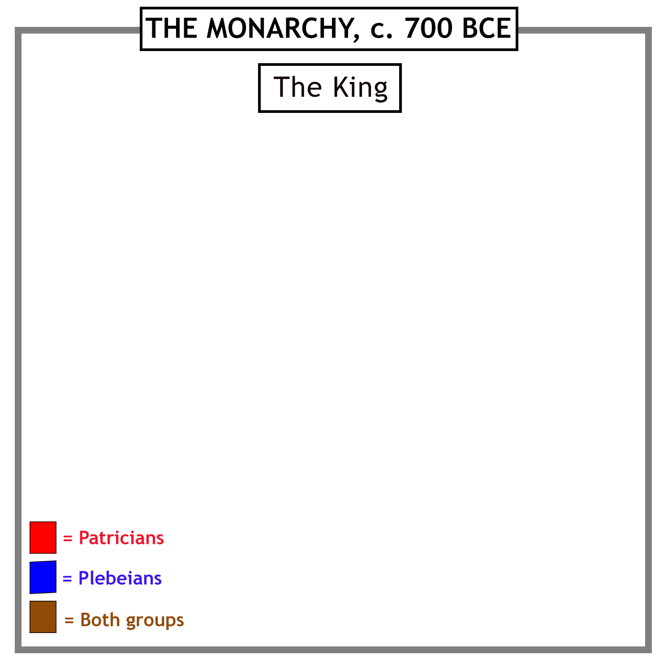
Early Rome was ruled by
a series of kings.
The early Roman community was divided
into two groups:
…the rich and powerful Patricians…
…and the rest.

Slide 2
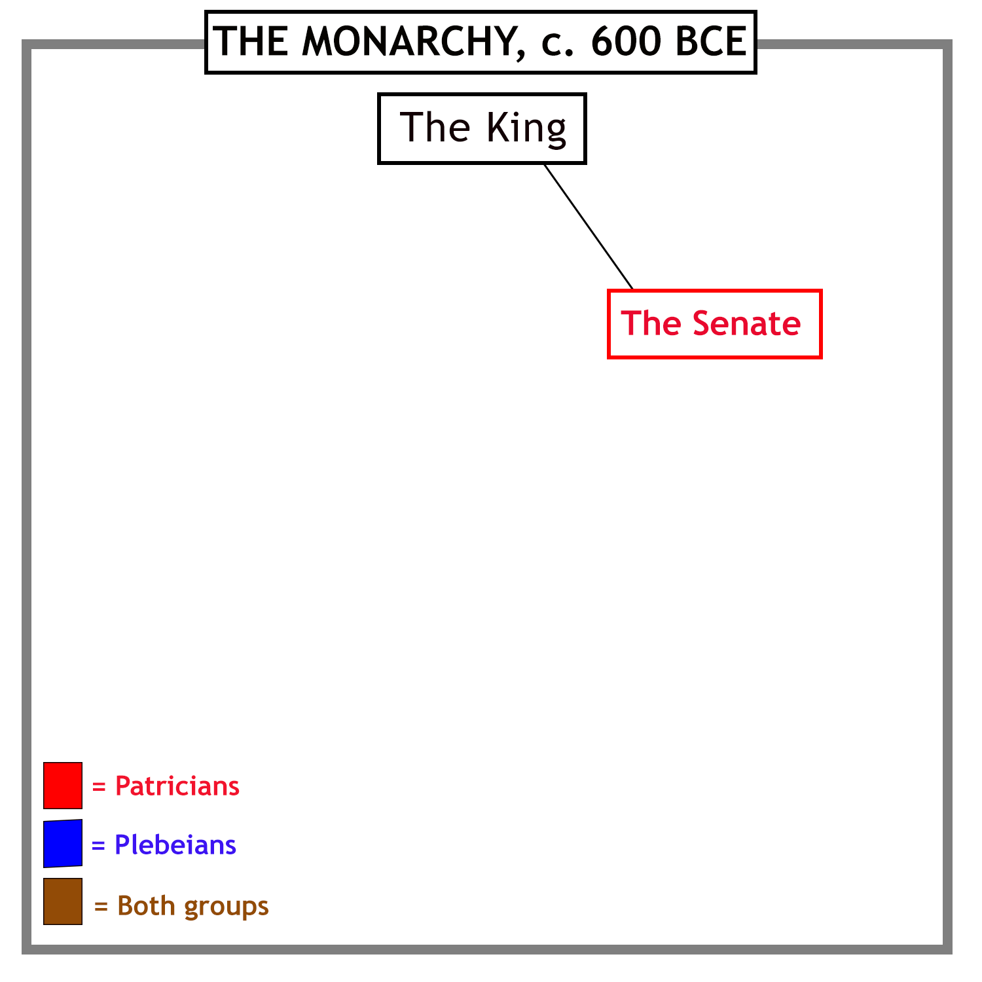
The kings were advised by a council of the leading members of the community - the Senate. They were all Patricians.

Slide 3
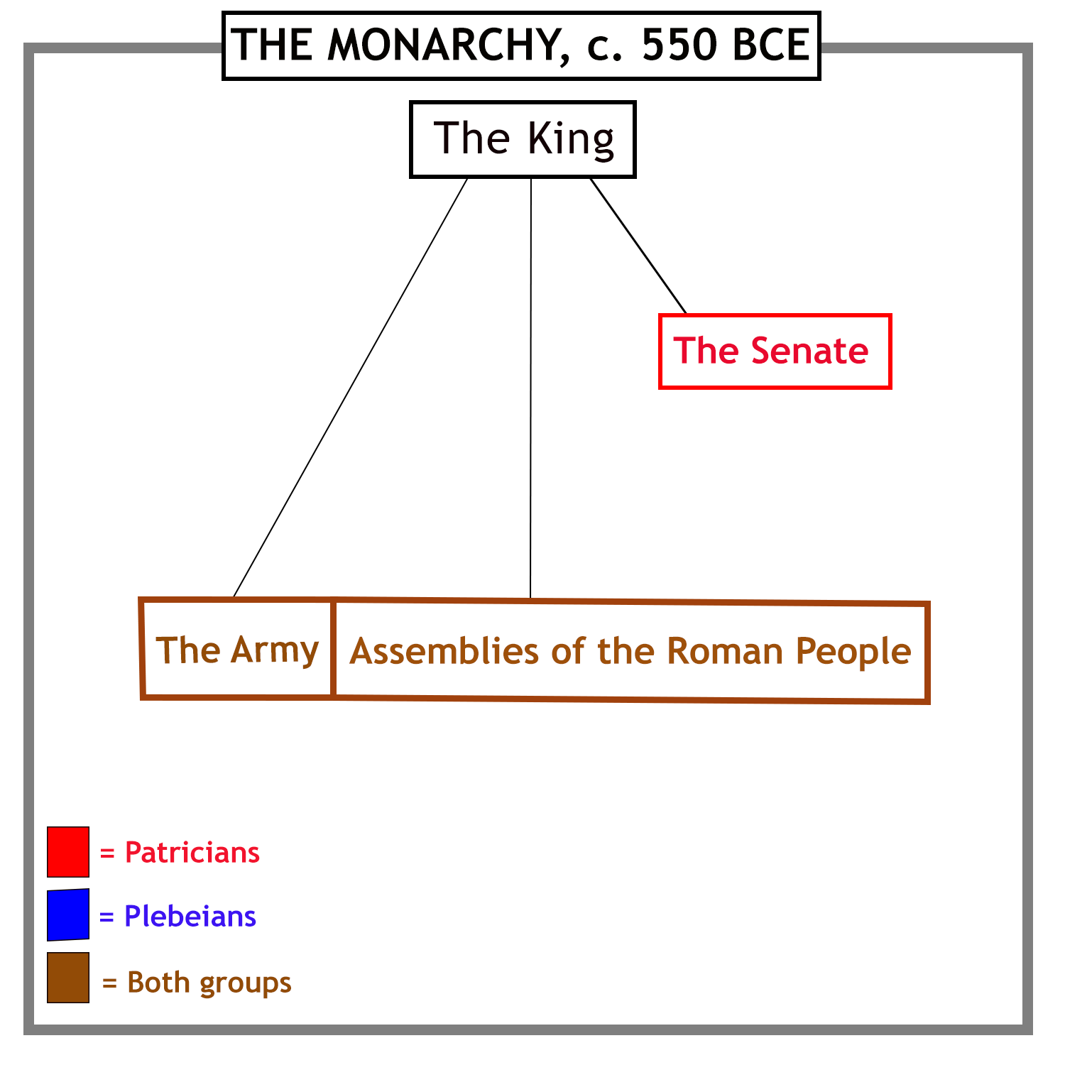
All Roman men, whether Patricians or Plebeians, served as
soldiers in the Roman army. They were also members of
various assemblies, which voted on important matters.

Slide 4
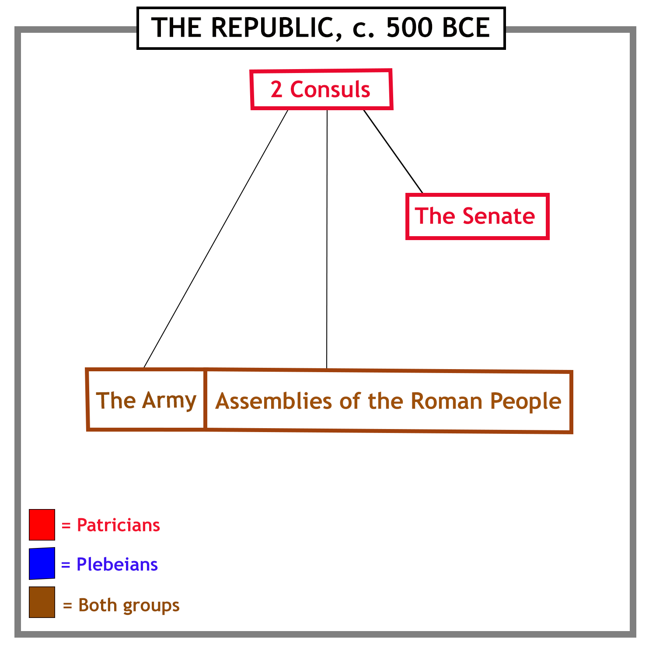
When the last king was expelled from Rome, his place as head of state was taken by two elected magistrates, called consuls.

Slide 5
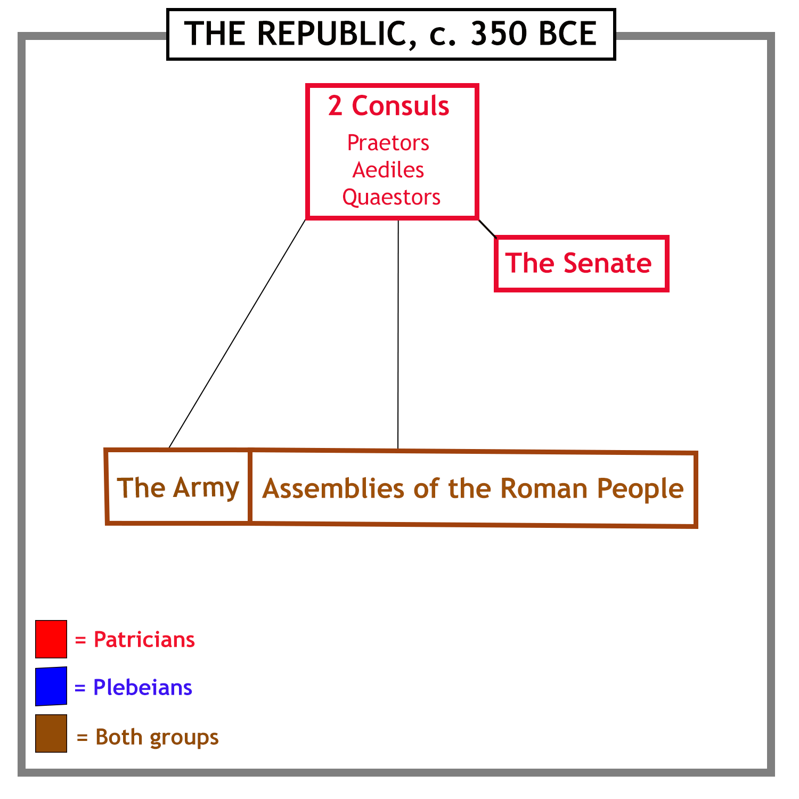
Over time, as Rome became more powerful and wealthy,
more magistrates were needed to handle
the growing complexity of government.

Slide 6
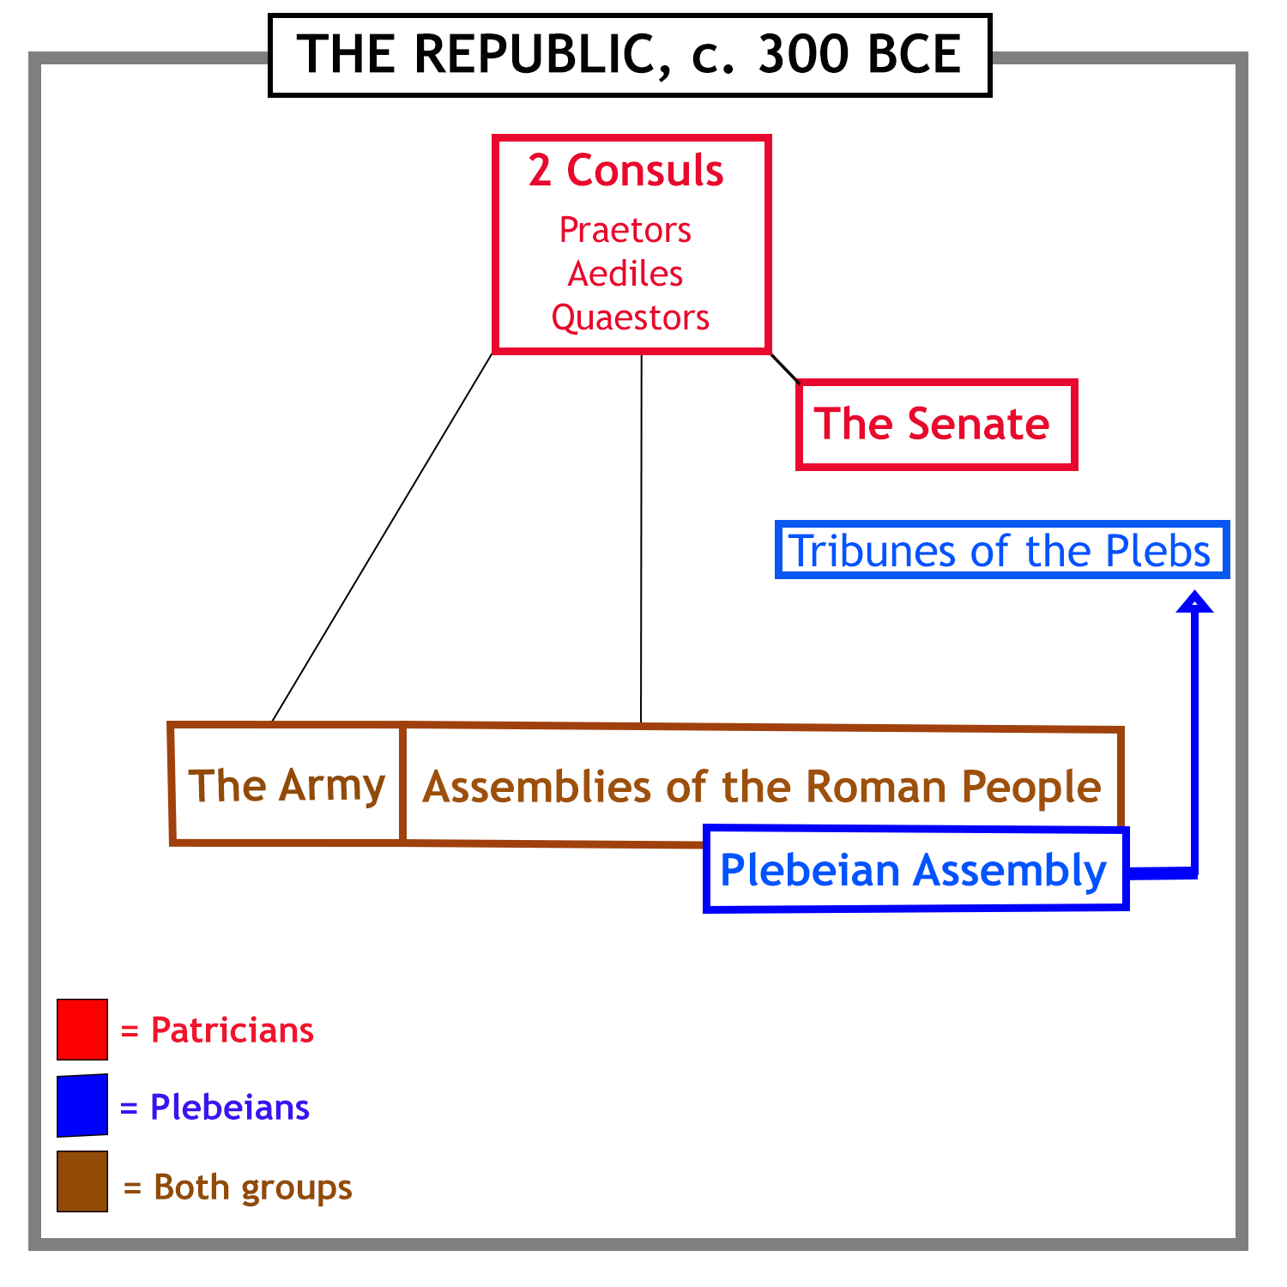
A struggle between the Patricians and Plebeians
led to the Plebeians getting their own assembly.
This assembly elected officers called tribunes, to protect the Plebeians’ interests.

Slide 7
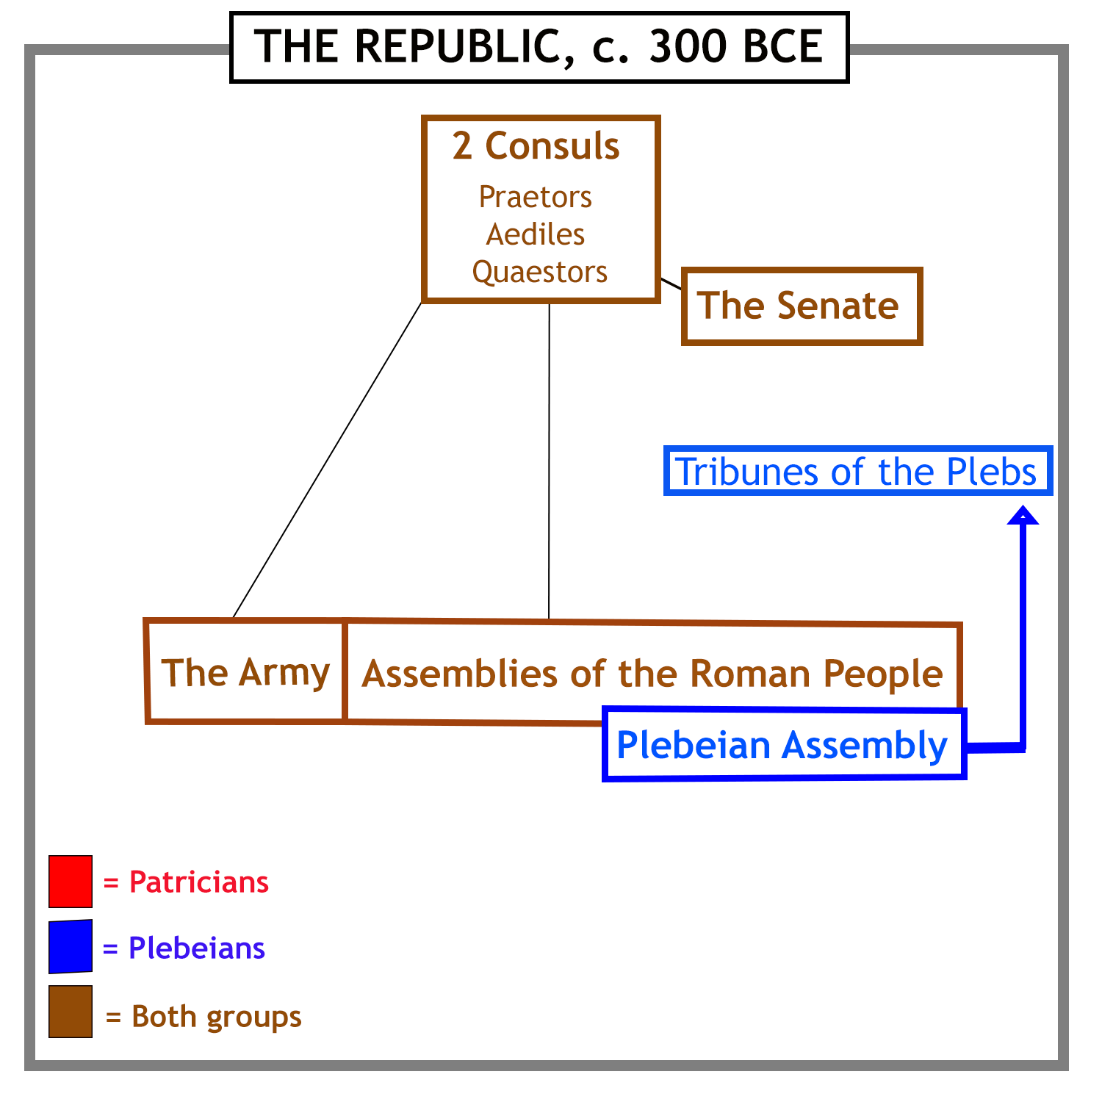
Plebeians then won the right to be elected to
public office and sit in the senate.

Slide 8
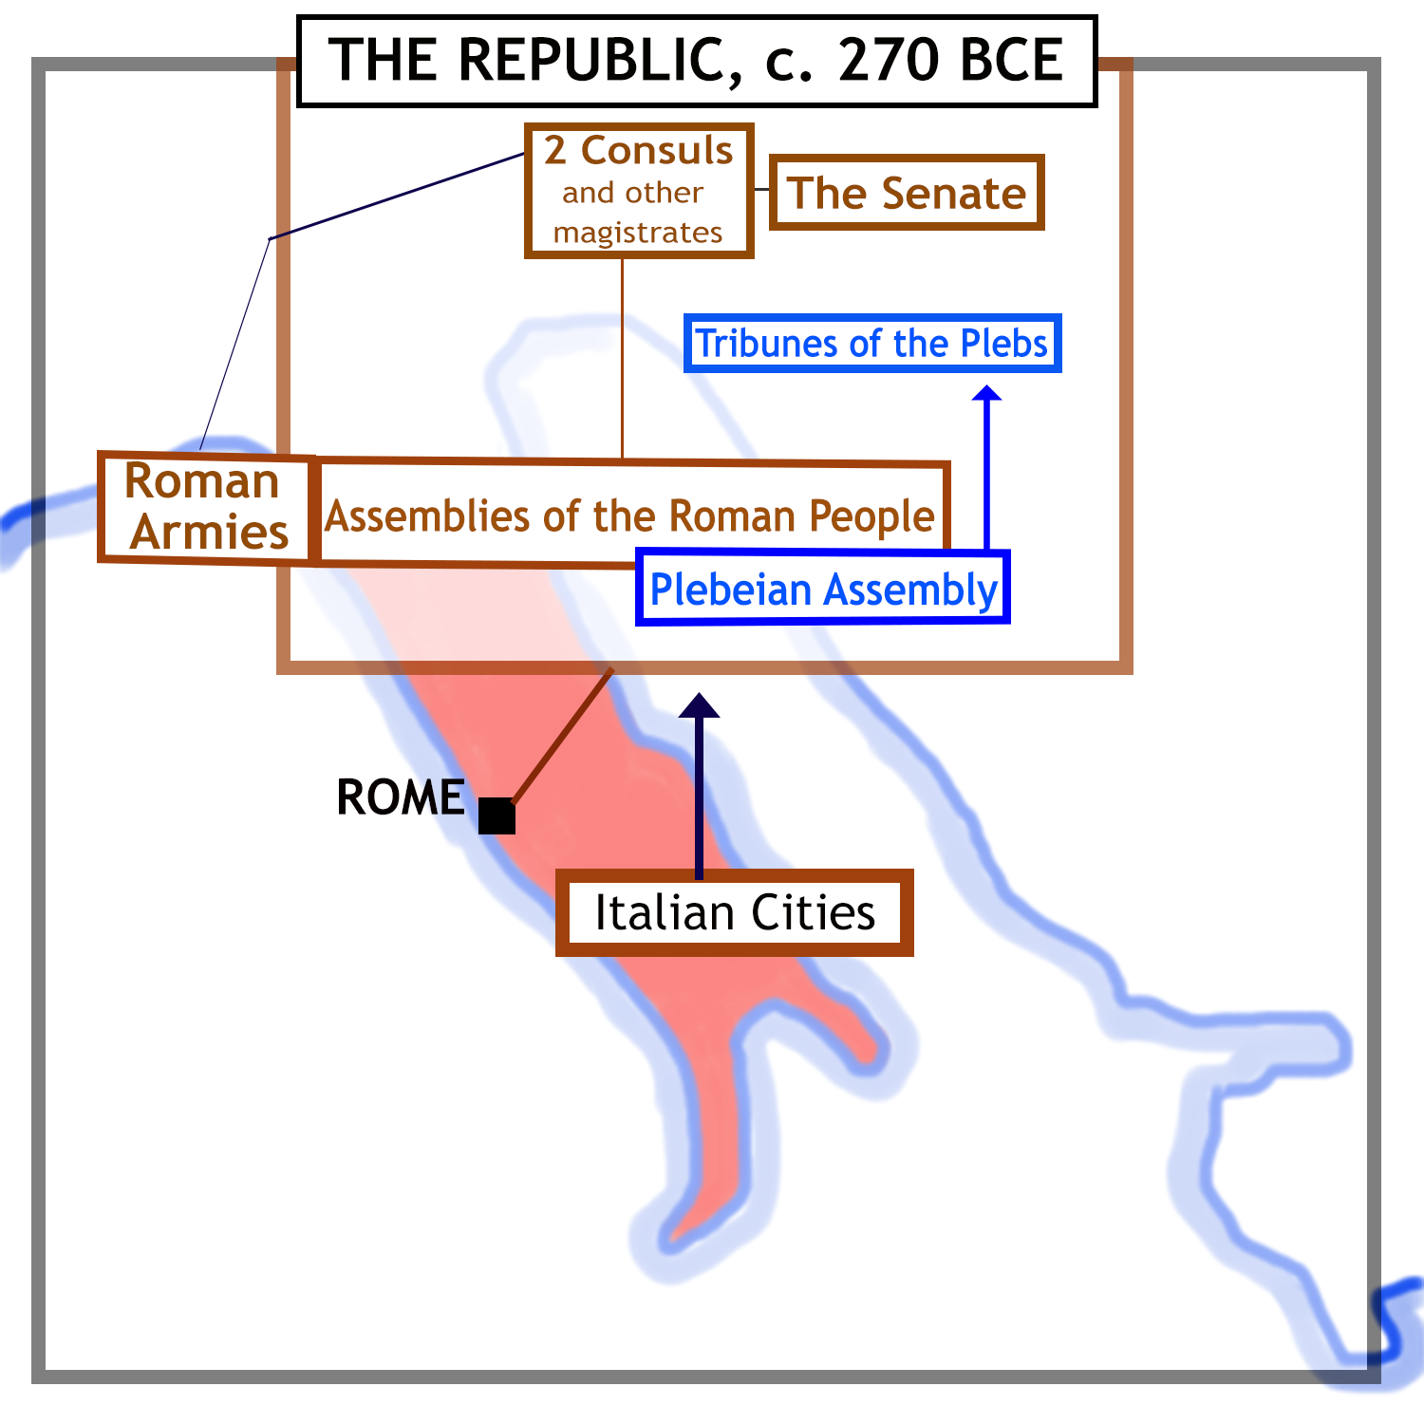
Most of Italy had come under Roman
control by 270 BCE. The cities were
allowed to run their own affairs so long as
they remained loyal allies of Rome.
Roman armies now operated throughout
the Italian Peninsula, often far from Rome.

Slide 9
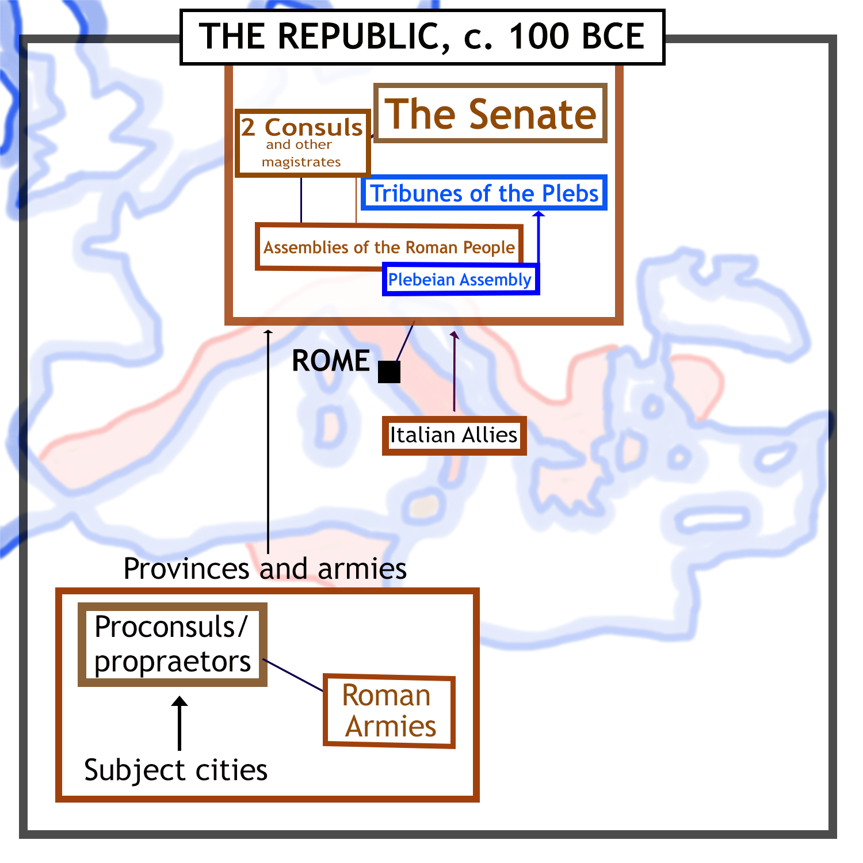
As Roman power expanded overseas, new provinces were placed under the control of ex-consuls (where large armies were needed) and ex-praetors.
The senate now became much
more important, as it supervised
the proconsuls and propraetors
and took responsibility for Rome’s foreign policy.

Slide 10
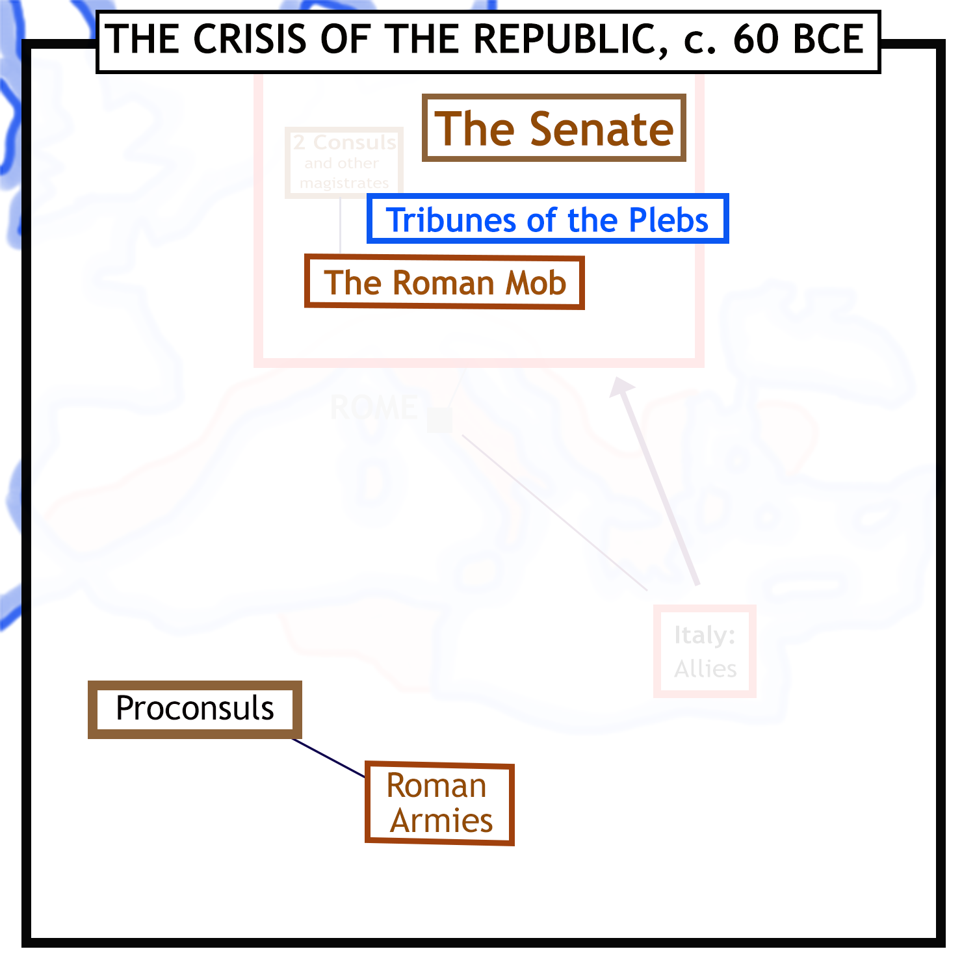
In the 1st century BCE, the Roman state fell into a major crisis. The main actors are shown here.
The senate was
faction-ridden
and unable
to act decisively.
The tribunes were the agents of
different factions and blocked change.
The Roman mob could be bribed to support one
faction or another, and fuelled organised
crime. This was heavily involved in politics.
Proconsuls with loyal and powerful armies under their command
became a major threat, launching a series of civil wars.

Slide 11
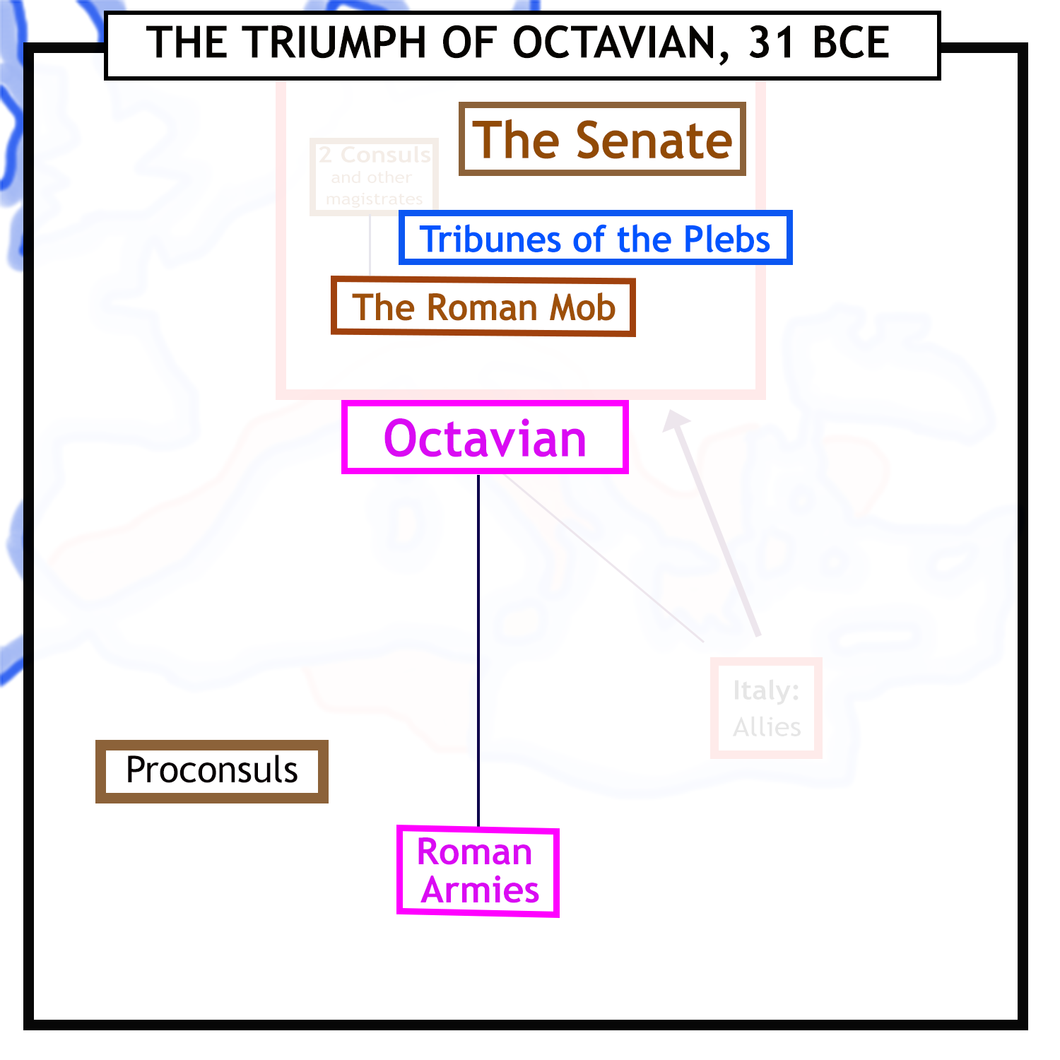
Civil war after civil war followed, as powerful proconsuls fought for control. Finally, a leader called Octavian emerged as the sole master of the Roman world.
Octavian was the adopted son and heir of the
famous proconsul and dictator Julius Caesar.
Octavian’s defeat of his rival Mark Antony
left him in control of all Roman armies.
But how would Octavian place his rule on enduring foundations?

Slide 12
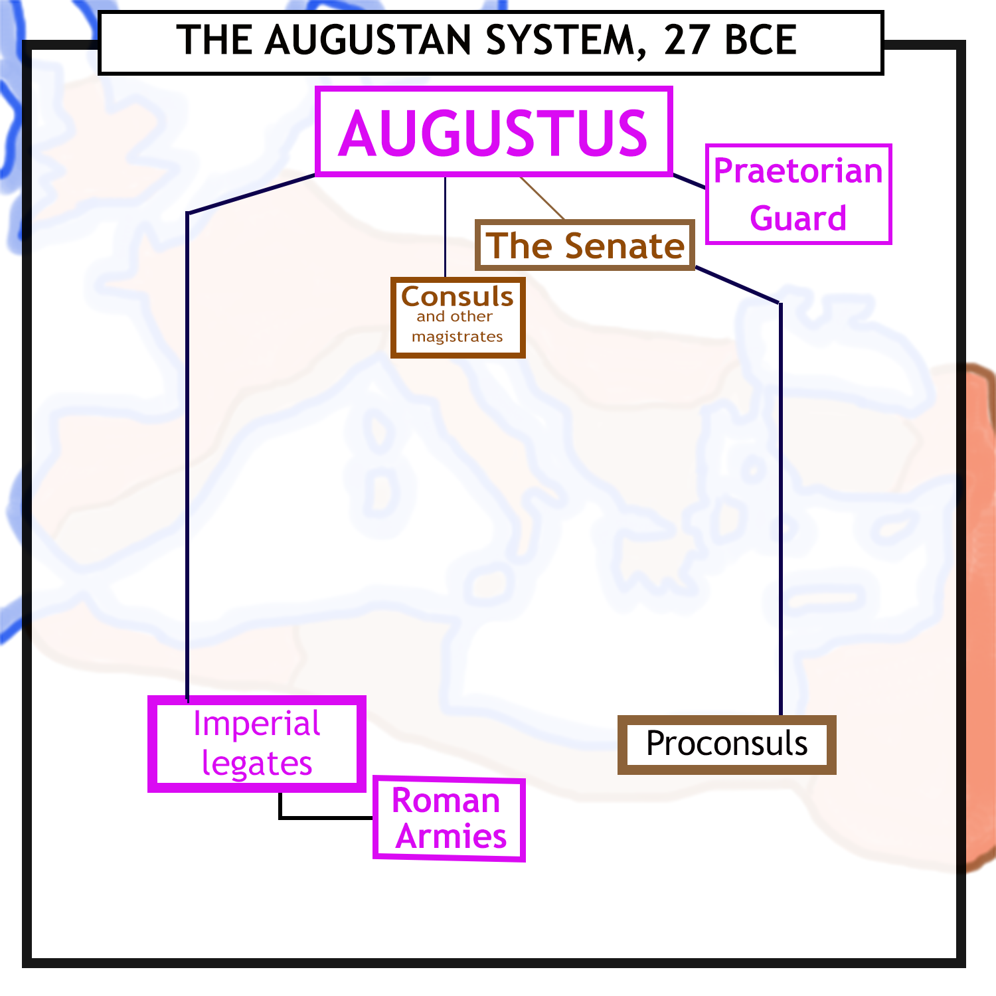
In 27 BCE Octavian took the name Augustus - “Revered one”.
He respected the senate and the old magistracies, but restricted their powers.
He created the Praetorian Guard, to protect him and help control the Roman mob.
He left half the provinces under the control of the senate, but kept control of those with armies stationed in them.
He appointed men loyal to himself to run the provinces and armies under his control.

Slide 13
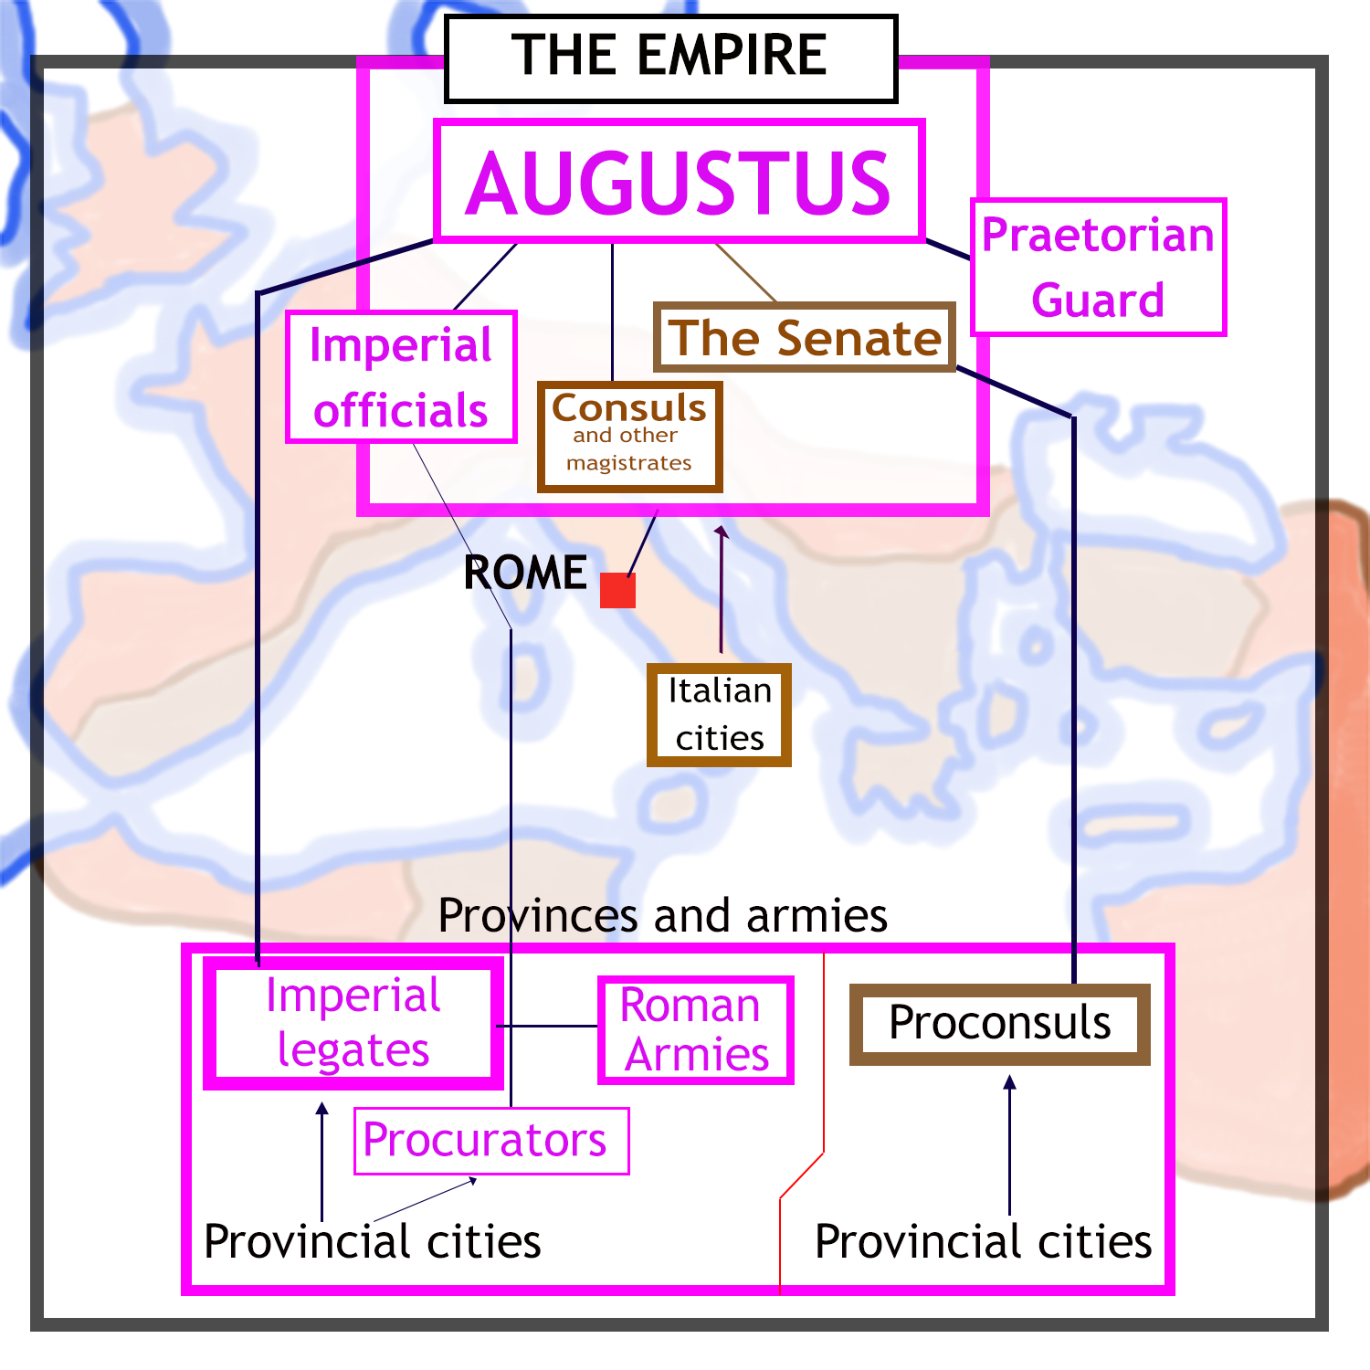
Augustus was the first Roman emperor.
Senators continued to hold the old magistracies, but these now served as stepping stones to high posts in the emperor’s service.
The emperors appointed their own officials to help them govern. Some worked in Rome, others in the provinces.
Local affairs were handled by the city councils and their officials.

