Slide 1
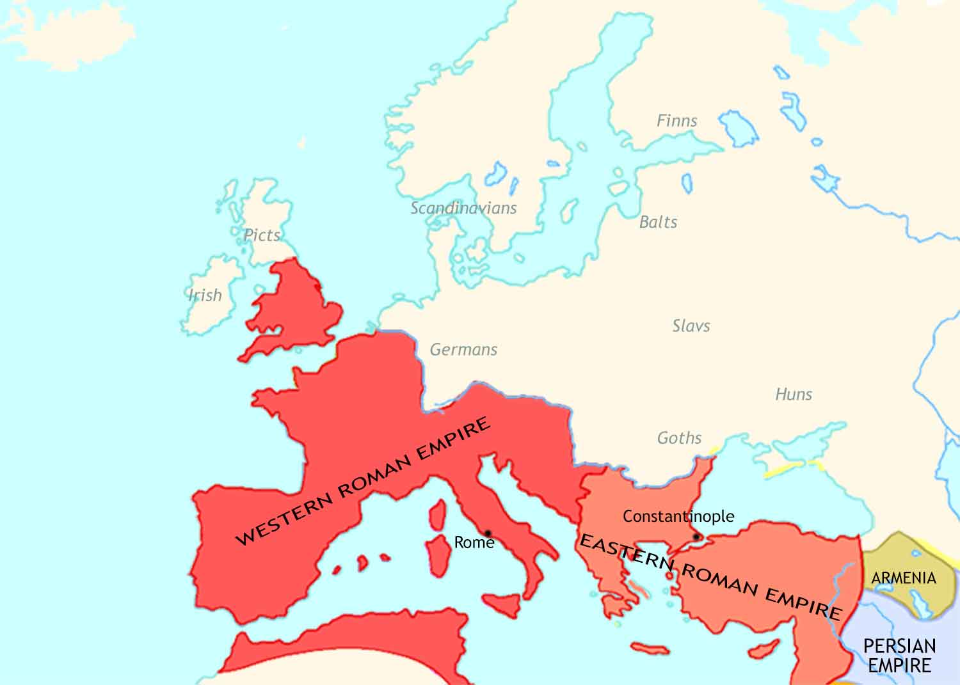
Medieval Europe: 400 CE
In the late fourth century, the Roman Empire stands intact. Its economy is still strong.
The Roman Empire is now ruled by two emperors, one in the east and one in the west.
Christianity is the official religion of the empire. The bishop of Rome is its leading figure.

Slide 2
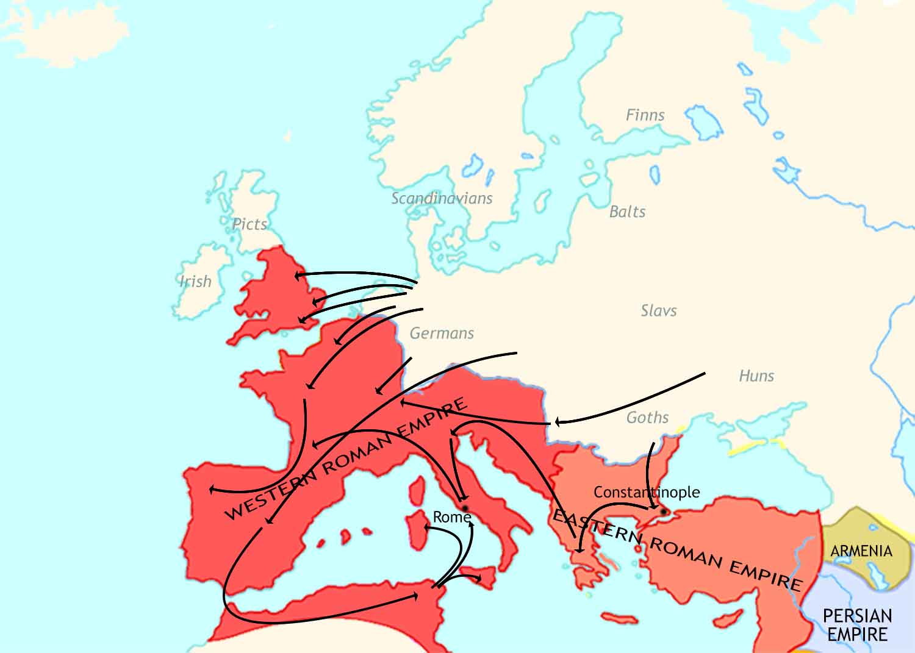
Medieval Europe: 400-500 CE
In the fifth century, German tribes invade deep into the empire.
Angles, Saxons, Jutes
Franks
They cause large-scale destruction in the Western Roman Empire.
Suebi
Vandals
Huns
Goths
Rome is sacked twice, by the Goths in 410 CE and the Vandals in 455 CE.

Slide 3
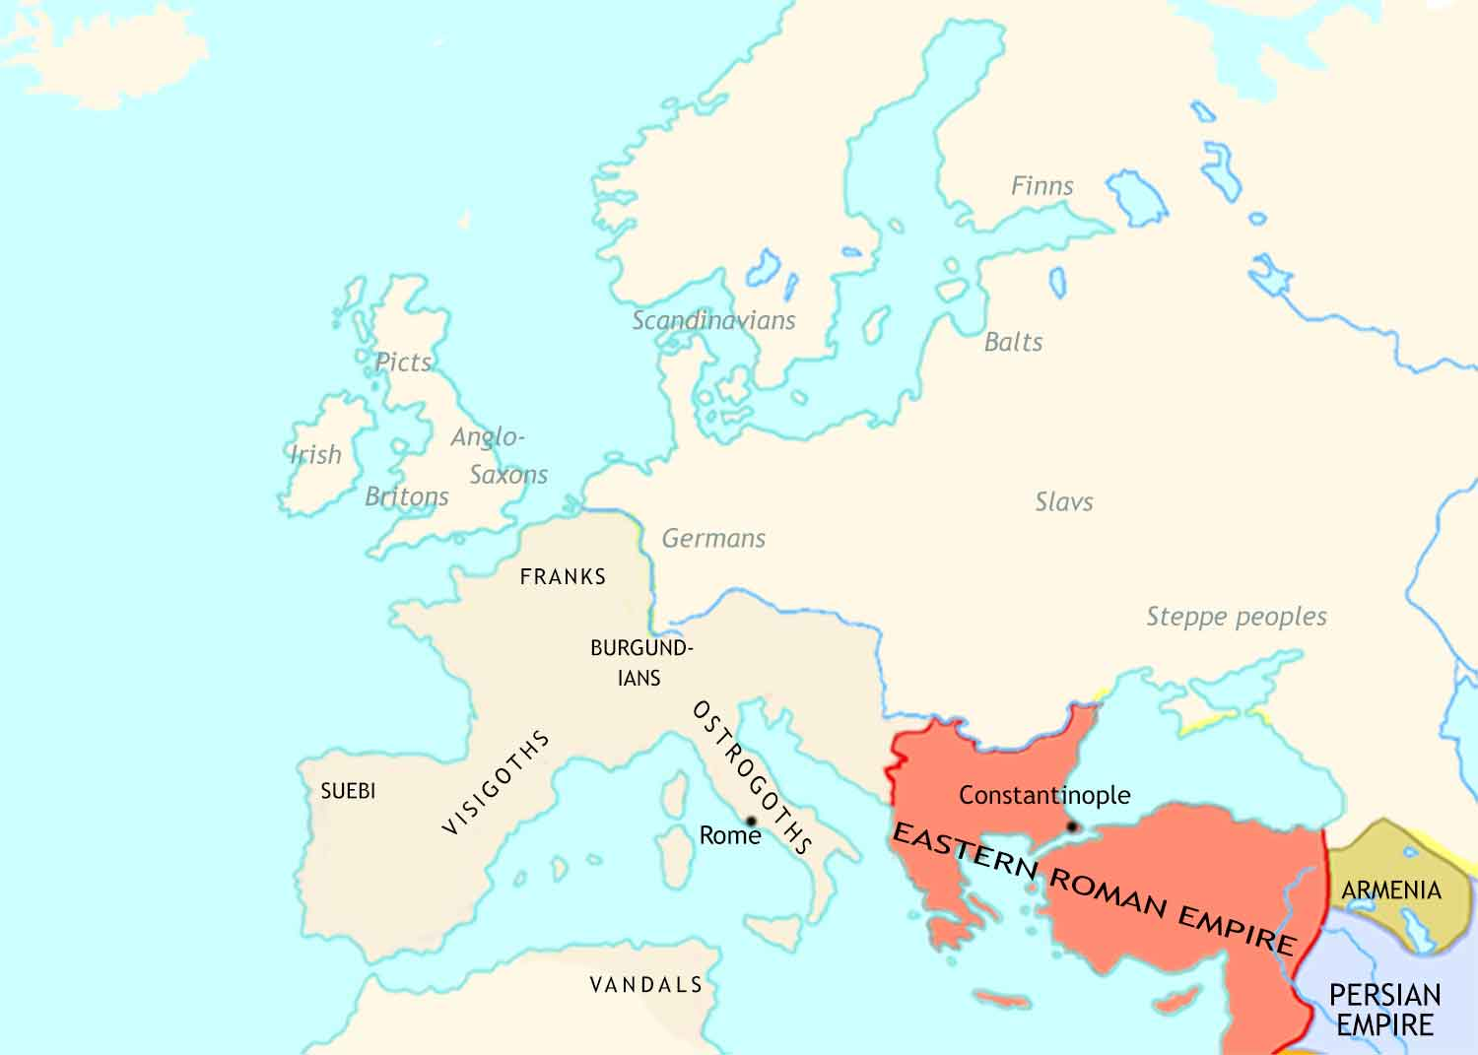
Medieval Europe: 500 CE
Anglo-Saxon tribes have settled in southern Britain, destroying Roman civilization, including Christianity.
The Eastern Roman Empire has been almost unaffected. Life continues here much as before.
German tribes have formed several kingdoms in what was the Western Roman Empire.
Roman civilization has been badly damaged, but in most places Christianity has survived.

Slide 4
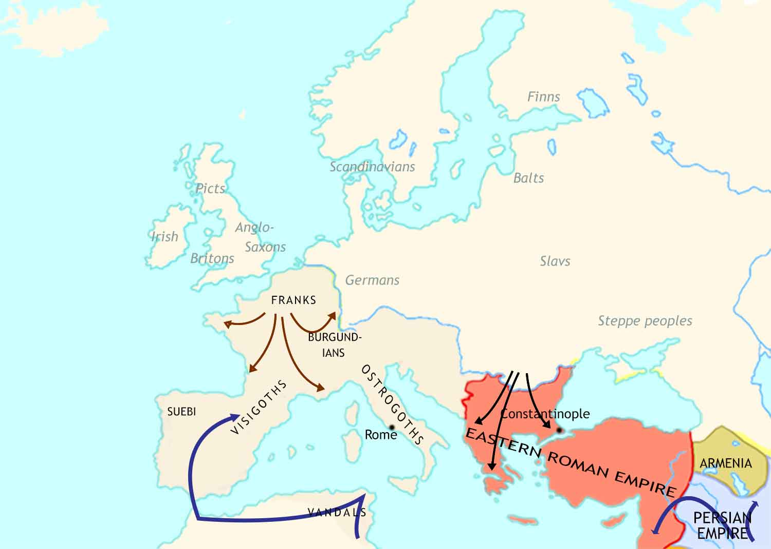
Medieval Europe: 500-711 CE
The kingdom of the Franks expands across modern-day France and beyond.
Great invasions by Avar and Slav tribes from central Europe, and by Muslim armies from Arabia, almost bring an end to the East Roman Empire.
After conquering most of the Middle East, Arab armies occupy North Africa and Spain.

Slide 5
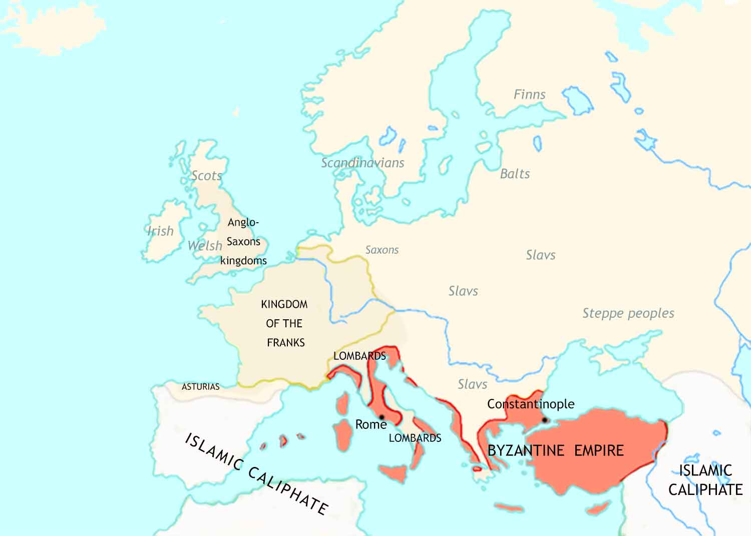
Medieval Europe: 711 CE
Missionaries from Ireland and from Rome have converted England and Scotland to Christianity.
The Eastern Roman Empire has been radically changed by the invasions, so from now on we will refer to it as the Byzantine Empire.
Italy is now divided between the Byzantine Empire and a German tribe called the Lombards.

Slide 6
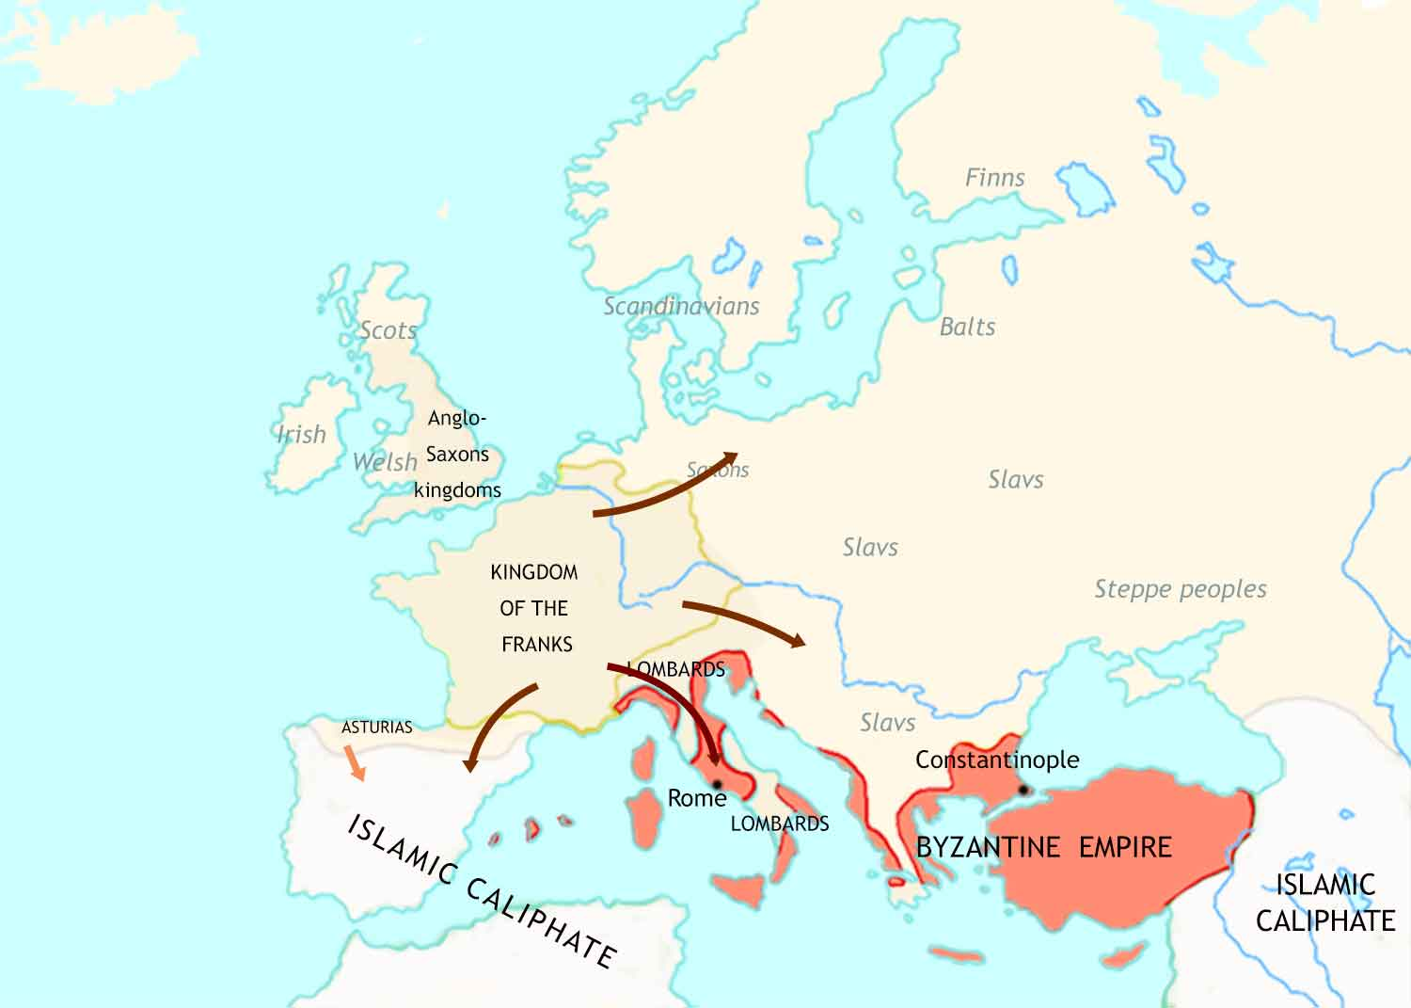
Medieval Europe: 711-814 CE
The Frankish realm continues to expand, especially under its great ruler, Charlemagne.
The Christian kingdom of Asturias seizes territory from the Muslims. This begins the Christian “Reconquista” of Spain.

Slide 7
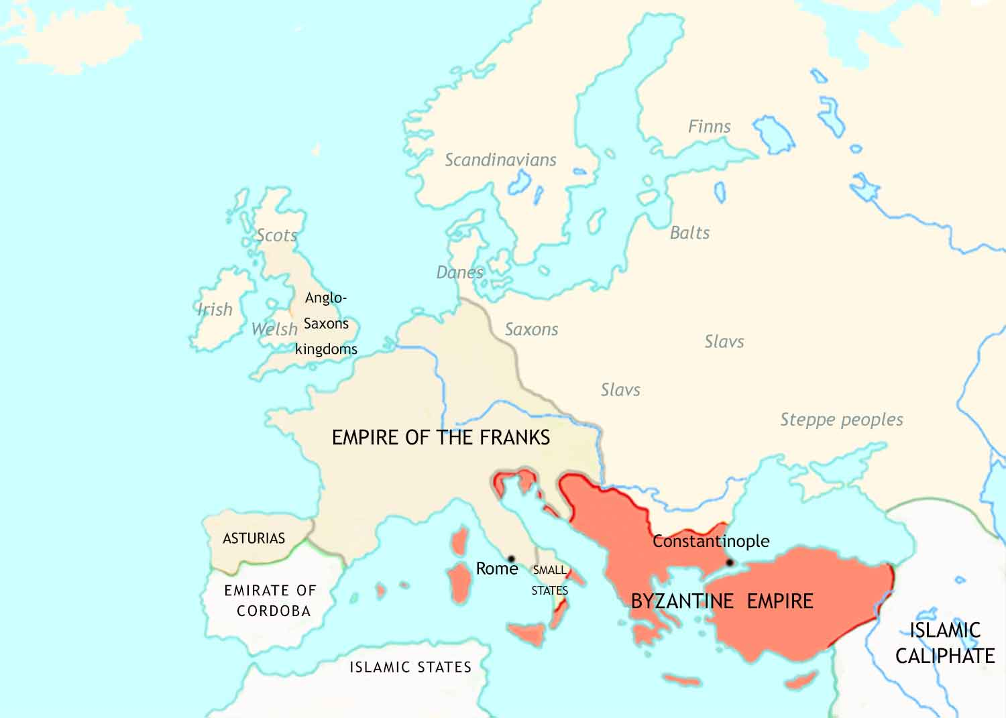
Medieval Europe: 814 CE
Charlemagne is crowned emperor by the bishop of Rome (the “pope”) on Christmas day, 800.
The Byzantine Empire regains much of the territory it had lost.

Slide 8
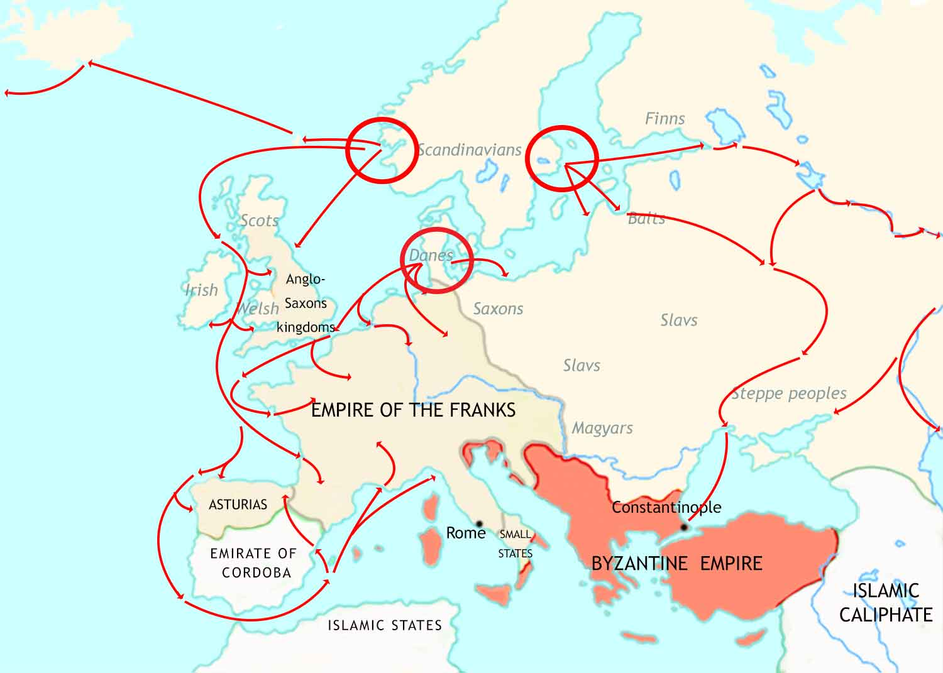
Medieval Europe: 814-962 CE- I
Norwegians
Swedes
Vikings from Scandinavia attack along the coasts and up the rivers of western Europe.
Danes

Slide 9
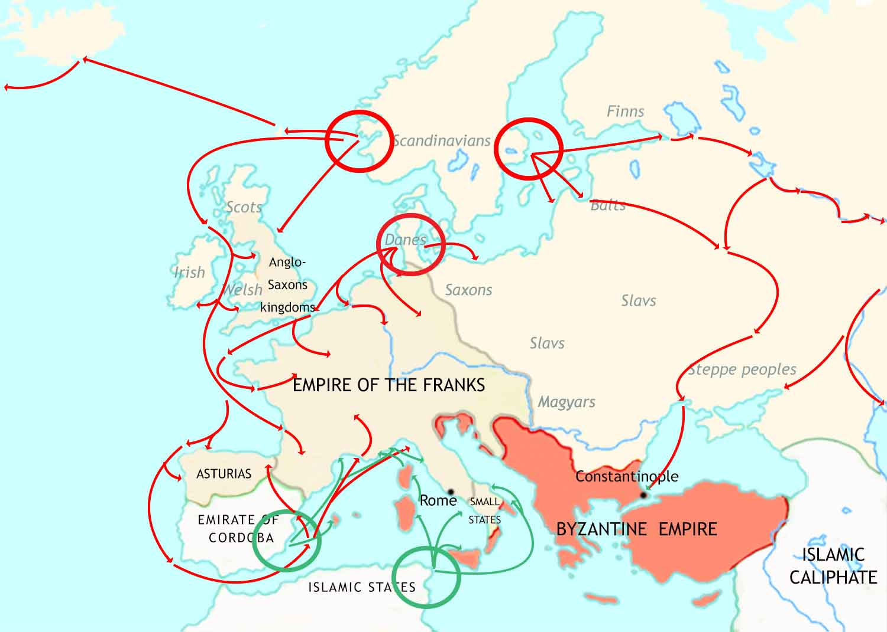
Medieval Europe: 814-962 CE - II
Norwegians
Swedes
Danes
Muslim raiders attack coasts of Christian lands in the Mediterranean.

Slide 10
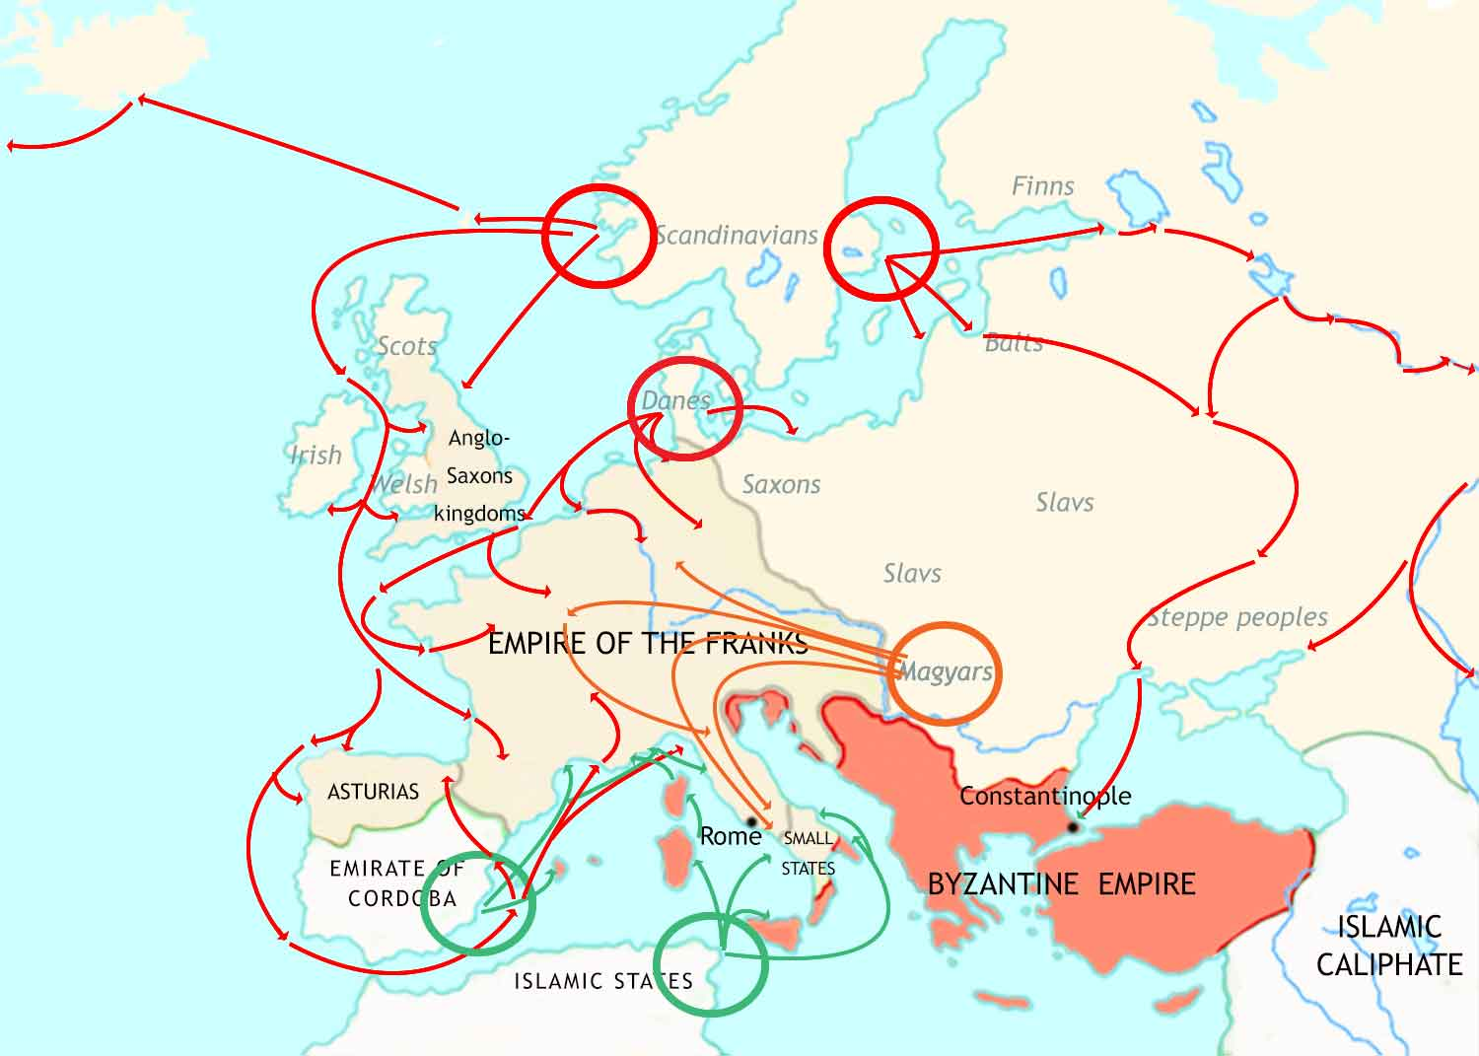
Medieval Europe: 814-962 CE - III
Norwegians
Swedes
Danes
The Magyars, a nomadic tribe from central Asia, raid deep into Christian Europe.

Slide 11
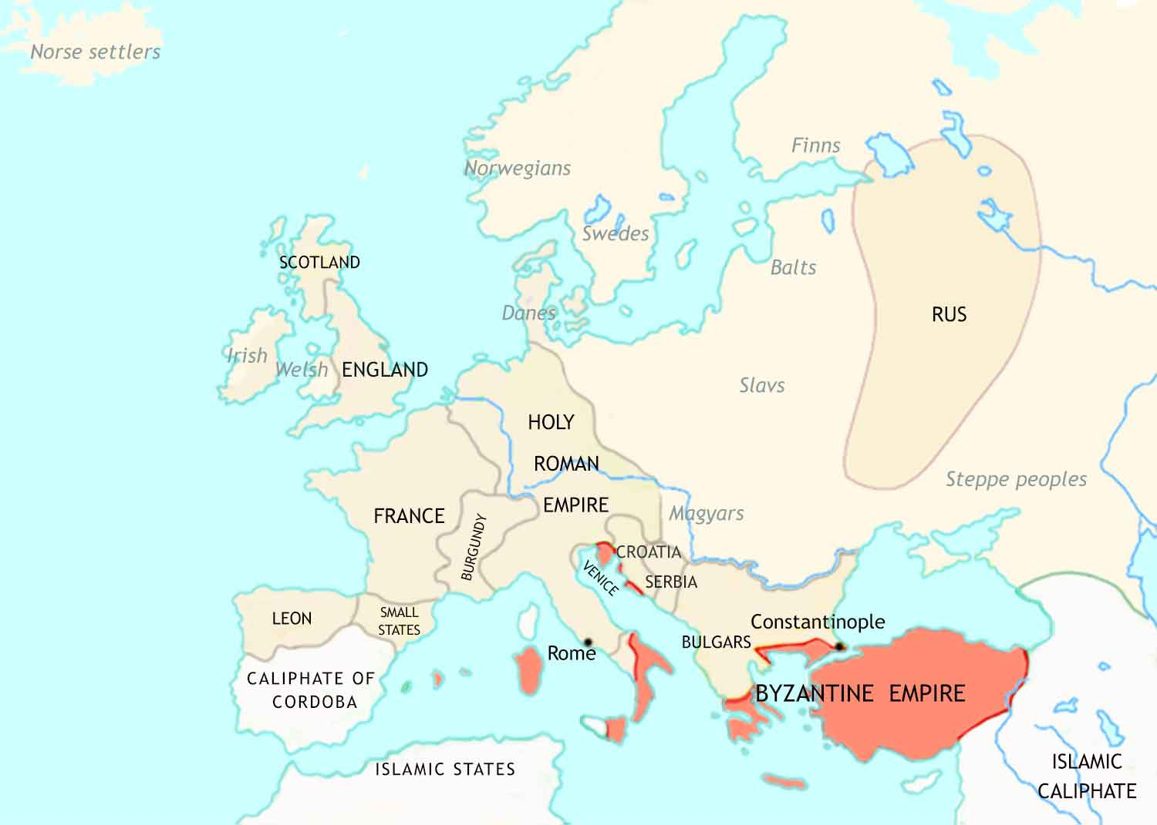
Medieval Europe: 962 CE
The Frankish Empire has broken up, but out of the wreckage has appeared the Holy Roman Empire.
Viking settlers (known as the Rus) have established a huge new state in what is now Russia and Ukraine.
The attacks, plus civil wars, cause chaos. This gives rise to a new social and political system, called Feudalism.
The Bulgars have taken a large chunk of territory from the Byzantines.

Slide 12
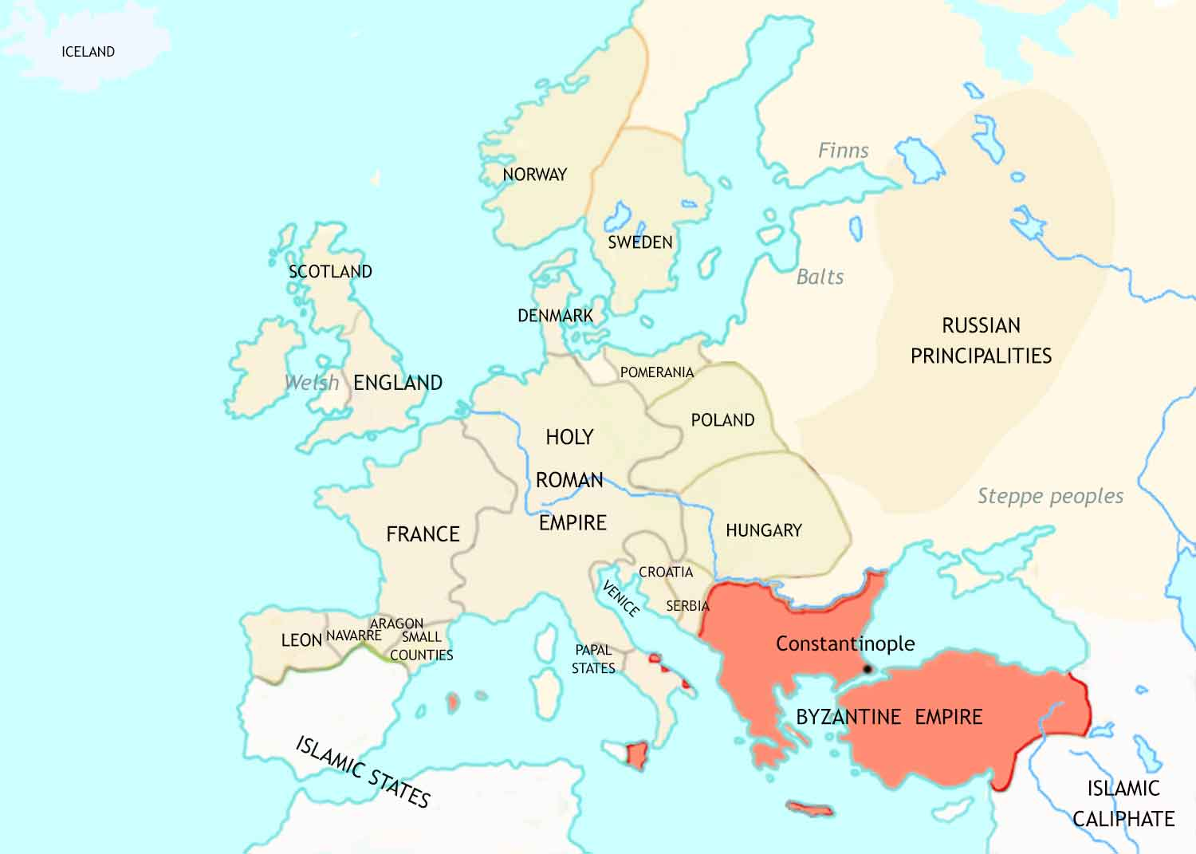
Medieval Europe: 962-1066 CE
Feudalism has now developed fully in France, and is spreading to Italy, Germany, England and Spain.
New lands in northern and central Europe have joined “Christendom” by conversion from paganism to Christianity.
The bishops of Rome, the popes, are increasingly claiming spiritual and secular leadership in Christendom.
The Byzantines have again expanded their territory, by conquering the Bulgar kingdom.

Slide 13
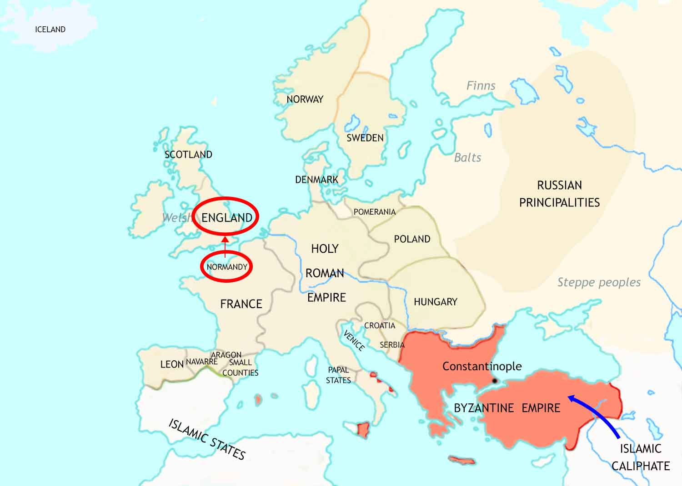
Medieval Europe: 1066-1215 CE - I
In 1066, a force from the French duchy of Normandy conquers England. Its leader will be famous in English history as “William the Conqueror”.
In 1071, an army of Turks inflicts a shattering defeat on the Byzantine army at the Battle of Manzikert. The Turks then go on to occupy a huge part of the Byzantine Empire.
The population of Europe is beginning to grow again, after many centuries.

Slide 14
Medieval Europe: 1066-1215 CE- II
The popes’ claim to leadership in Christendom threatens the position of secular rulers. A power struggle follows.
In England, the quarrel between kings and the church leads to the murder of an archbishop in his own cathedral (1170).
In the Holy Roman Empire the power struggle greatly weakens the emperors’ authority.
In France, the kings cast themselves as allies of the popes. With papal support their power increases.

Slide 15
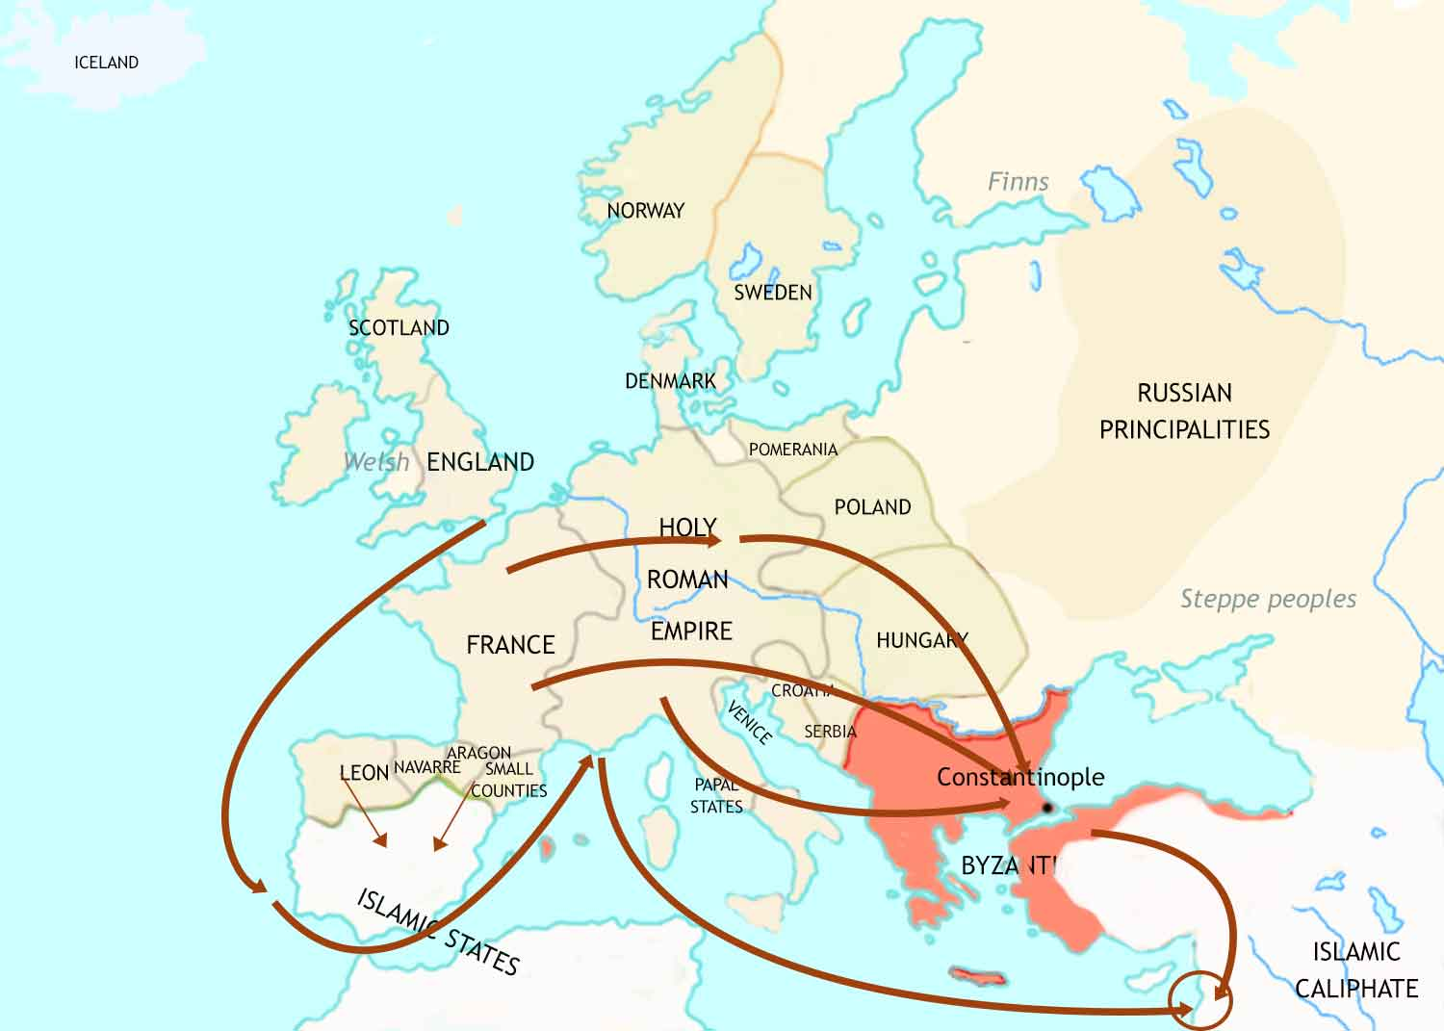
Medieval Europe: 1066-1215 CE - III
In response to the threat to the Byzantines, the Christian rulers in western Europe oganize several Crusades against Muslim control of Jerusalem.
Close contact between Christians and Muslims leads to new knowledge and ideas coming into Europe.
The Christian reconquista of Spain makes great strides.
Jerusalem

Slide 16
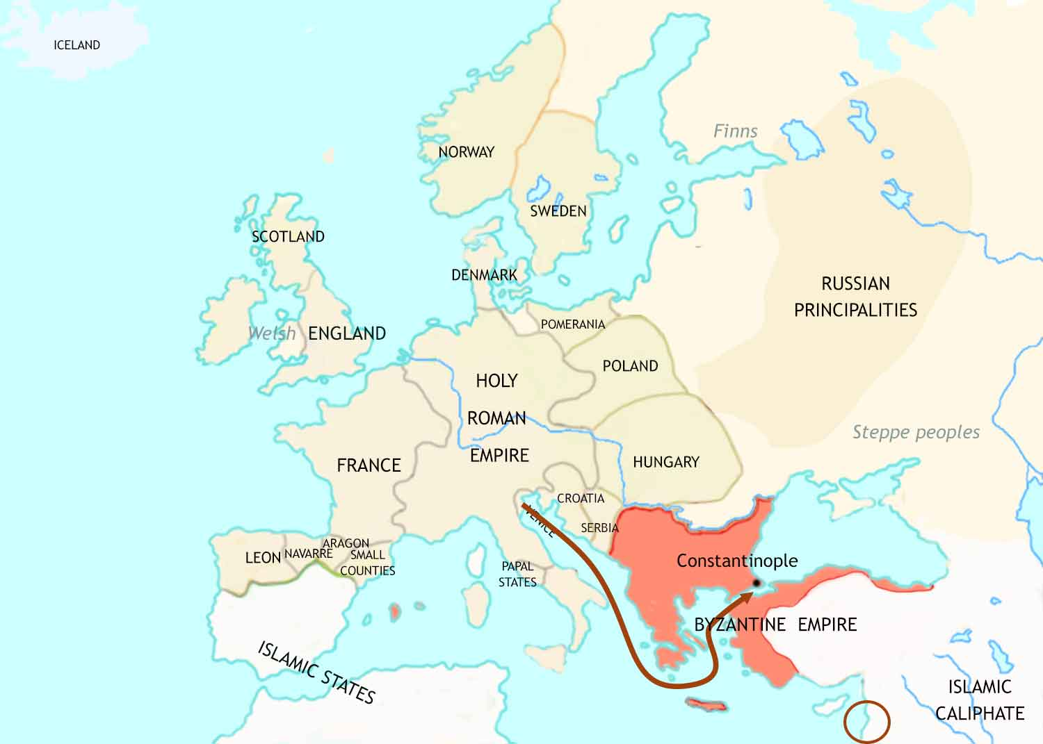
Medieval Europe: 1066-1215 CE - IV
Instead of fighting the Muslims, in 1204 the
4th Crusade attacks the
Byzantine (and Christian) city of Constantinople.
Jerusalem

Slide 17
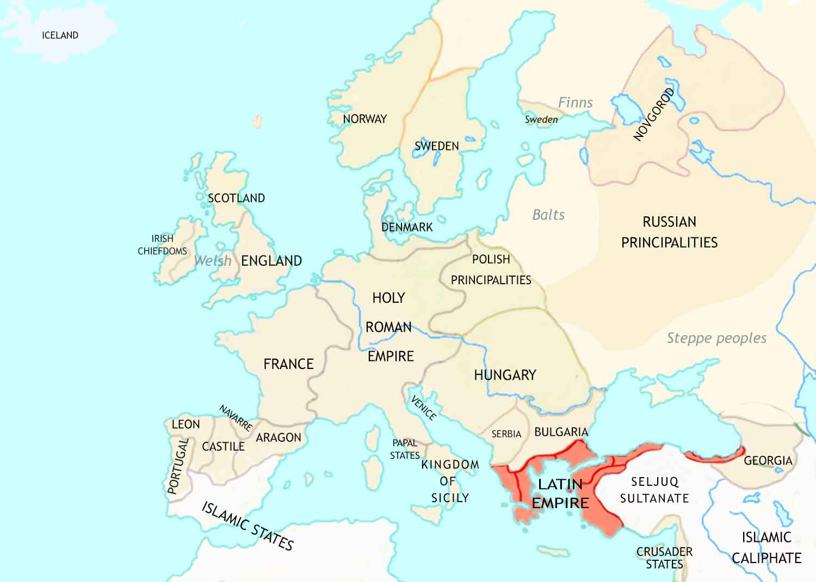
Medieval Europe: 1215 CE
In England, the barons force the king to respect the rights of his subjects by signing Magna Carta.
Instead of fighting the Muslims, in 1204 the
4th Crusade attacks the
Byzantine (and Christian) city of Constantinople.
Western Europe is experiencing strong economic growth, with populations, trade and towns all expanding.

Slide 18
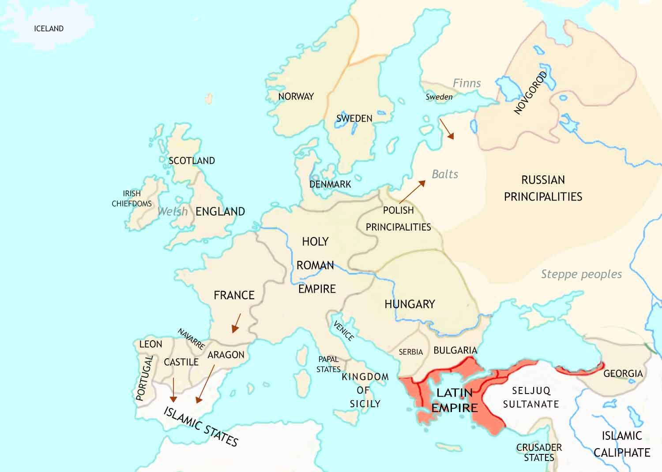
Medieval Europe: 1215-1347 CE - I
The Crusades to the Middle East peter out, but Crusading movements spring up in other places.

Slide 19
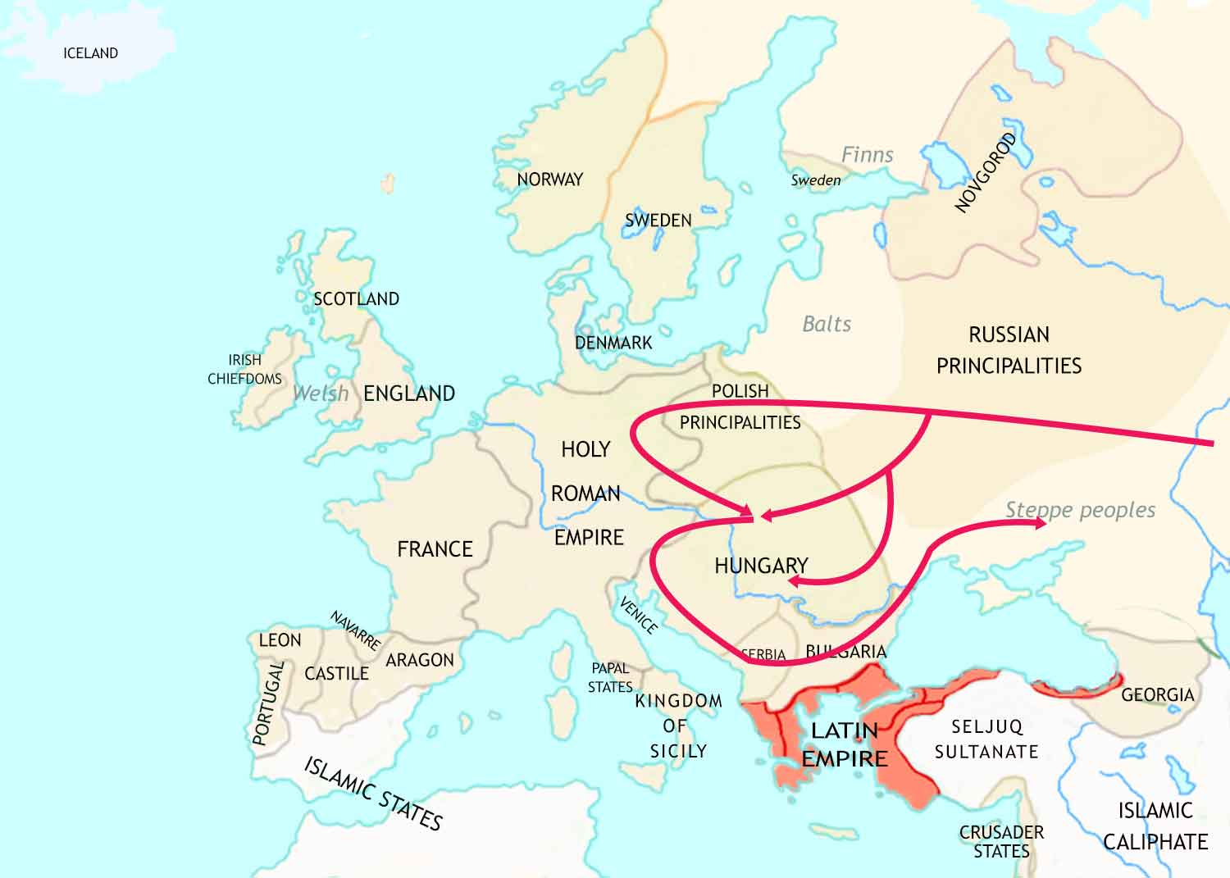
Medieval Europe: 1215-1347 CE - II
A ferocious invasion by the Mongols, a people from central Asia, leaves a trail of destruction. The Russians are now under Mongol rule.

Slide 20
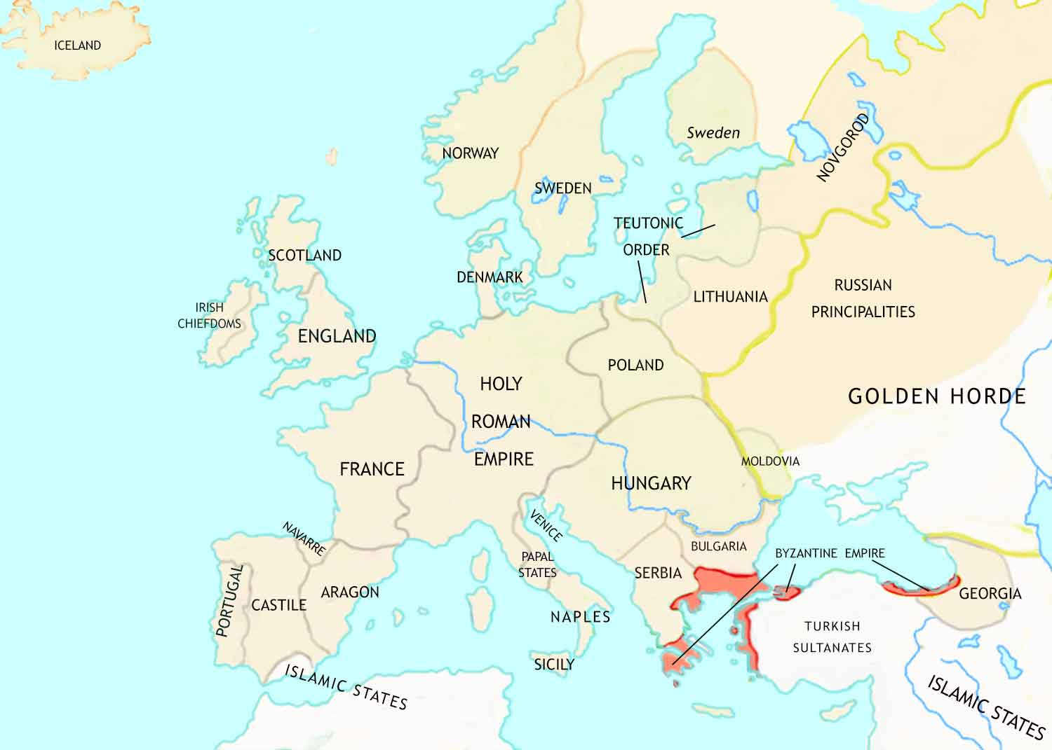
Medieval Europe: 1347 CE
In England, parliament has become an important part of government.
In the Holy Roman Empire, the emperor has become so weak that the leading nobles, bishops and towns have become almost independent of him.
The Crusaders have been driven from the eastern Mediterranean.

Slide 21
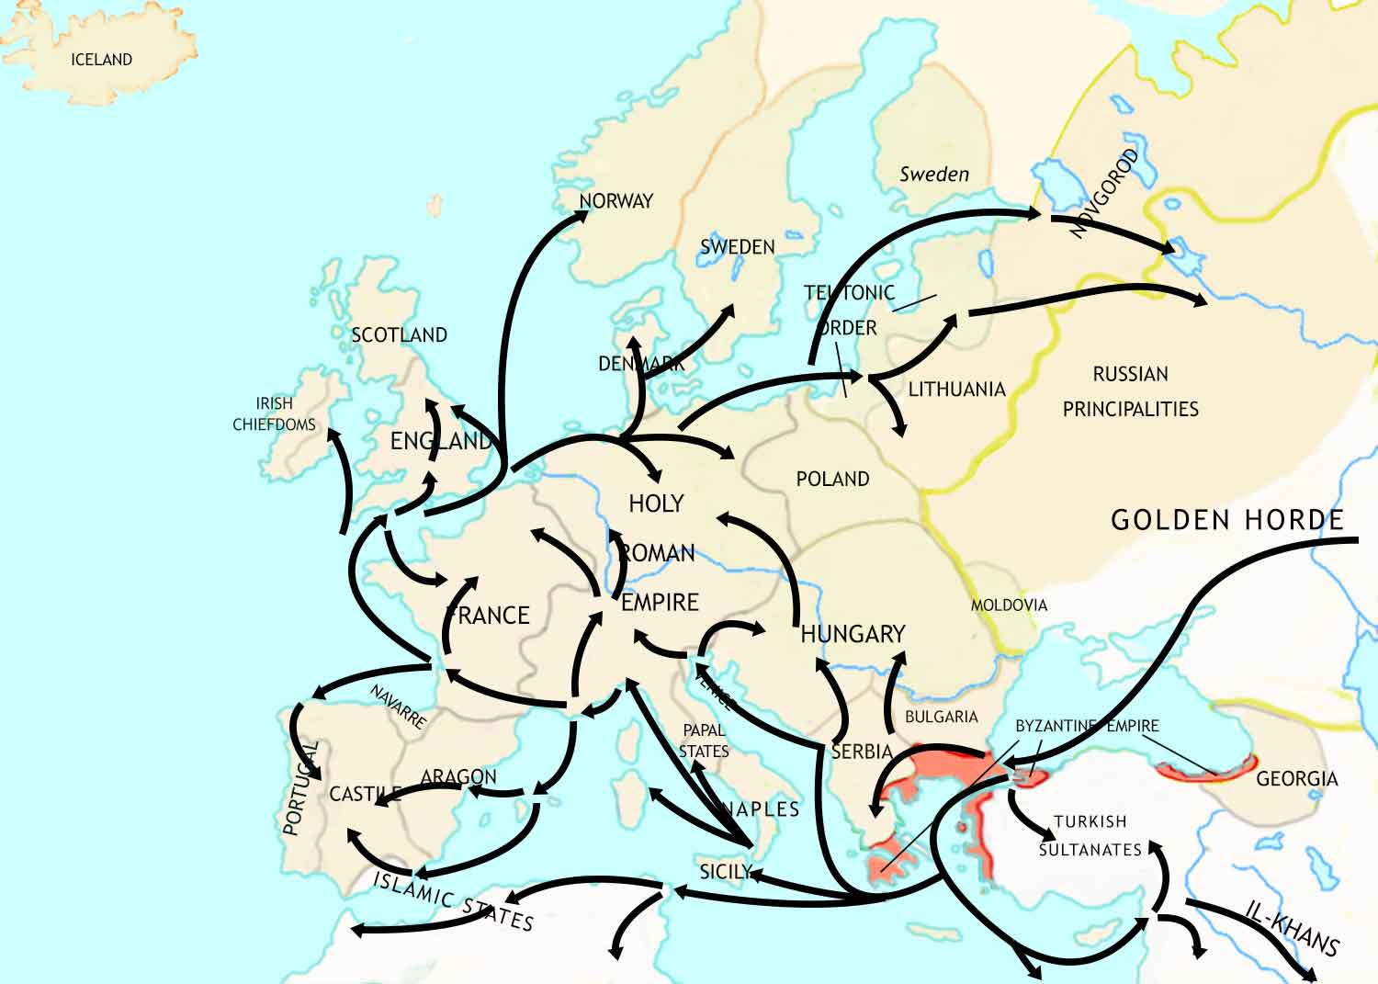
Medieval Europe: 1347-1352 CE
Between 1347 and 1352, a dreadful plague sweeps through Europe. This is known as the Black Death. It kills more than a third of the population.

Slide 22
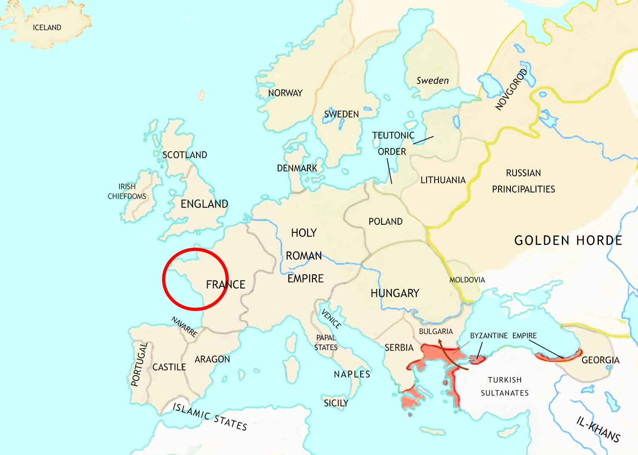
Medieval Europe: 1352-1450 CE
In the wake of the Black Death, huge changes in western European society take place.
Religious unrest grows as criticism of the Catholic Church grows.
The Hundred Years War between England and France transforms European warfare.
The Ottoman expands its power in Asia Minor and into Europe.

Slide 23
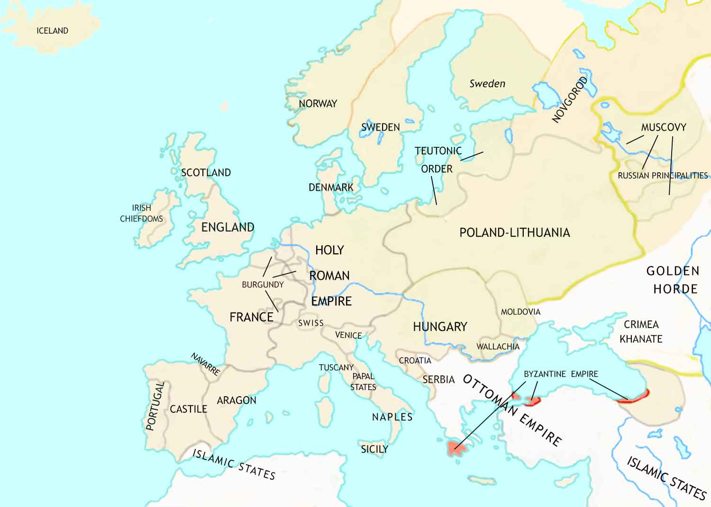
Medieval Europe: 1450 CE
The Italian Renaissance begins. This will revolutionize European culture.
The Portuguese send out voyages of discovery to find out more about the world outside Europe.
The Ottoman Empire has conquered deep into Europe.

