Slide 1
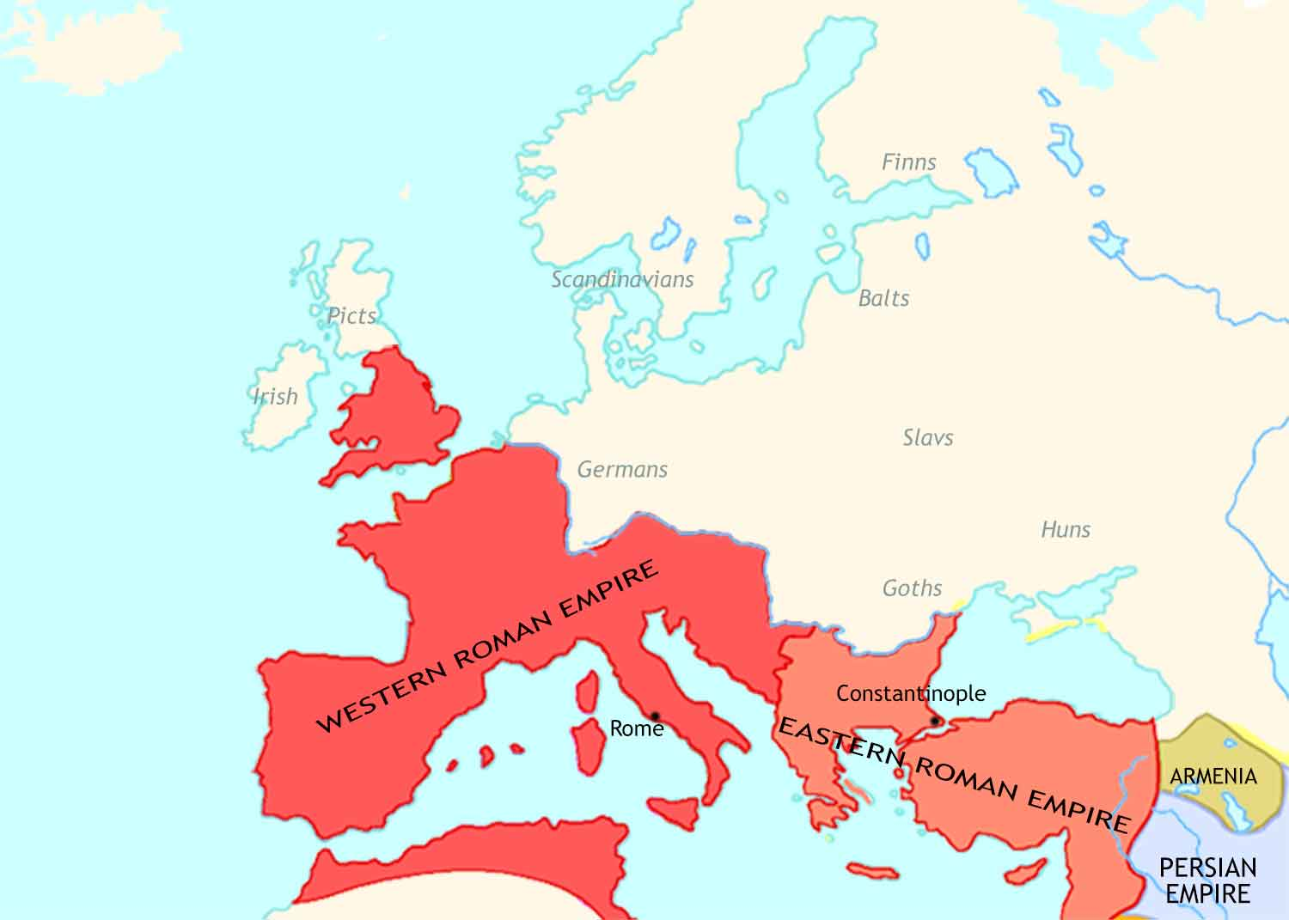
Medieval Europe: 400 CE
In the late fourth century, the Roman Empire stands intact. Its economy is still strong.
The Roman Empire is now ruled by two emperors, one in the east and one in the west.
Christianity is the official religion of the empire. The bishop of Rome is its leading figure.

Slide 2
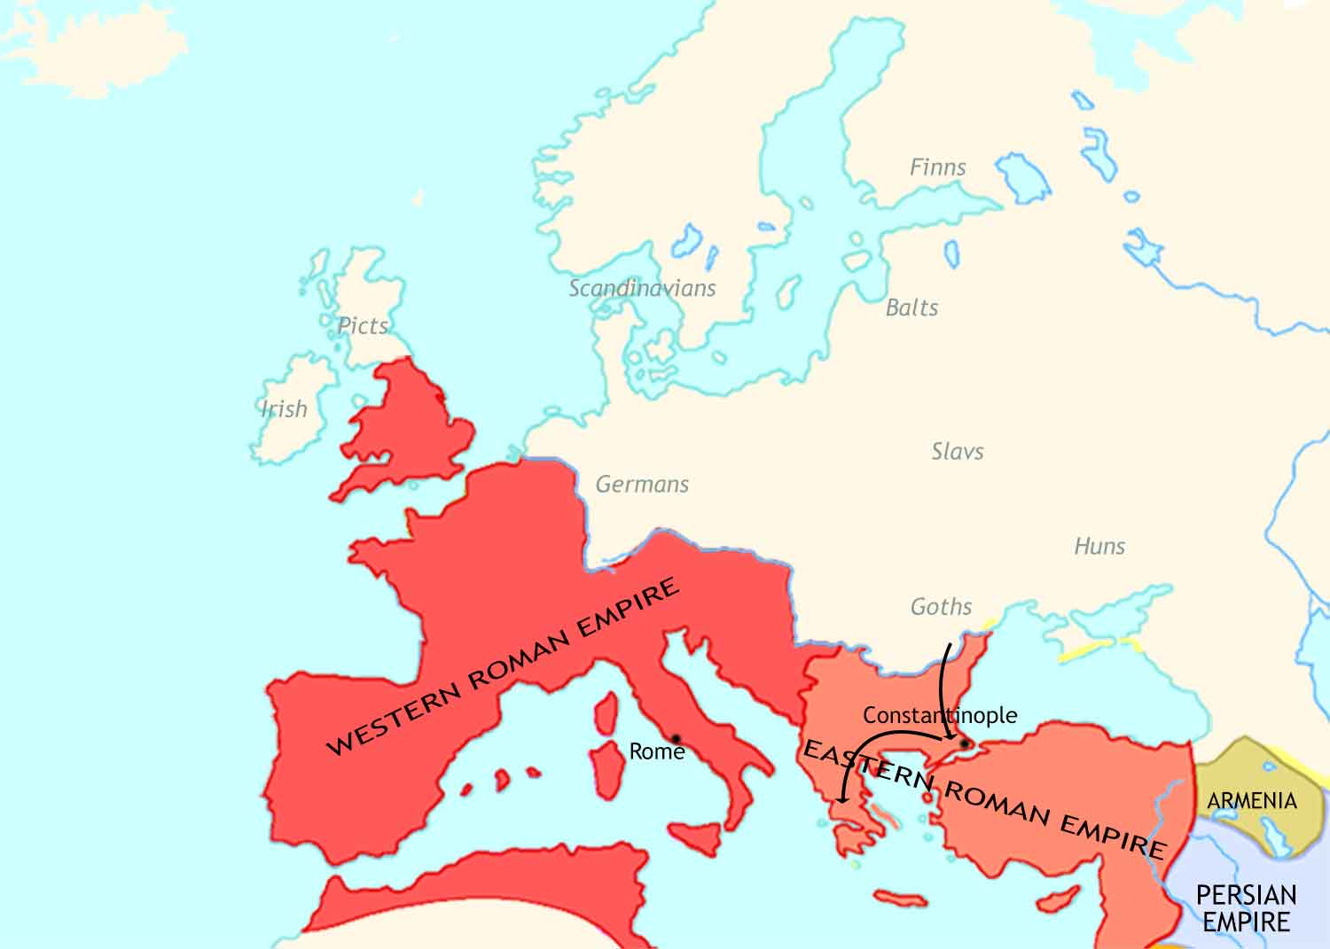
Medieval Europe: 400-500 CE
In the fifth century, German tribes invade deep into the empire.

Slide 3
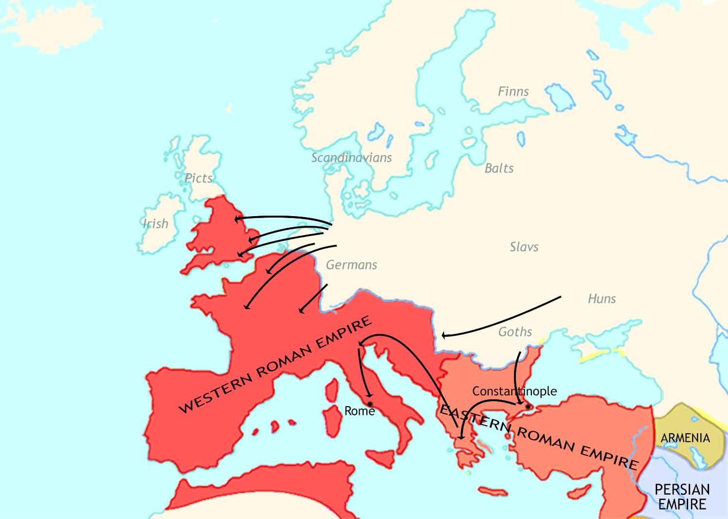
Medieval Europe: 400-500 CE
In the fifth century, German tribes invade deep into the empire.

Slide 4
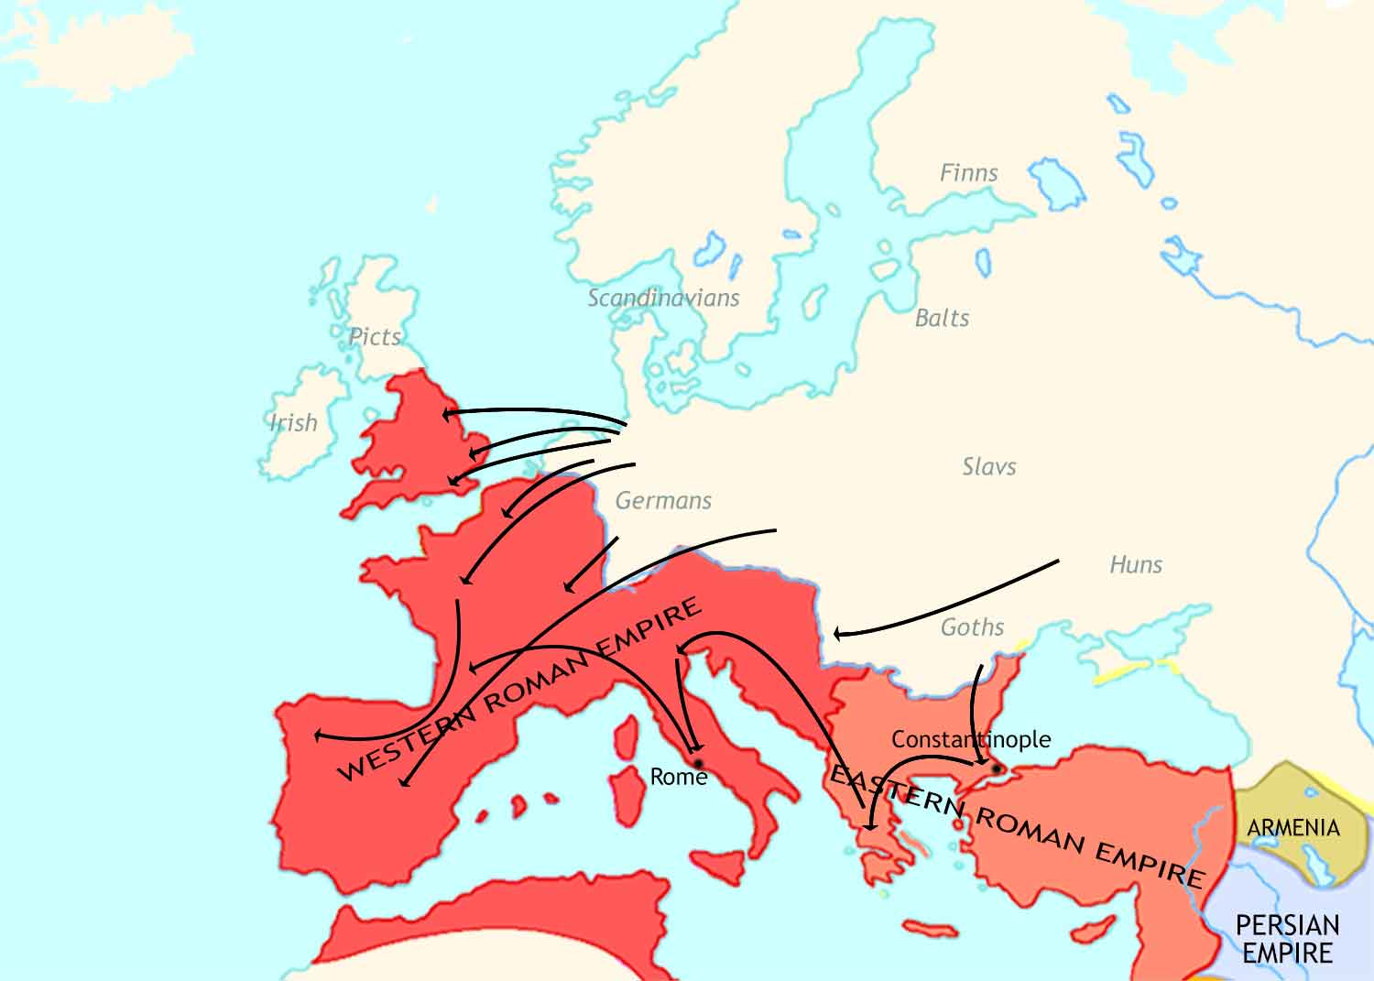
Medieval Europe: 400-500 CE
In the fifth century, German tribes invade deep into the empire.

Slide 5

Medieval Europe: 400-500 CE
In the fifth century, German tribes invade deep into the empire.
Angles, Saxons, Jutes
Franks
They cause large-scale destruction in the Western Roman Empire.
Suebi
Vandals
Huns
Goths
Rome is sacked twice, by the Goths in 410 CE and the Vandals in 455 CE.

Slide 6
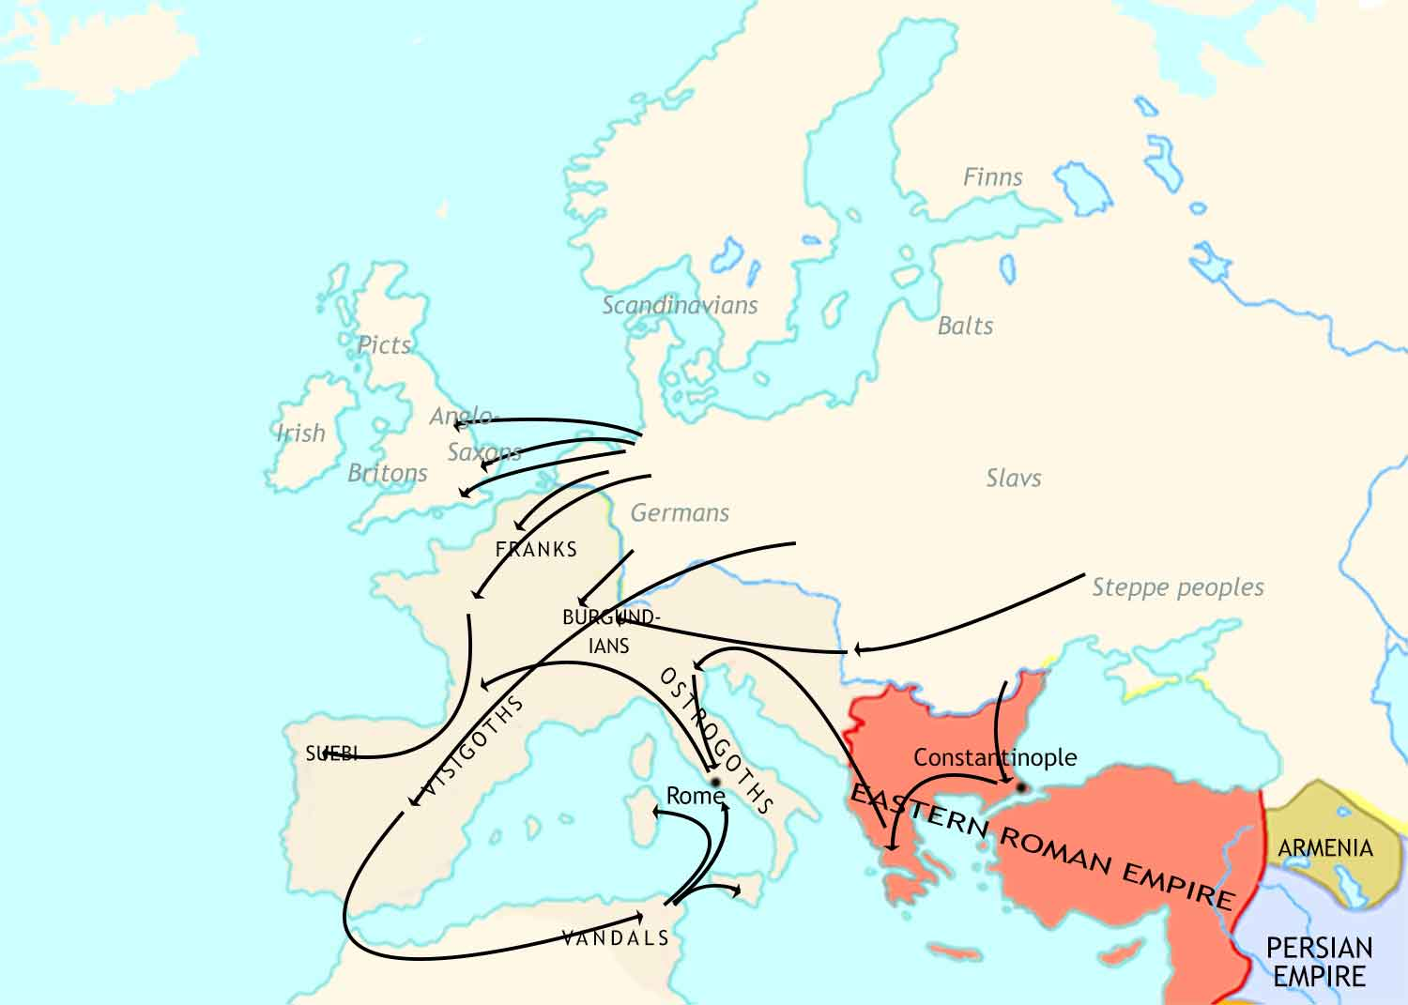
Medieval Europe: 500 CE

Slide 7
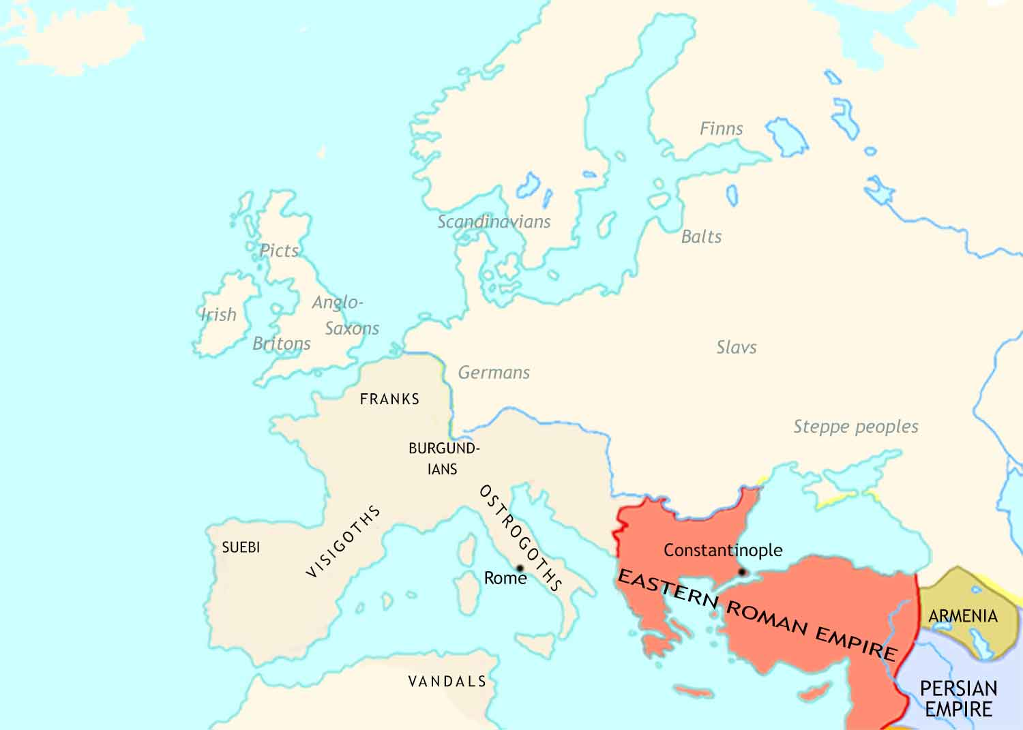
Medieval Europe: 500 CE
German tribes have formed several kingdoms in what was the Western Roman Empire
Anglo-Saxon tribes have settled in southern Britain, destroying Roman civilization, including Christianity.
The Eastern Roman Empire has been almost unaffected. Life continues here much as before.
Roman civilization has been badly damaged, but in most places Christianity has survived.

Slide 8
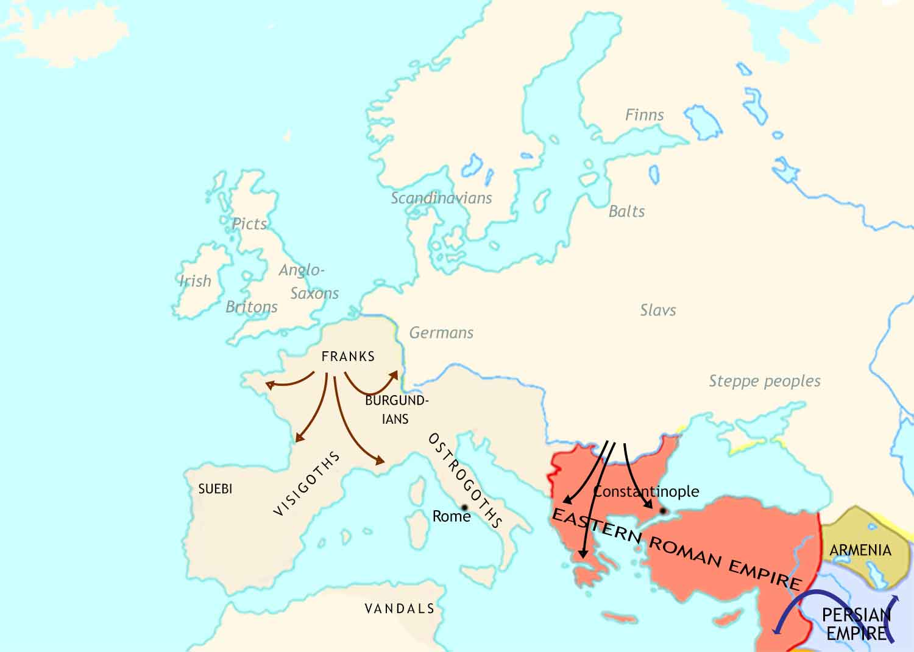
Medieval Europe: 500-711 CE
Western Europe has seen the expansion of the kingdom of the Franks.
The Eastern Roman Empire faces destructive attacks from Slav tribes from central Europe and Muslim armies from Arabia.

Slide 9
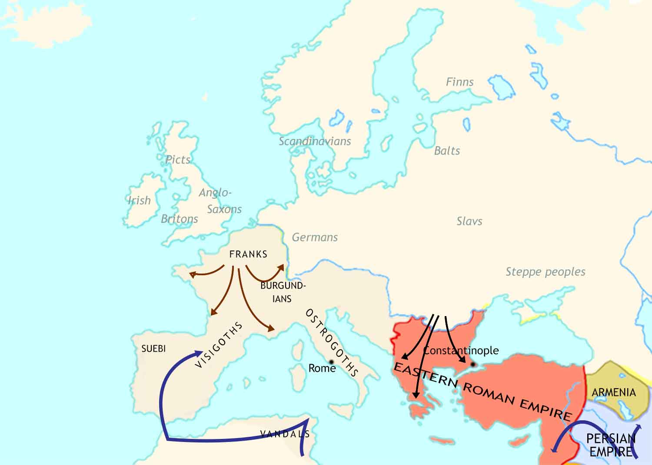
Medieval Europe: 500-711 CE
Western Europe has seen the expansion of the kingdom of the Franks.
Great invasions from central Europe and Muslim armies from Arabia transform the Eastern Roman Empire into what modern scholars call the Byzantine Empire.
After conquering most of the Middle East, Arab armies occupy North Africa and Spain.

Slide 10
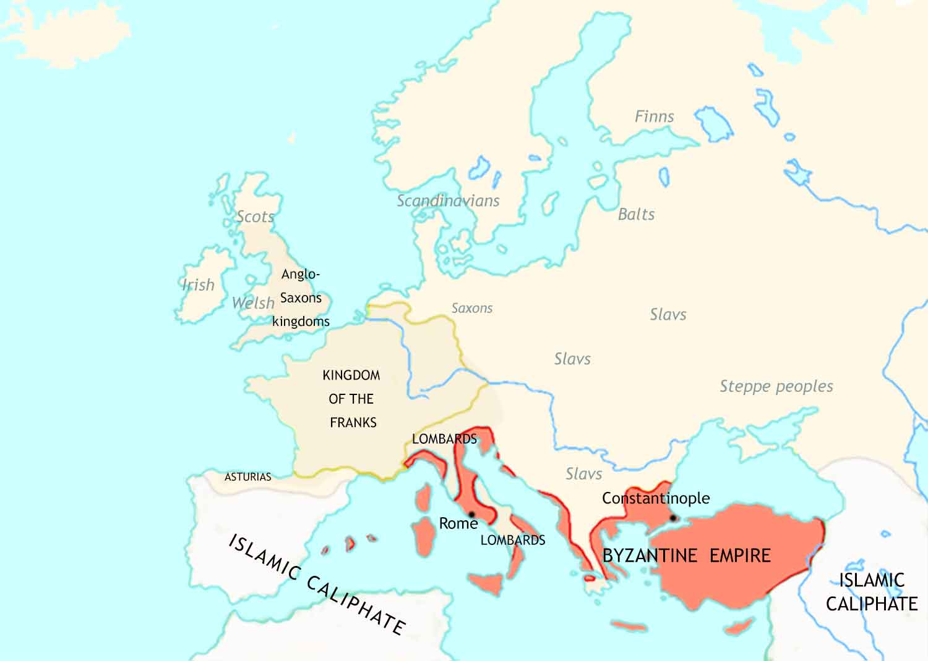
Medieval Europe: 711 CE
Missionaries from Ireland and from the Rome have converted England and Scotland to Christianity.
Western Europe has seen the expansion of the kingdom of the Franks.
Great invasions from central Europe and Muslim armies from Arabia transform the Eastern Roman Empire into what modern scholars call the Byzantine Empire.
After conquering most of the Middle East, Arab armies occupy North Africa and Spain.

Slide 11
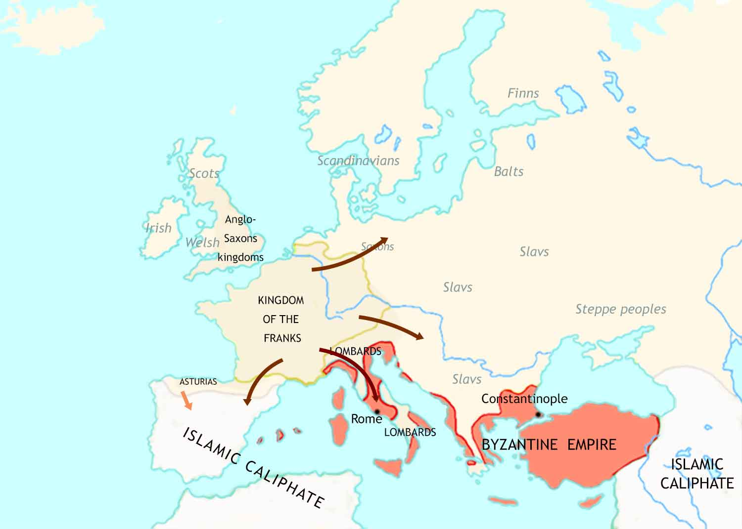
Medieval Europe: 711-814 CE
The Christian kingdom of Asturias seizes territory from the Muslims. This begins the Christian “Reconquista” of Spain.
The Frankish realm continues to expand, especially under its great ruler, Charlemagne.
Charlemagne is crowned emperor by the bishop of Rome (the “pope”) on Christmas day, 800.

Slide 12
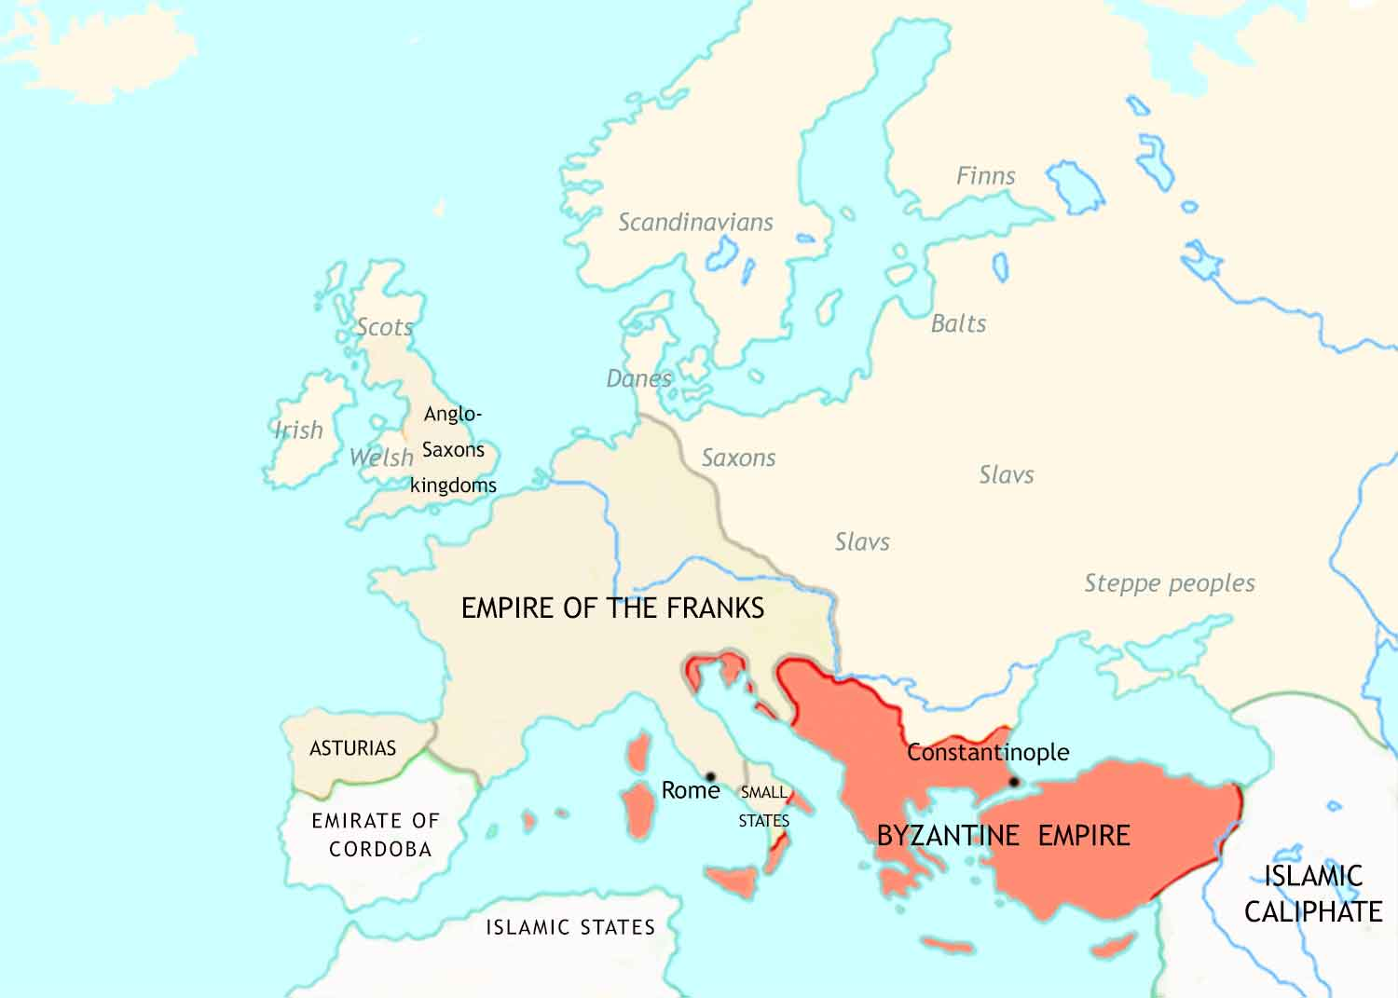
Medieval Europe: 814 CE
The Christian kingdom of Asturias seizes territory from the Muslims. This begins the Christian “Reconquista” of Spain.
The Frankish realm continues to expand, especially under its great ruler, Charlemagne.
Charlemagne is crowned emperor by the bishop of Rome (the “pope”) on Christmas day, 800.

Slide 13
Medieval Europe: 814 CE
The Christian kingdom of Asturias seizes territory from the Muslims. This begins the Christian “Reconquista” of Spain.
Charlemagne is crowned emperor by the bishop of Rome (the “pope”) on Christmas day, 800.

Slide 14
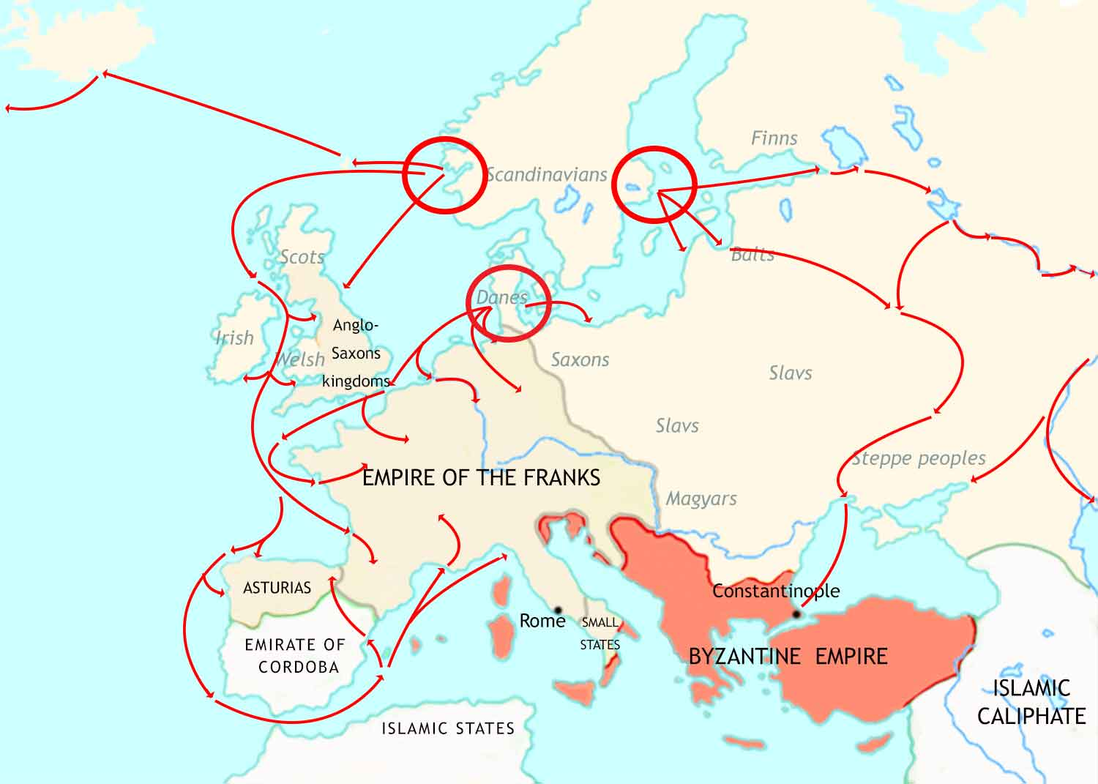
Medieval Europe: 814-962 CE
Norwegians
Swedes
Vikings from Scandinavia attack along the coasts and up the rivers of western Europe.
Danes

Slide 15
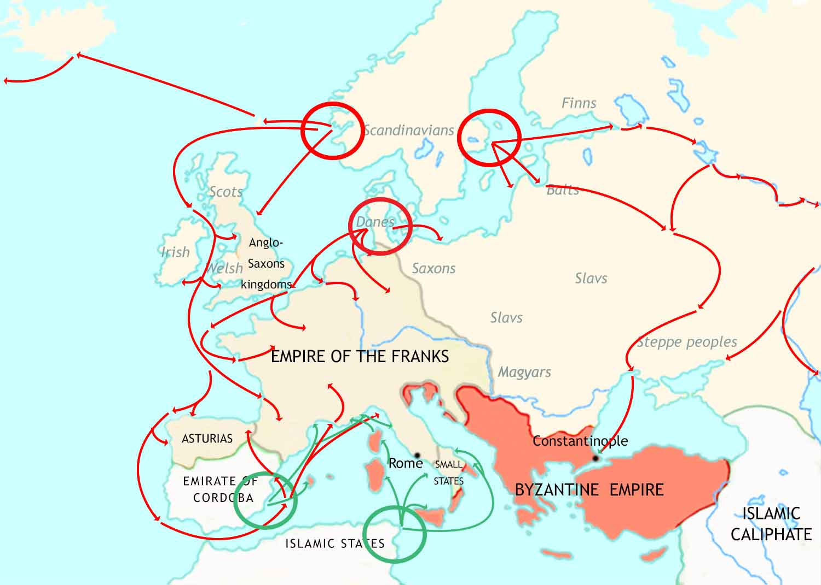
Medieval Europe: 814-962 CE
Norwegians
Swedes
Vikings from Scandinavia attack along the coasts and up the rivers of western Europe.
Danes
Muslim raiders attack coasts of Christian lands in the Mediterranean.

Slide 16
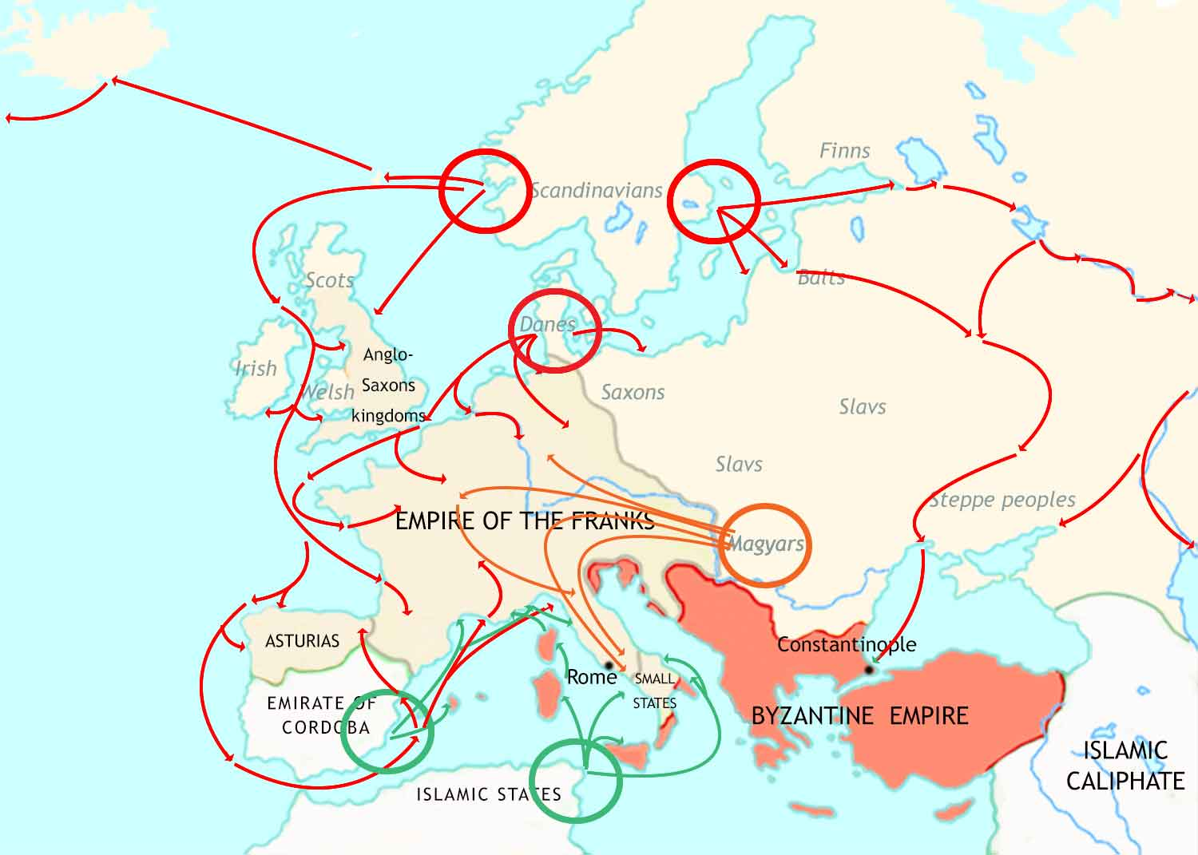
Medieval Europe: 814-962 CE
Norwegians
Swedes
Vikings from Scandinavia attack along the coasts and up the rivers of western Europe.
Danes
The Magyars, a nomadic tribe from central Asia, raid deep into Christian Europe.
Muslim pirates attack Christian coastlands in the Mediterranean.

Slide 17
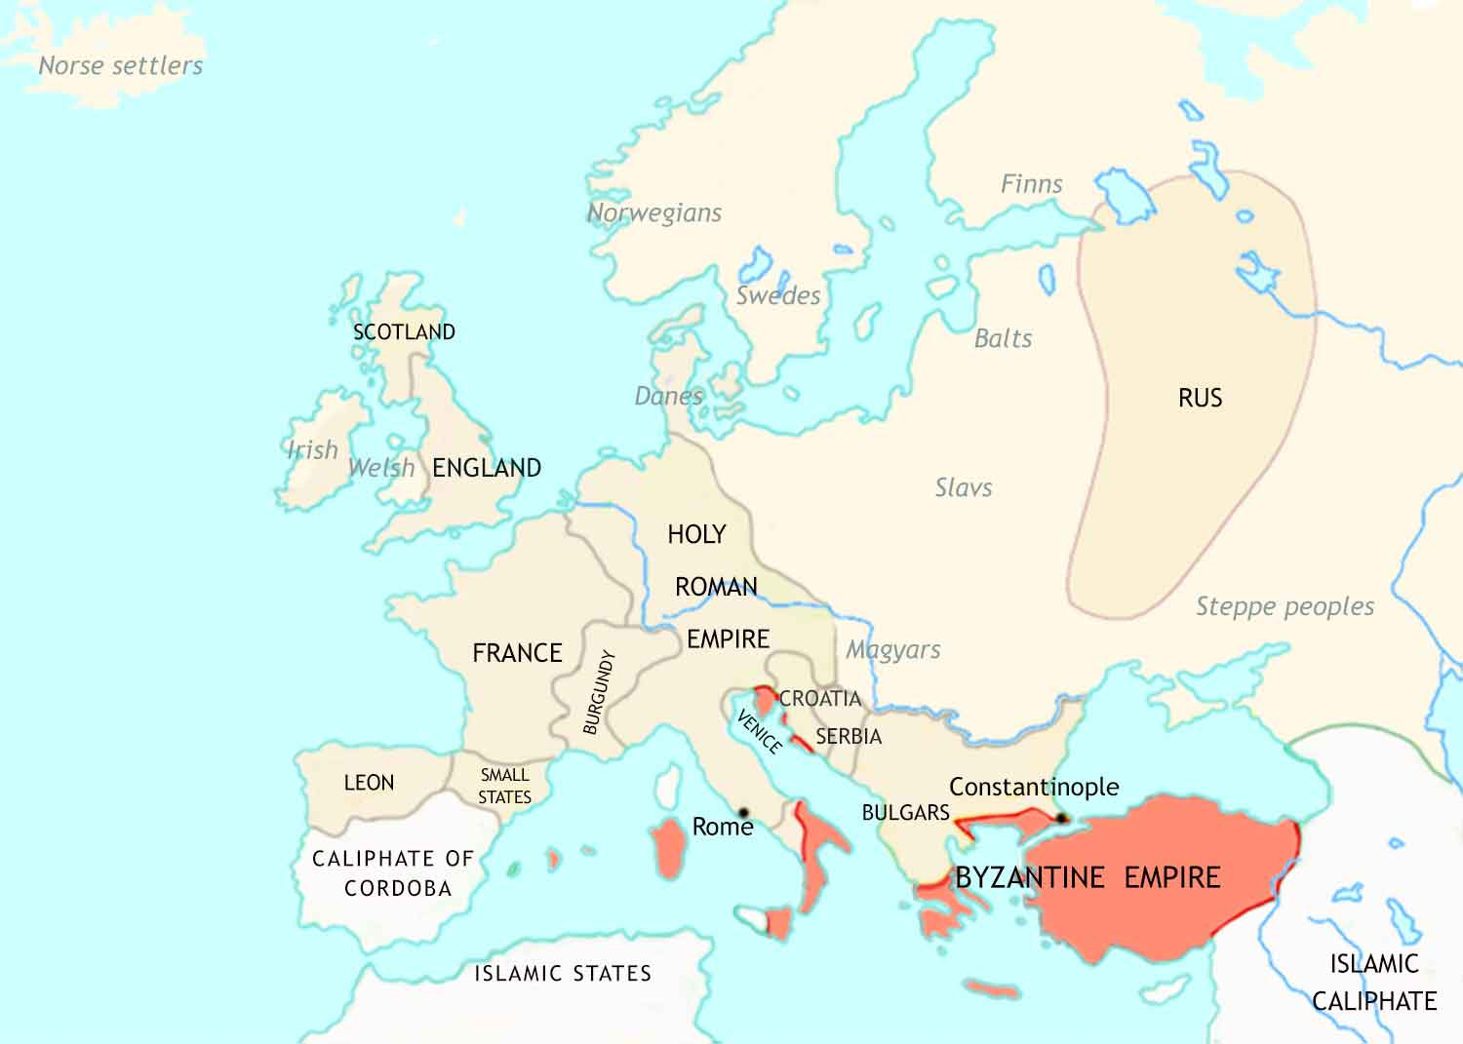
Medieval Europe: 962 CE
The Frankish Empire has broken up, but out of the wreckage has appeared the Holy Roman Empire.
The Viking attacks, plus civil wars, cause chaos. This gives rise to a new social and political system, called Feudalism.
Viking settlers (known as the Rus) have established a huge new state in what is now Russia and Ukraine.

Slide 18
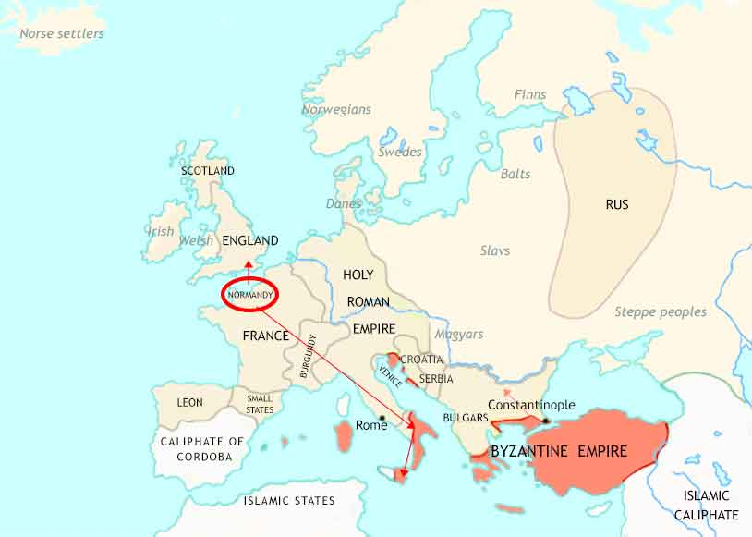

Slide 19
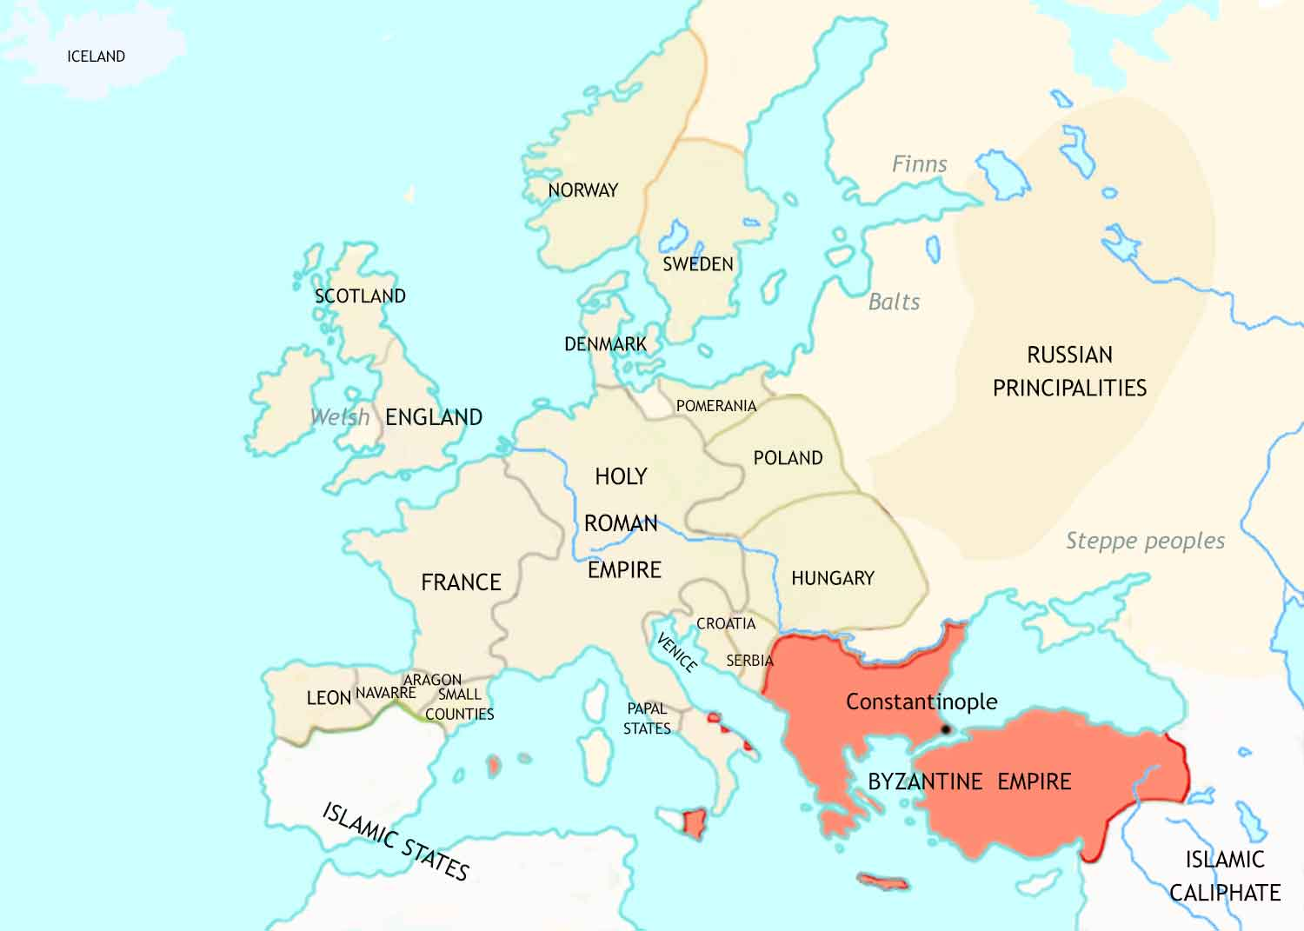
Medieval Europe: 1066 CE
New lands in northern and central Europe have joined “Christendom” by conversion from paganism to Christianity.
Feudalism has now developed fully in France, and is spreading to Italy, Germany, England and Spain.
The bishops of Rome, the popes, are increasingly claiming spiritual and secular leadership of Christendom.

Slide 20
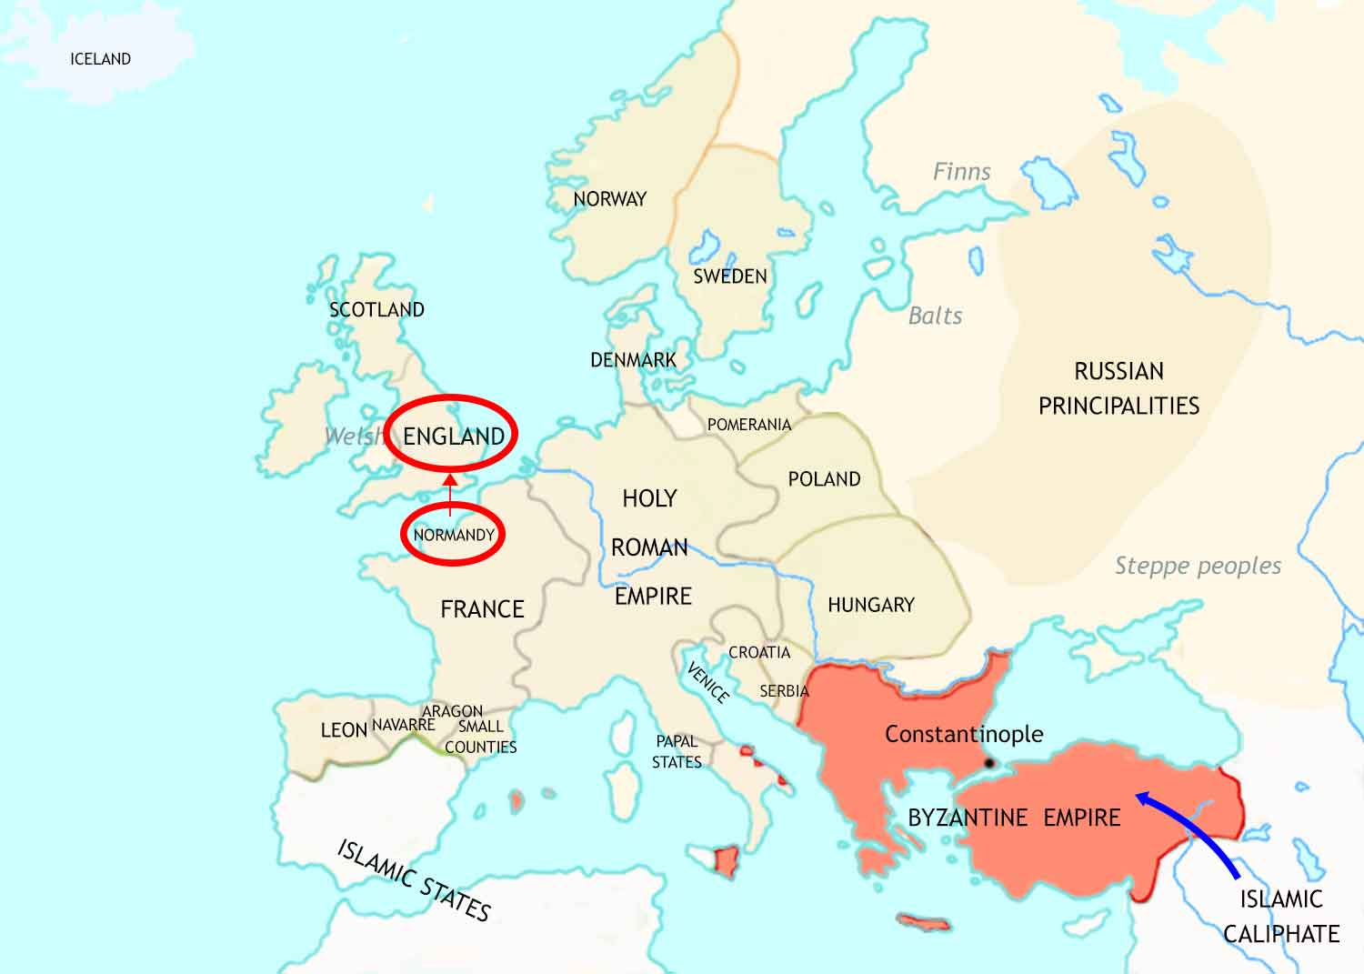
Medieval Europe: 1066-1071 CE
In 1066, a force from the French duchy of Normandy conquers England. Its leader will be famous in English history as “William the Conqueror”.
In 1071, an army of Turks inflicts a shattering defeat on the Byzantine army at the Battle of Manzikert. The Turks then go on to occupy a huge part of the Byzantine Empire.

Slide 21
Medieval Europe: 1066-1215 CE
The popes’ claim to leadership in Christendom threatens the position of secular rulers. A power struggle follows.
In England, the quarrel between kings and the church leads to the murder of an archbishop in his own cathedral (1170).
In the Holy Roman Empire the power struggle greatly weakens the emperors’ authority.
In France, the kings cast themselves as allies of the popes. With papal support their power increases.

Slide 22
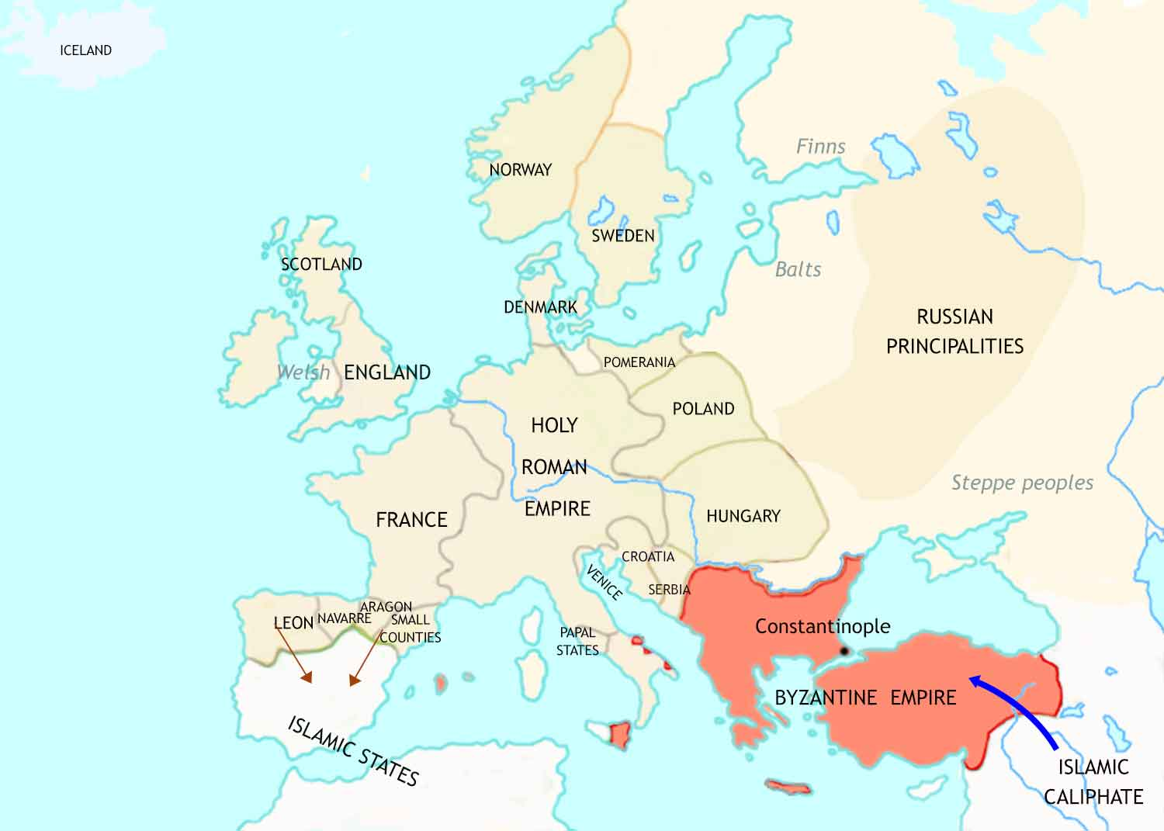
Medieval Europe: 1071-90 CE

Slide 23
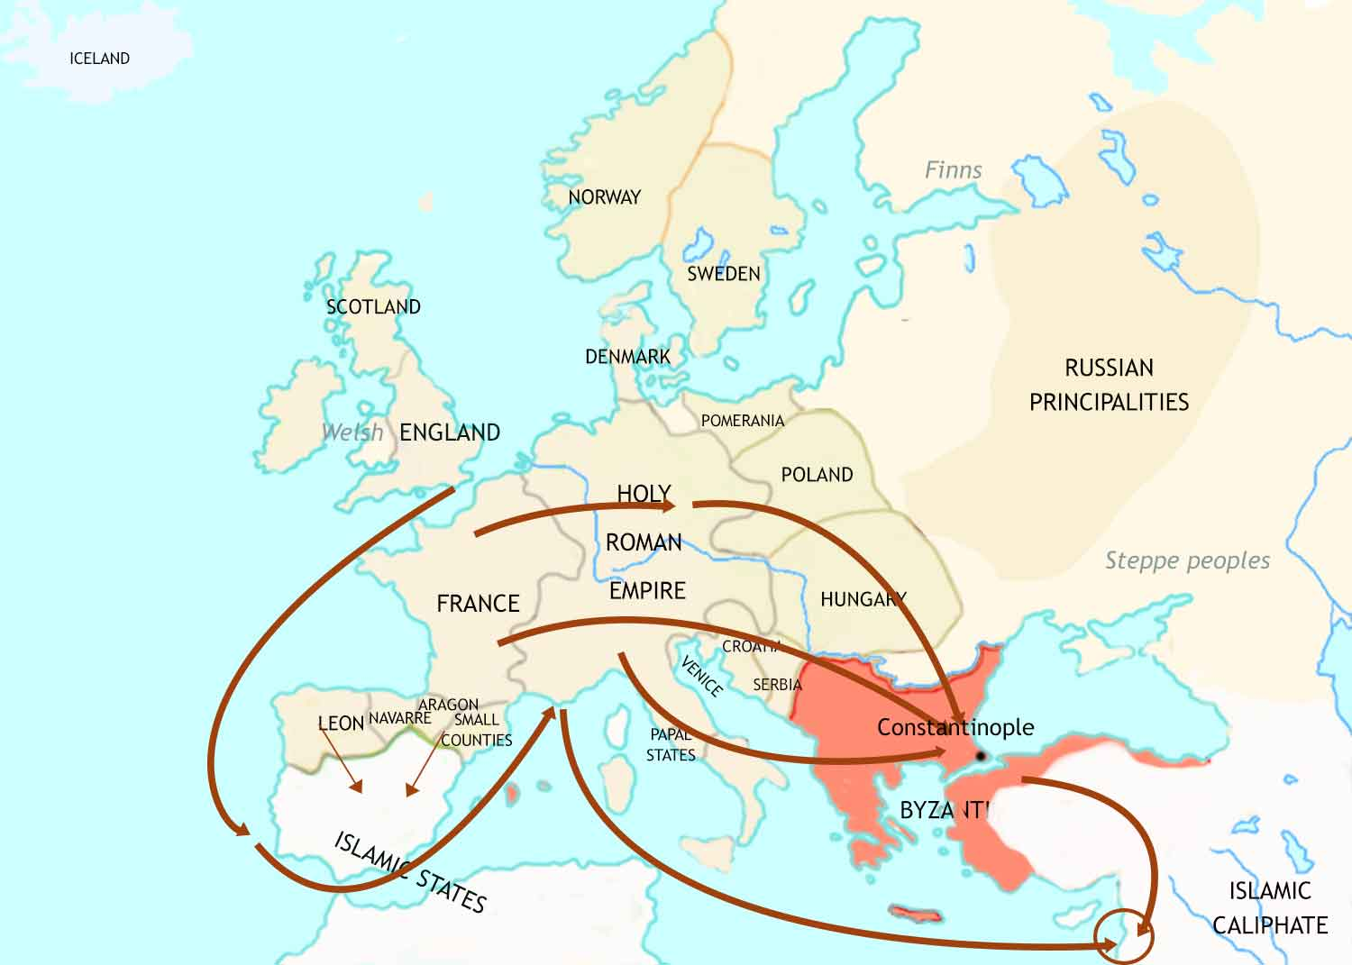
Medieval Europe: 1095-1215 CE
In response to the threat to the Byzantines, the Christian rulers in western Europe oganize several Crusades against Muslim control of Jerusalem.
The Christian Reconquista of Spain makes great strides.
Jerusalem

Slide 24
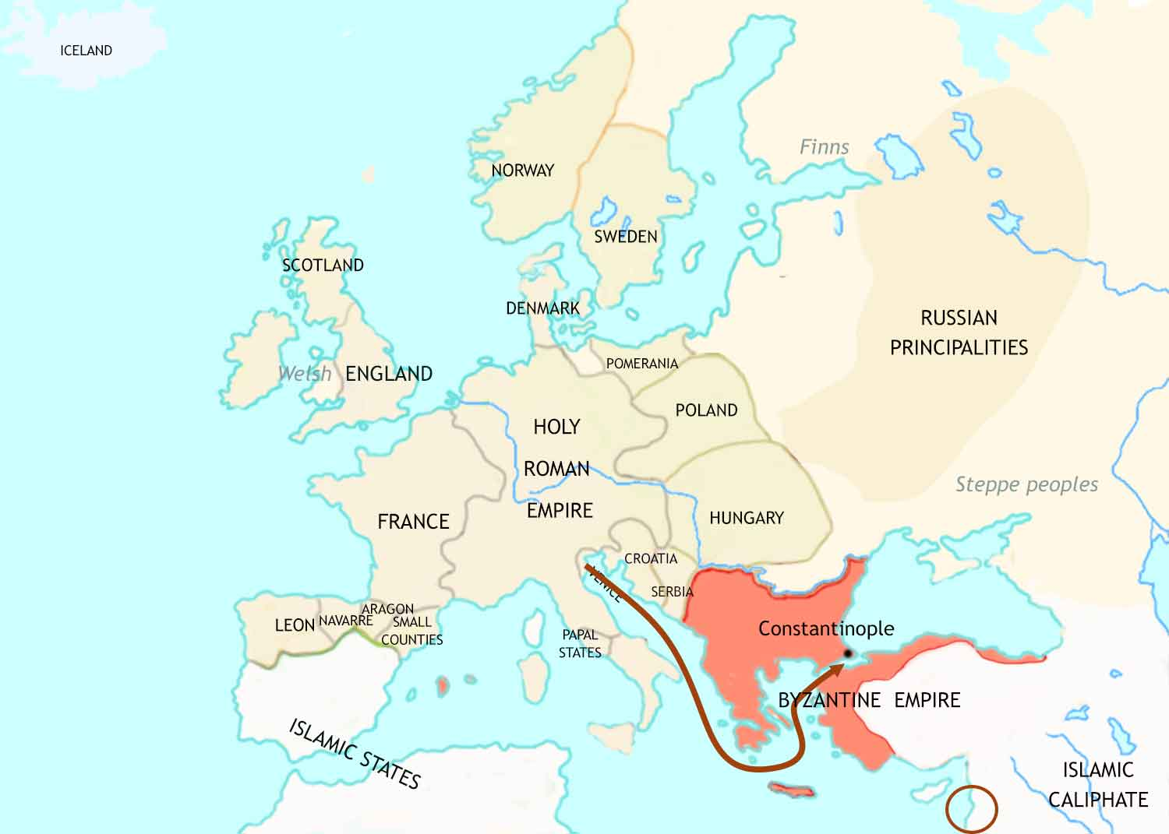
Medieval Europe: 1095-1215 CE
Instead of fighting the Muslims, in 1204 the
4th Crusade attacks the
Byzantine (and Christian) city of Constantinople.
Jerusalem

Slide 25
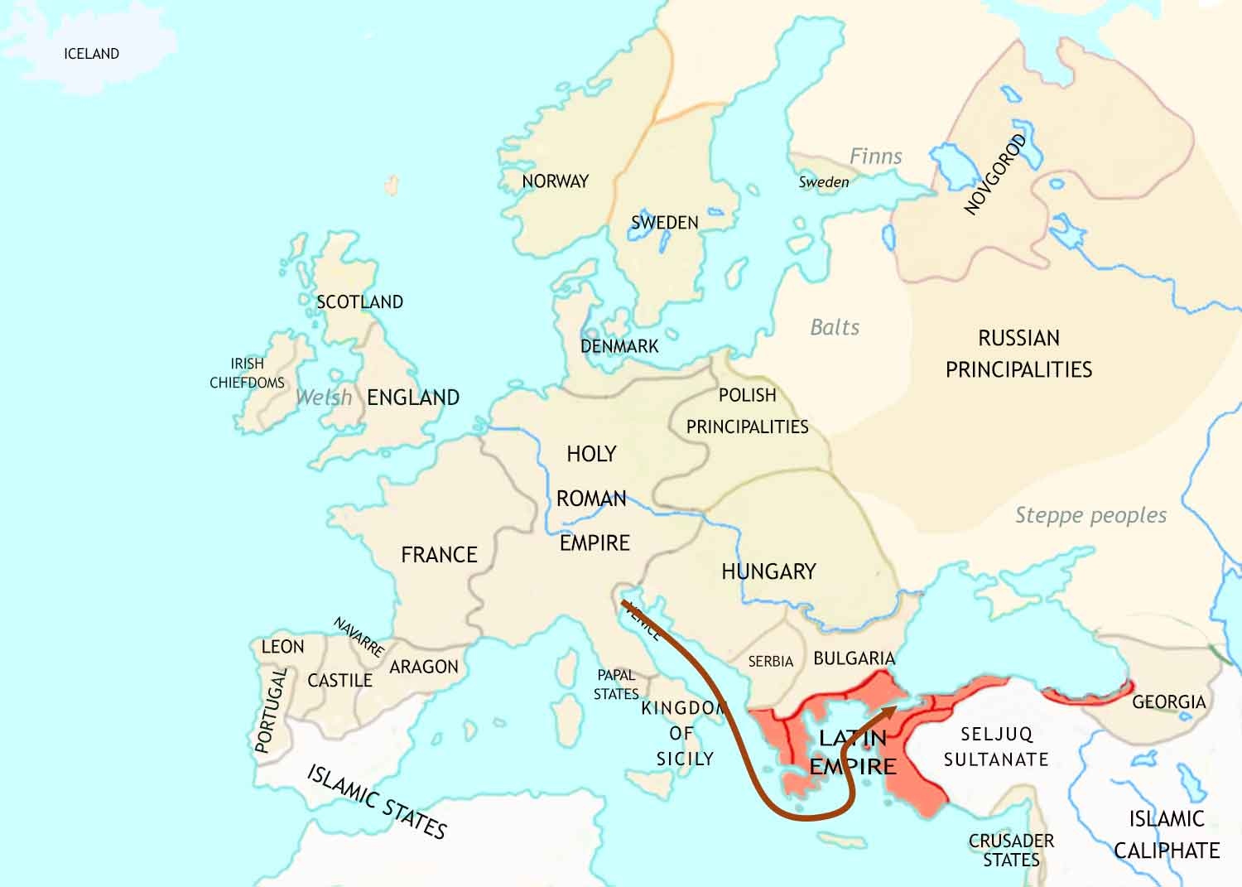
Medieval Europe: 1204 CE

Slide 26
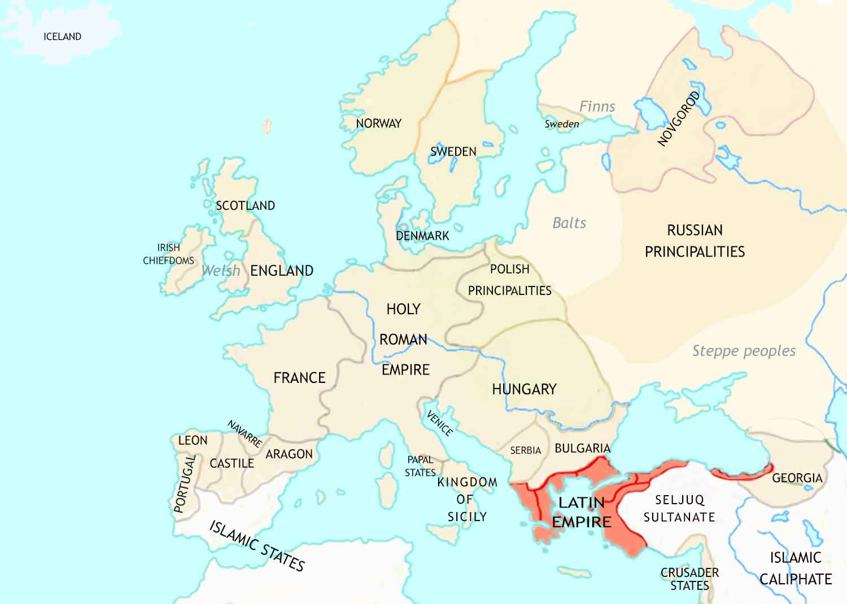
Medieval Europe: 1215 CE
In England, the barons force the king to sign Magna Carta and agree to respect the rights of his subjects.
Close contact between Christians and Muslims is leading to new knowledge and ideas coming into Europe.
Trade between Christians and Muslims has greatly increased. This benefits all of Europe but especially cities in northern Italy.
After the 4th Crusade, crusader leaders have divided the Byzantine Empire between themselves.

Slide 27
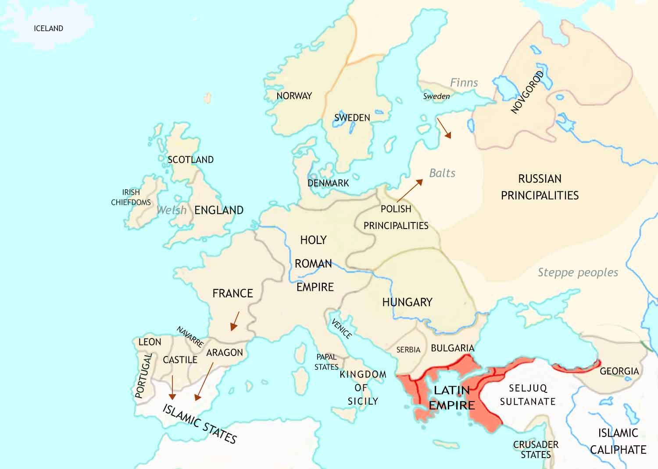
Medieval Europe: 1215-1347 CE
The Crusades to the Middle East peter out, but Crusading movements spring up in other places.
The Crusades to the Middle East peters out, but Crusading movements spring up in other places.
The Christian Reconquista of Spain closes in on the remaining Muslim strong-holds in the south.

Slide 28
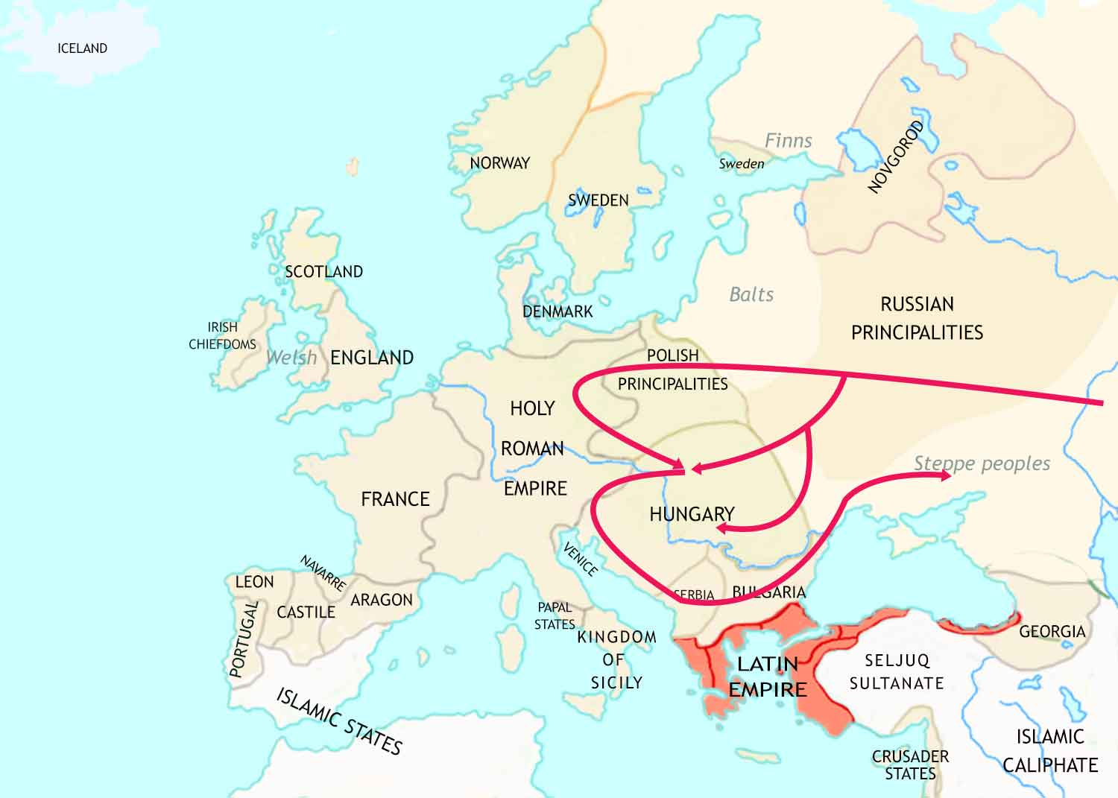
Medieval Europe: 1215-1347 CE
A ferocious invasion by the Mongols, a people from central Asia, leaves a trail of destruction, and the Russians under Mongol control.

Slide 29
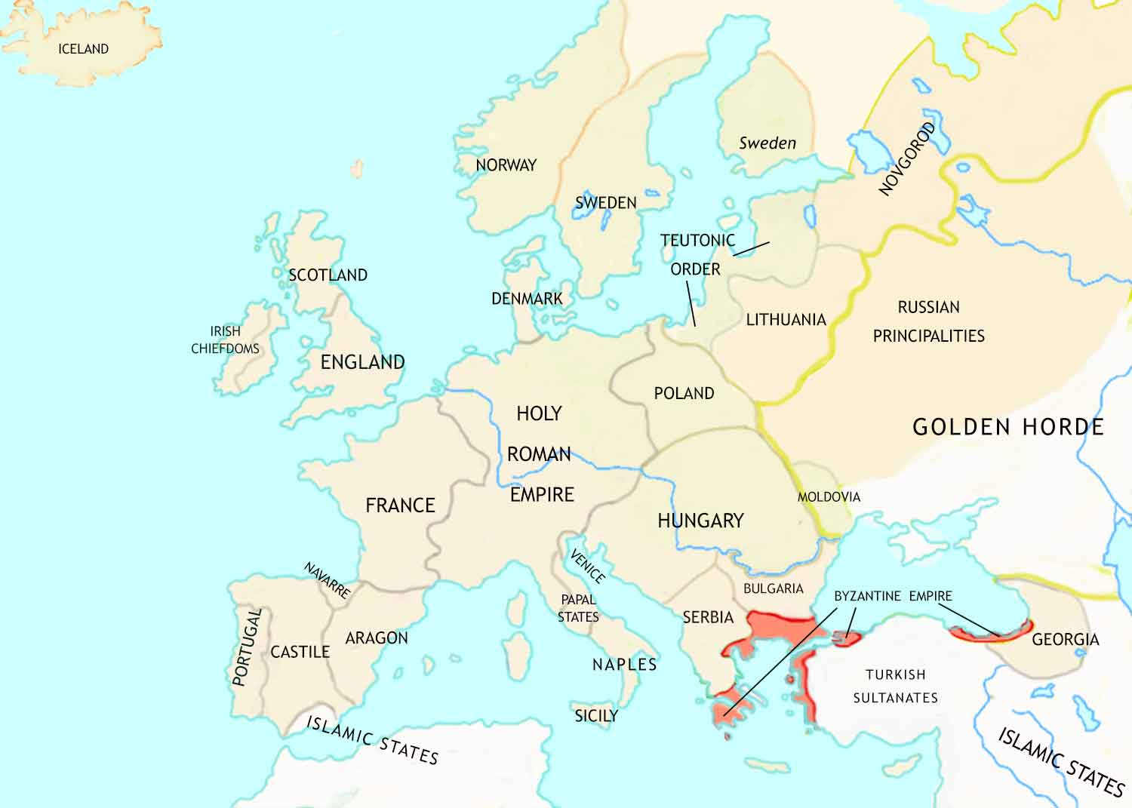
Medieval Europe: 1347 CE
In England, parliament has become an important part of government.
In the Holy Roman Empire, the emperor has become so weak that the leading nobles, bishops and towns have become almost independent of him.
Trade in the Mediterranean has greatly increased. This benefits all of Europe but especially the city-states of northern Italy.

Slide 30
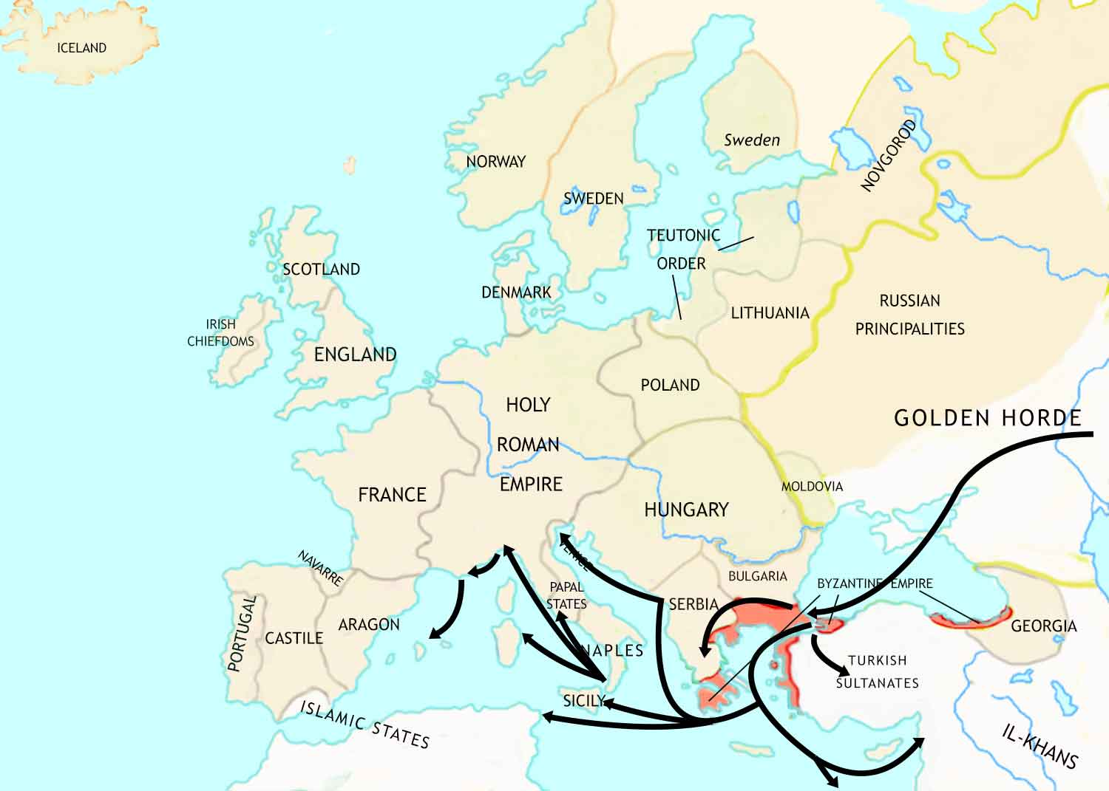
Medieval Europe: 1347-1352 CE
Between 1347 and 1352, a dreadful plague sweeps through Europe. This is known as the Black Death. It kills more than a third of the population.

Slide 31
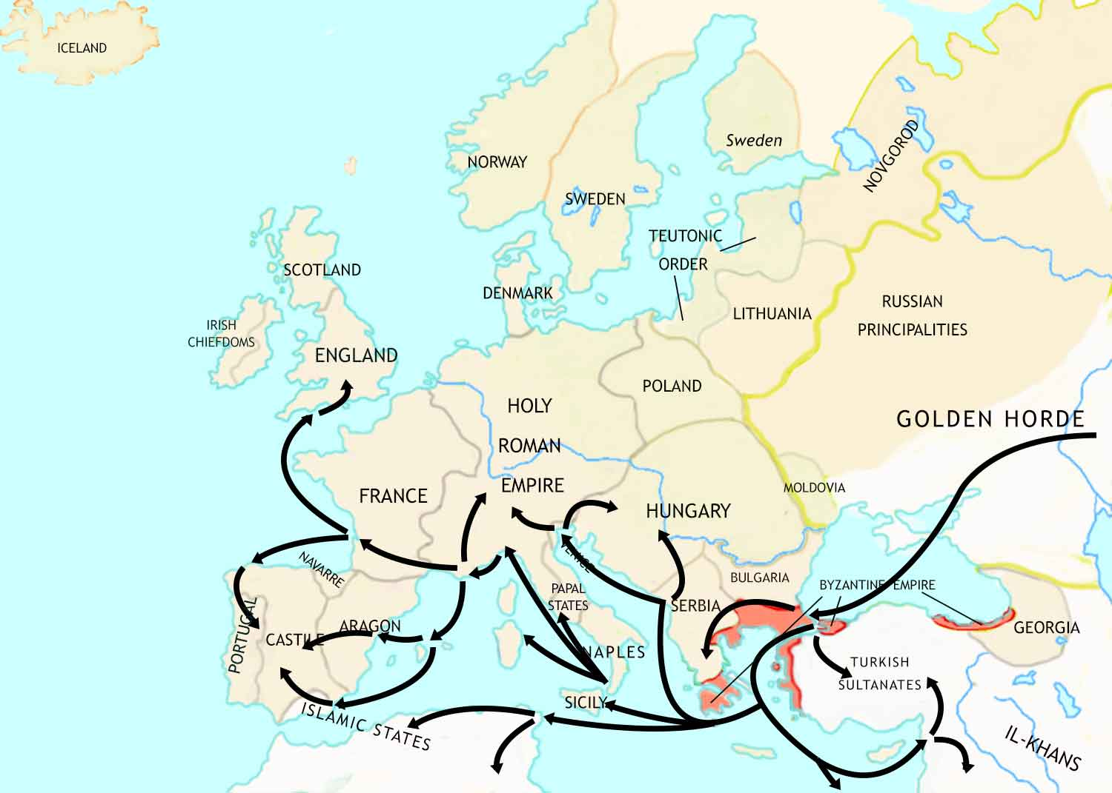
Medieval Europe: 1347-1352 CE
Between 1347 and 1352, a dreadful plague sweeps through Europe. This is known as the Black Death. It kills more than a third of the population.

Slide 32
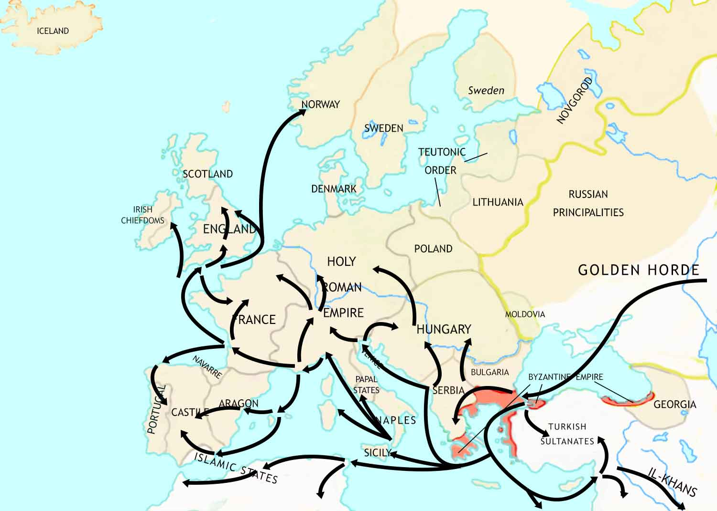
Medieval Europe: 1347-1352 CE
Between 1347 and 1352, a dreadful plague sweeps through Europe. This is known as the Black Death. It kills more than a third of the population.

Slide 33
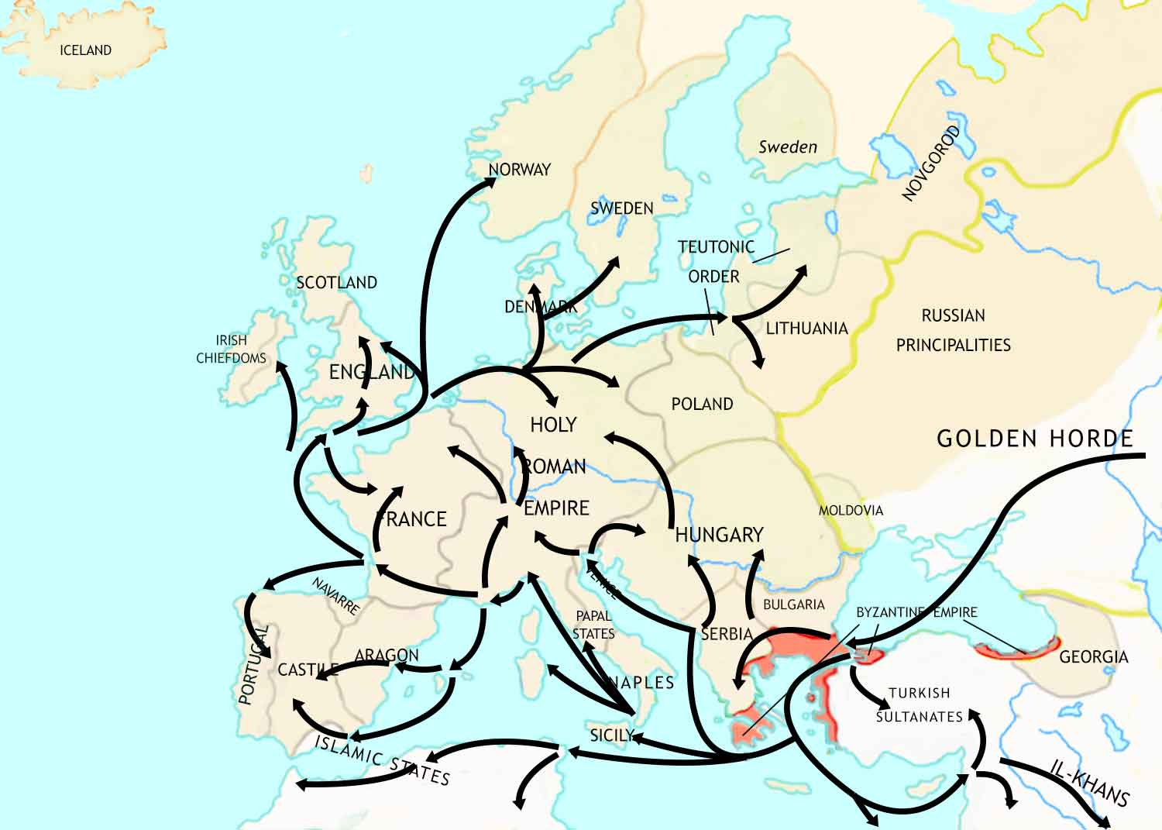
Medieval Europe: 1347-1352 CE
Between 1347 and 1352, a dreadful plague sweeps through Europe. This is known as the Black Death. It kills more than a third of the population.

Slide 34
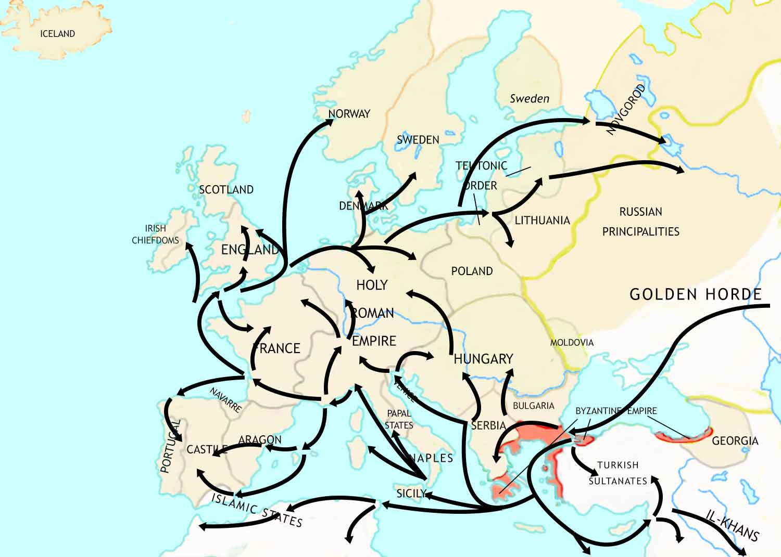
Medieval Europe: 1347-1352 CE
Between 1347 and 1352, a dreadful plague sweeps through Europe. This is known as the Black Death. It kills more than a third of the population.

Slide 35
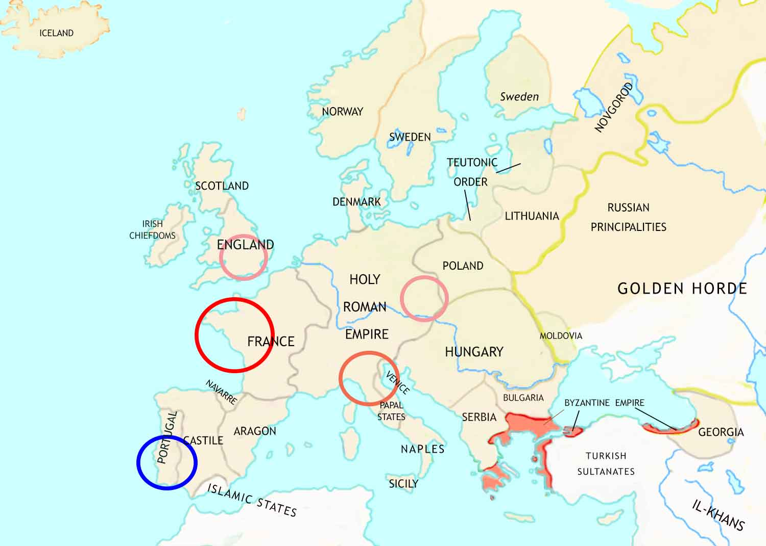
Medieval Europe: 1352-1450 CE
In the century after the Black Death, Medieval Europe begins to give way to early Modern Europe.
Medieval Christendom faces crisis as criticism of the teaching and practices of the Catholic Church grows.
The Hundred Years War between England and France transforms European warfare.
Lollards
Hussites
In northern Italy, the Italian Renaissance will change European culture for ever.
The Portuguese send out voyages of discovery to find out more about the world outside Europe.

Slide 36
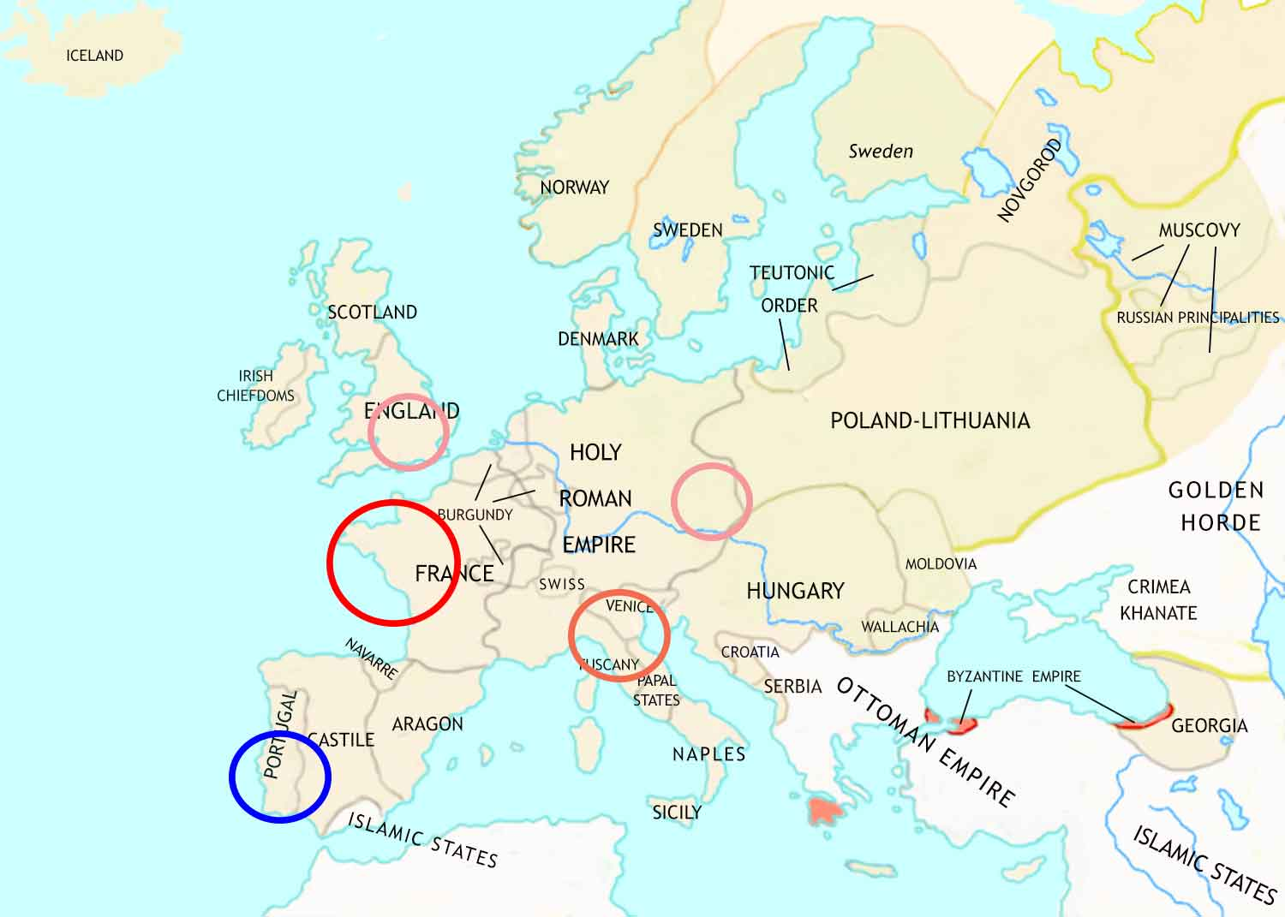
Medieval Europe: 1450 CE
In the century after the Black Death, Medieval Europe begins to give way to early Modern Europe.
Medieval Christendom faces crisis as criticism of the teaching and practices of the Catholic Church grows.
The Hundred Years War between England and France transforms European warfare.
The Italian Renaissance begins. This will change European culture for ever.
The Portuguese send out voyages of discovery to find out more about the world outside Europe.

