Slide 1
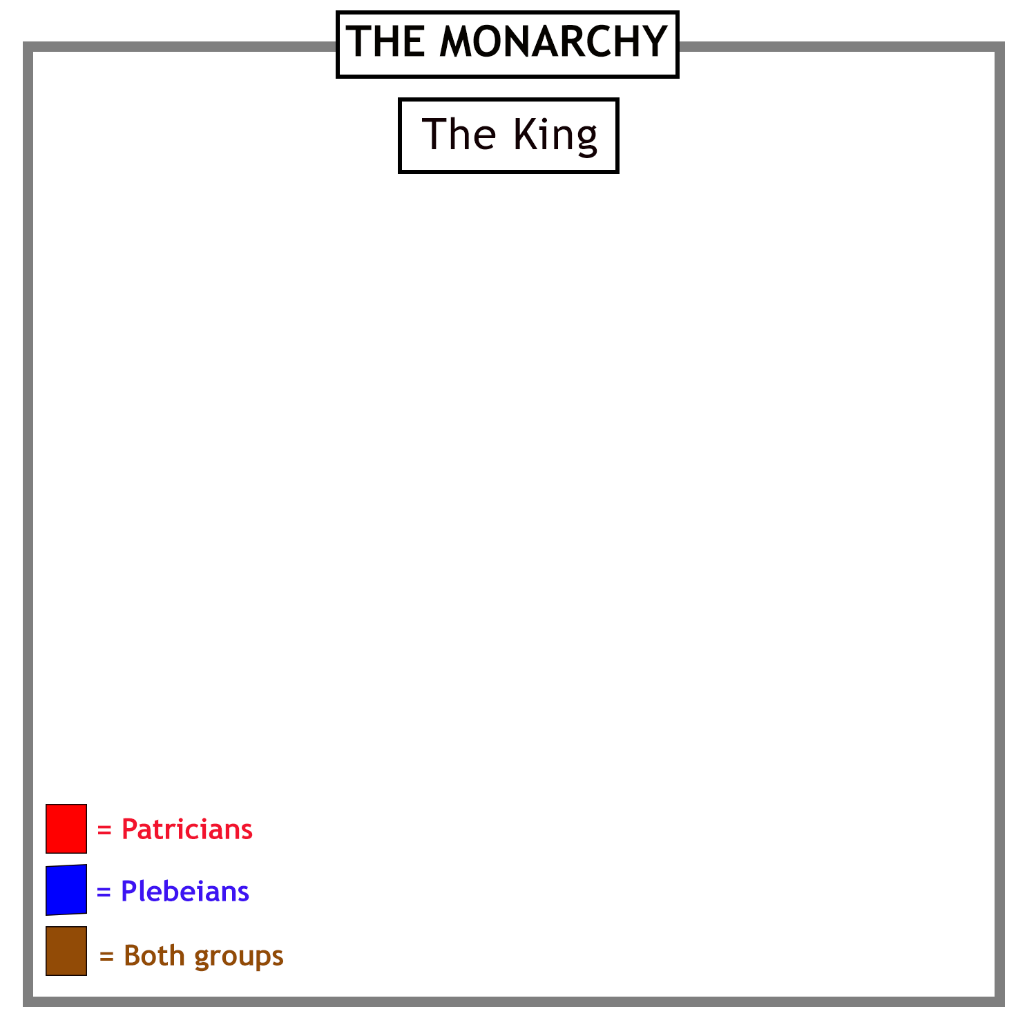
Early Rome was ruled by
a series of kings.
The early Roman community was divided
into two groups:
…the rich and powerful Patricians…
…and the rest.

Slide 2
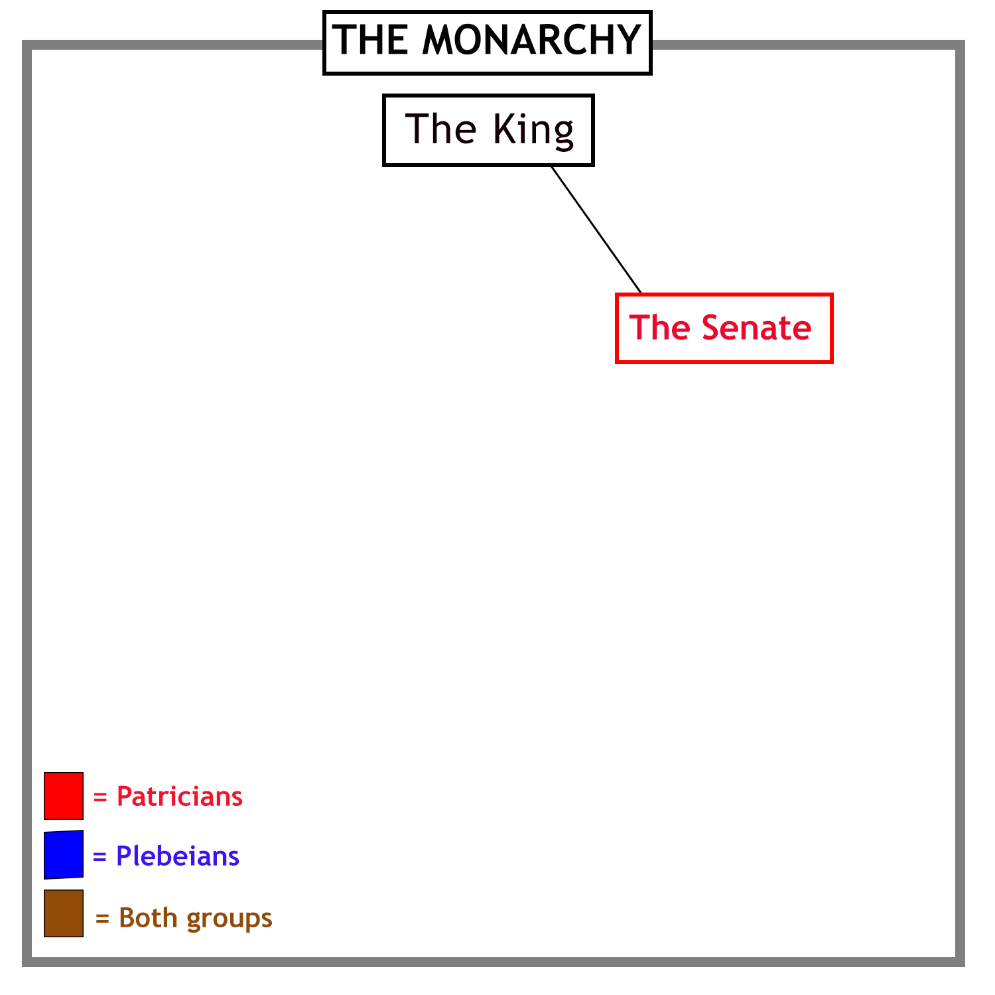
The kings were advised by a council of the
leading members of the community - the Senate.
They were all Patricians.

Slide 3
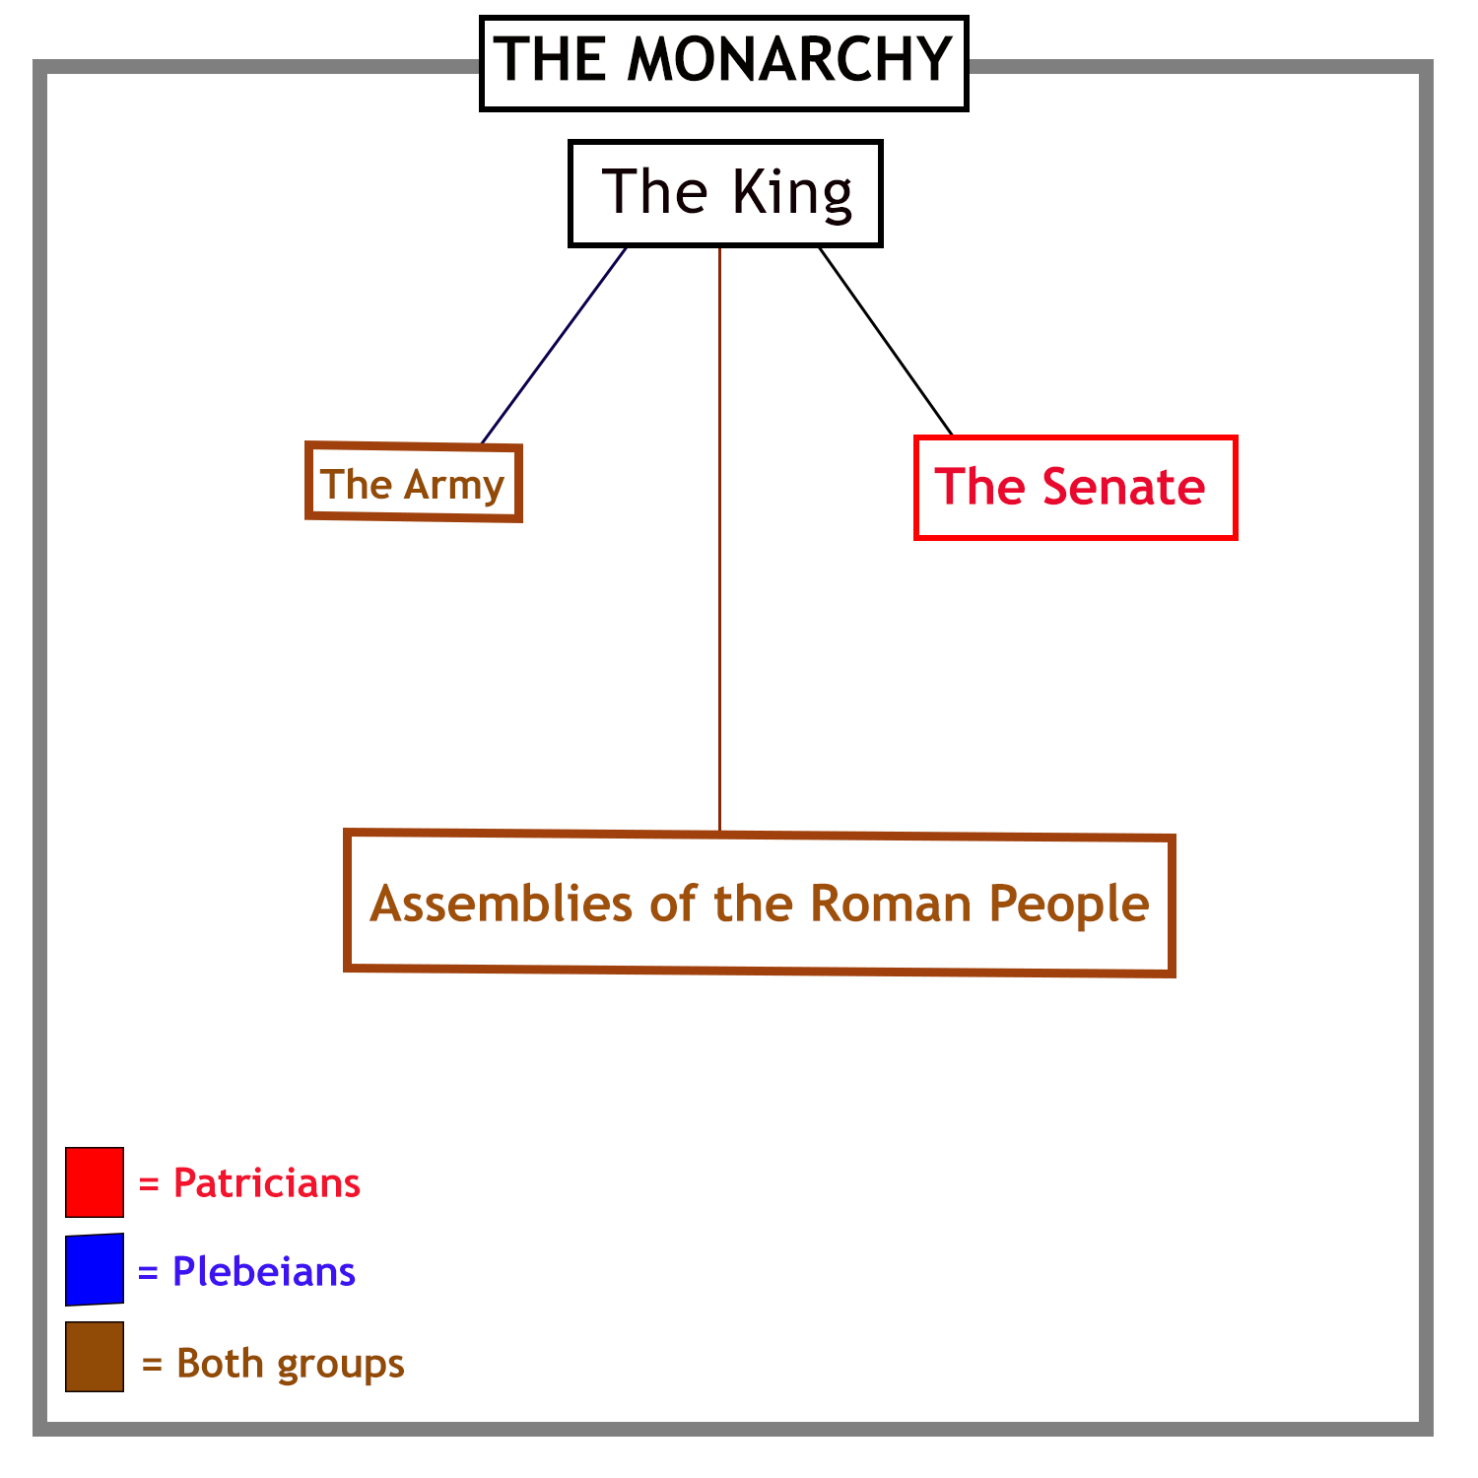
All Roman men, whether Patricians or Plebeians, served as
soldiers in the Roman army. They were also members of
various assemblies, which voted on important matters.

Slide 4
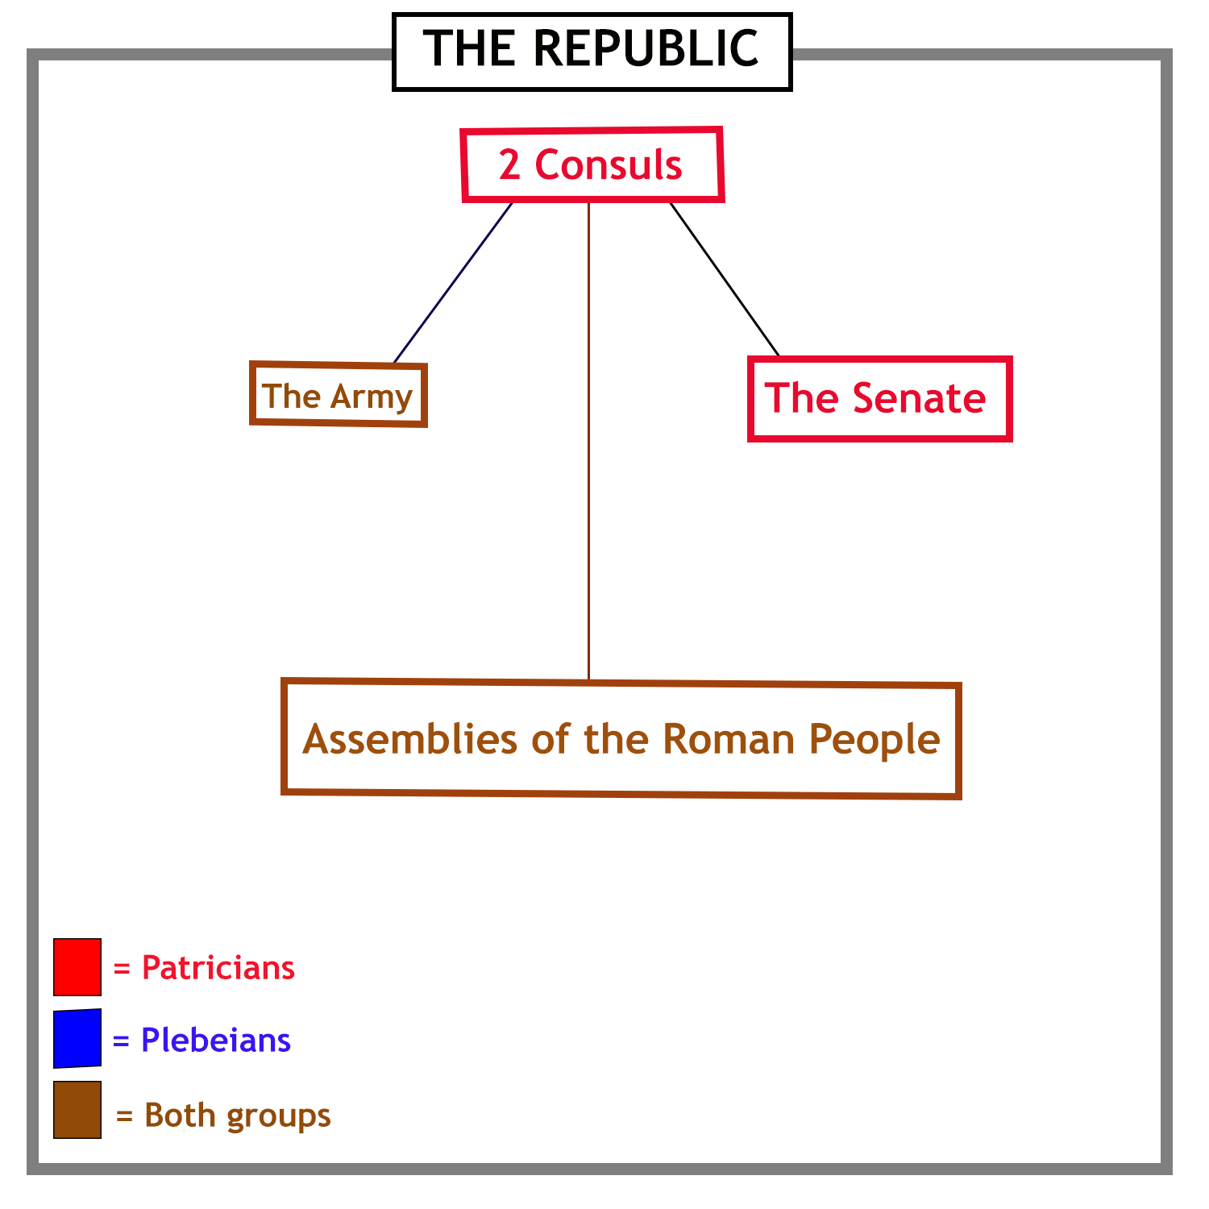
When the last king was expelled from Rome,
his place as head of state was taken by
two elected magistrates, called consuls.

Slide 5
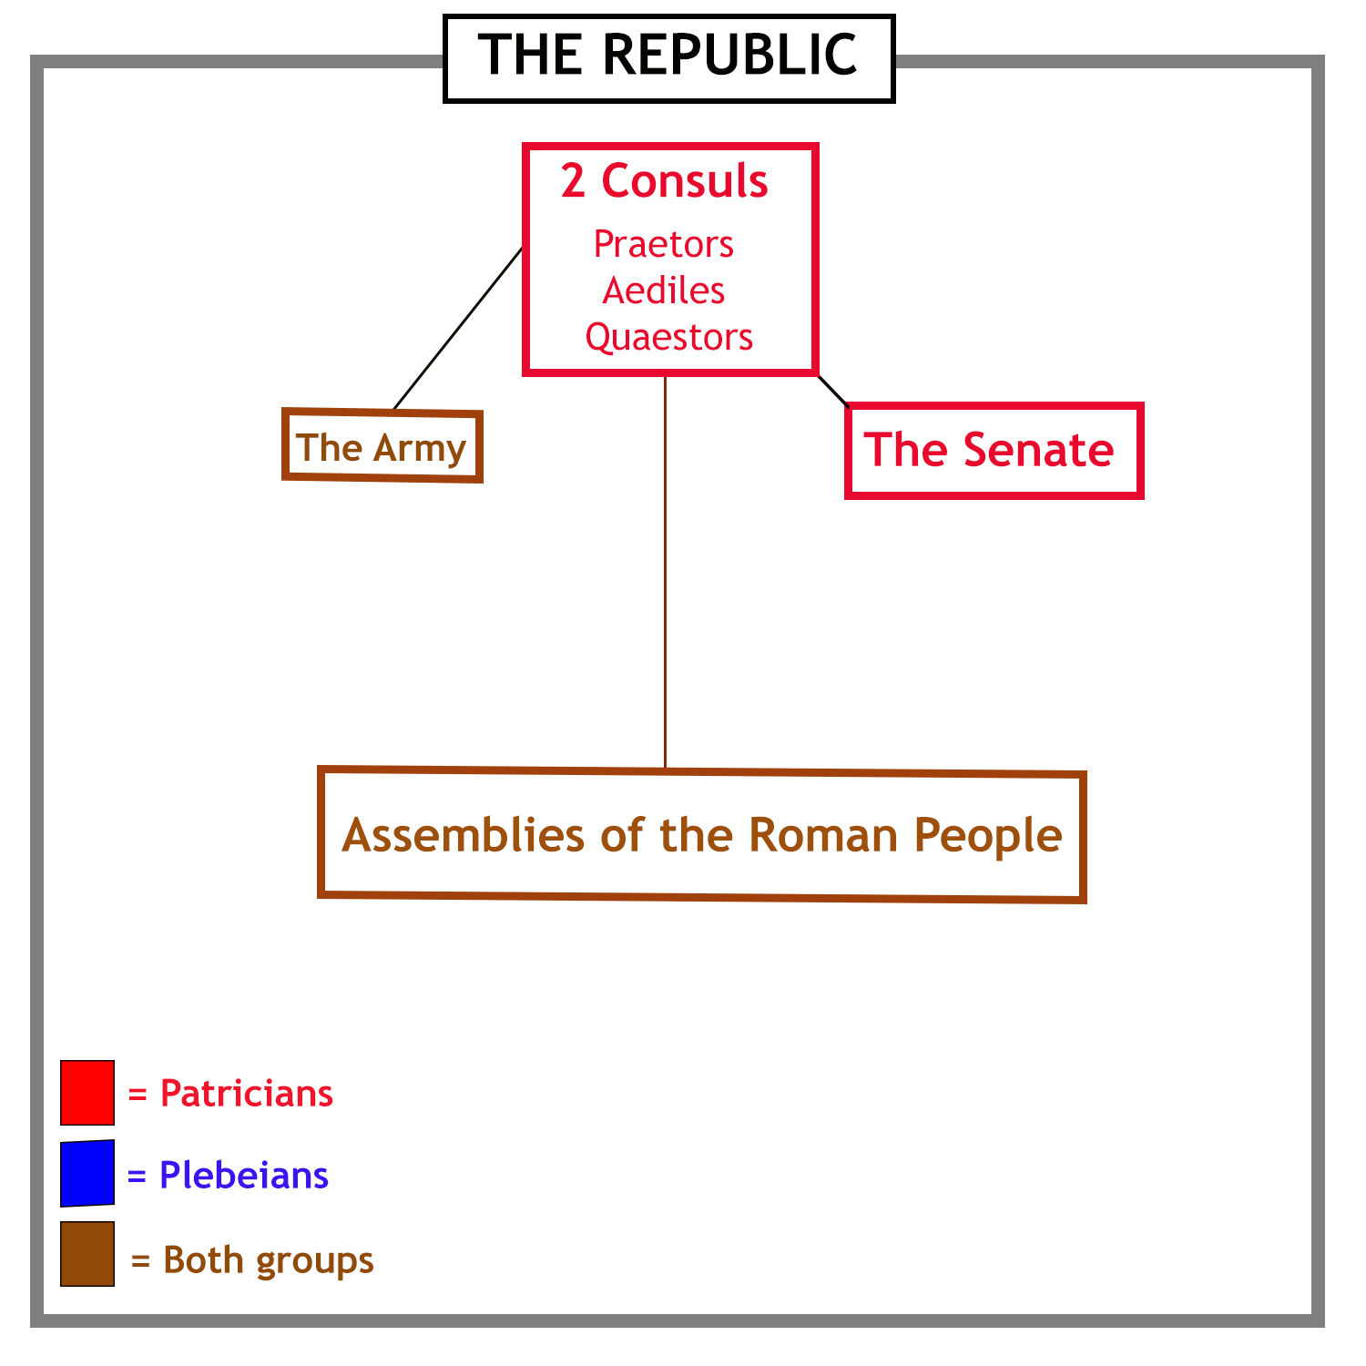
Over time, as Rome became more powerful and wealthy,
more magistrates were needed to handle
the growing complexity of government.

Slide 6
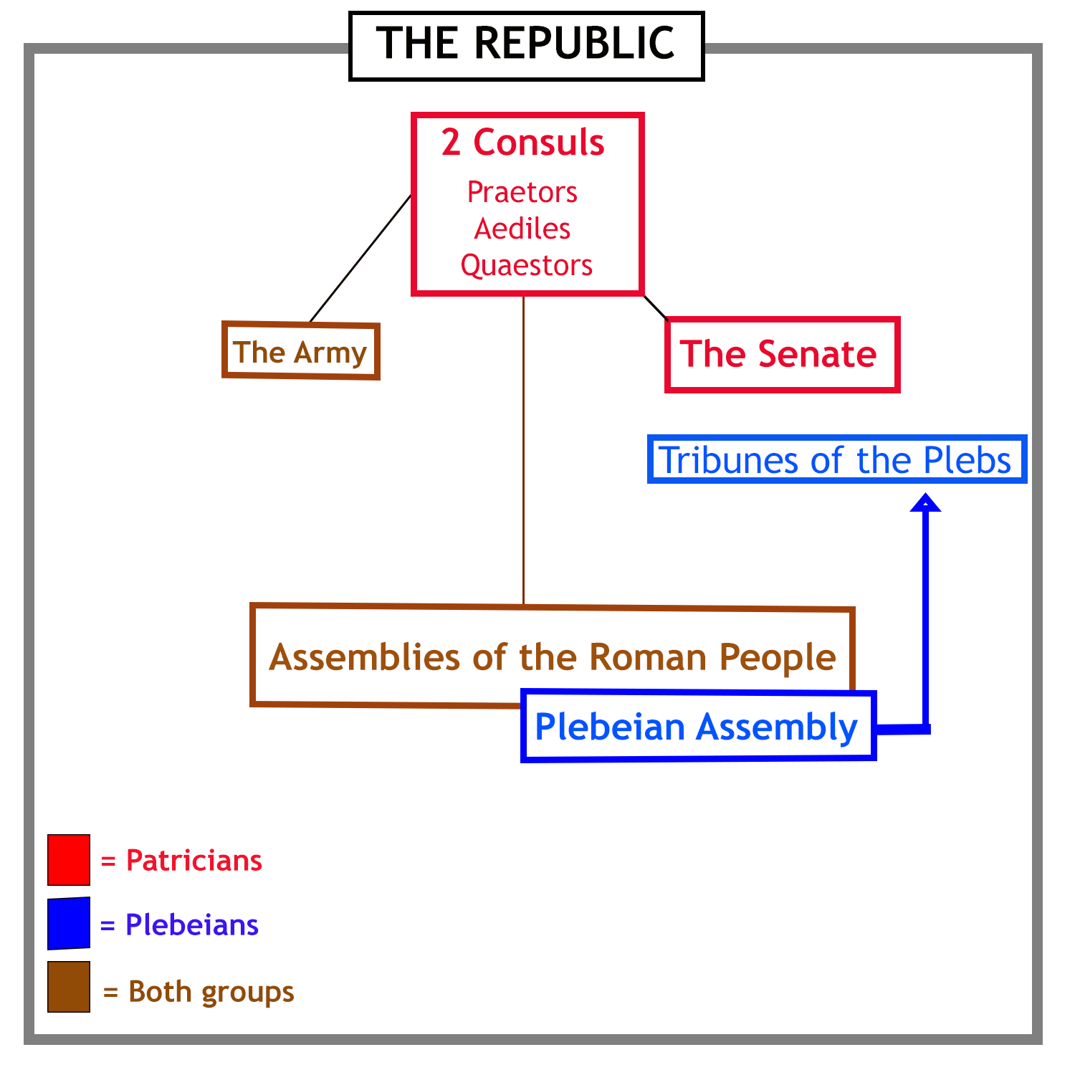
A struggle between the Patricians and Plebeians
led to the Plebeians getting their own assembly.
This assembly elected officers called tribunes, to protect the Plebeians’ interests.

Slide 7
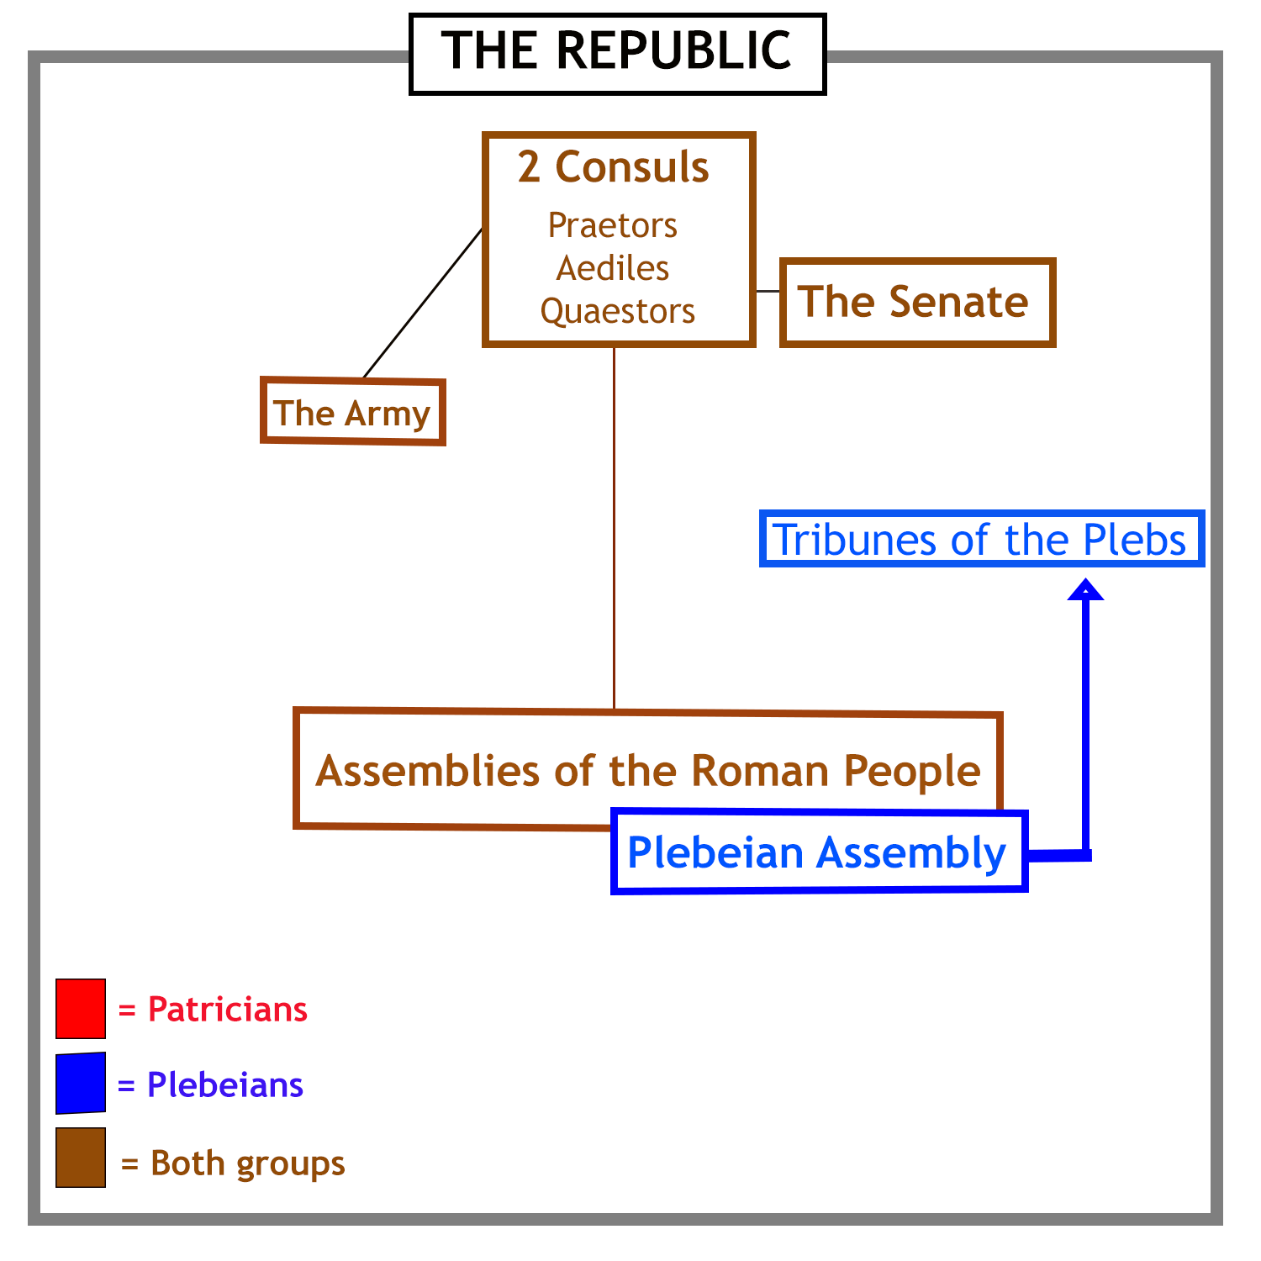
Plebeians then won the right to be elected for
public office and sit in the senate.

Slide 8
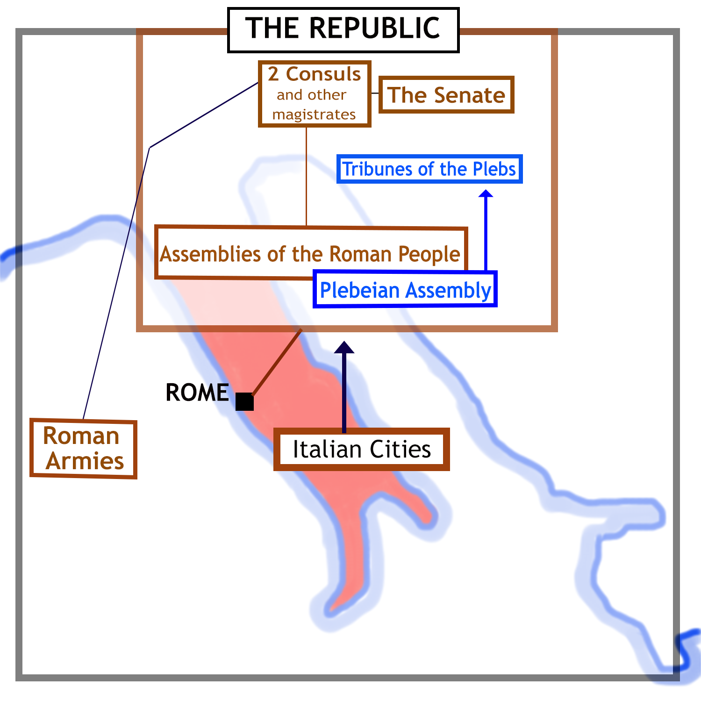
Most of Italy had come under Roman
control by 270 BCE. The cities were
allowed to run their own affairs so long as
they remained loyal allies of Rome.
Roman armies now operated throughout
the Italian Peninsula, often far from Rome.

Slide 9
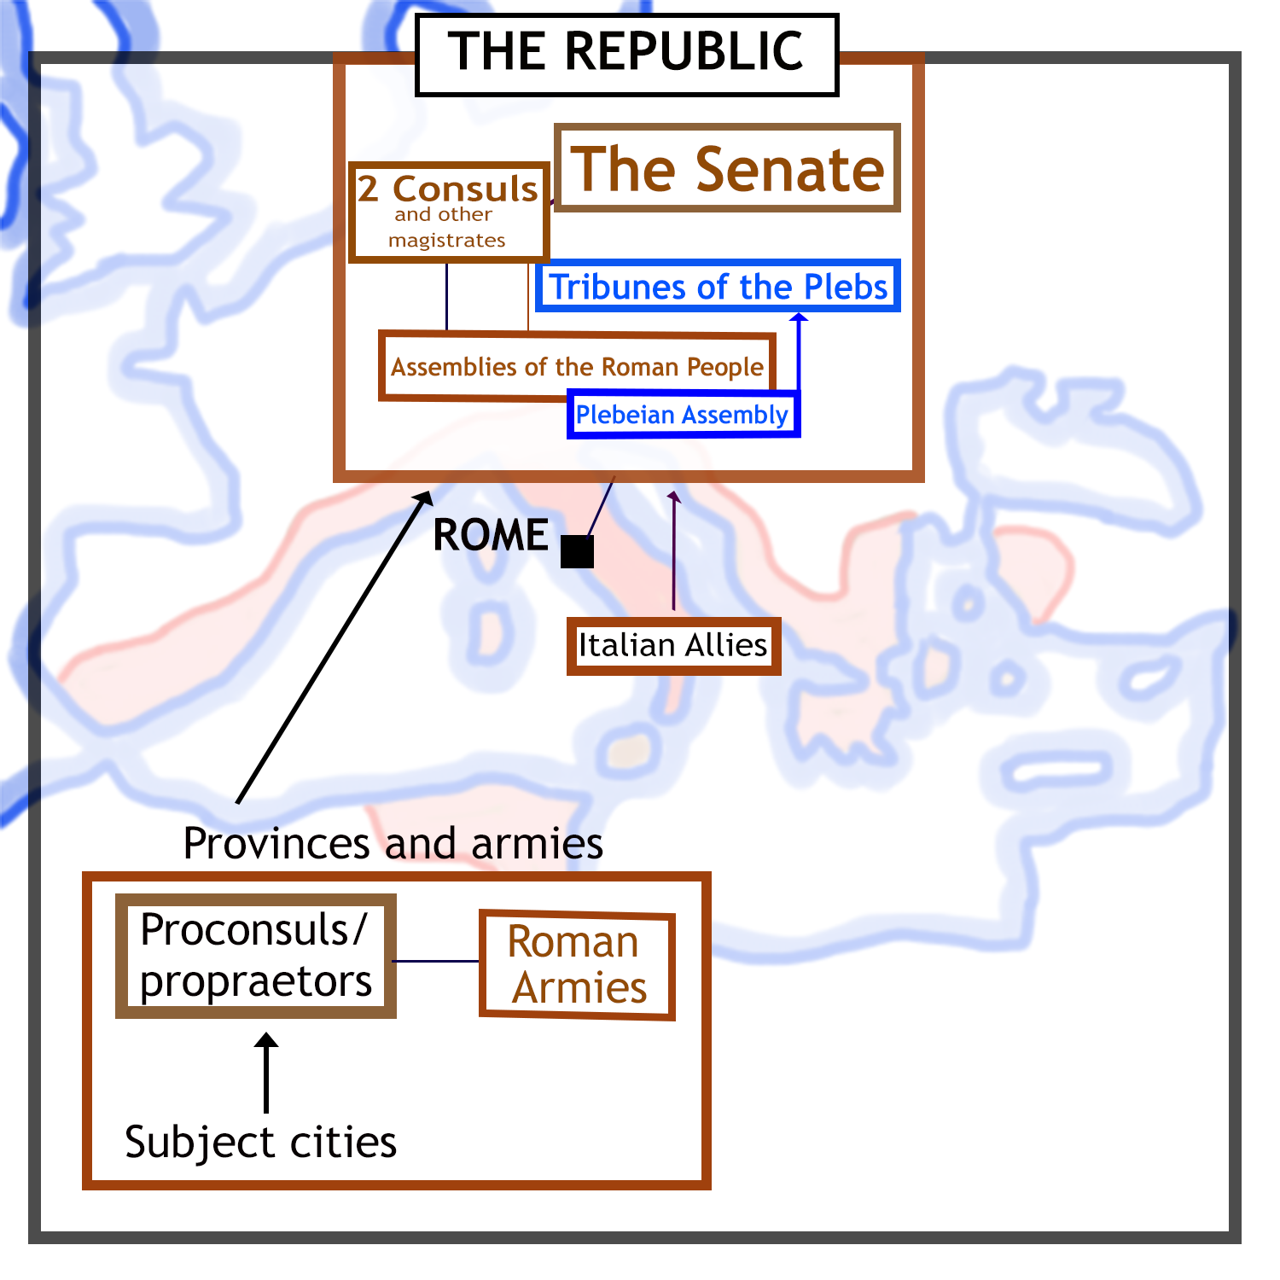
As Roman power expanded overseas, new provinces were placed under the control of ex-consuls (where large armies were needed) and ex-praetors.
The senate now became much
more important, as it supervised
the proconsuls and proprietors
and took responsibility for Rome’s foreign policy.

Slide 10
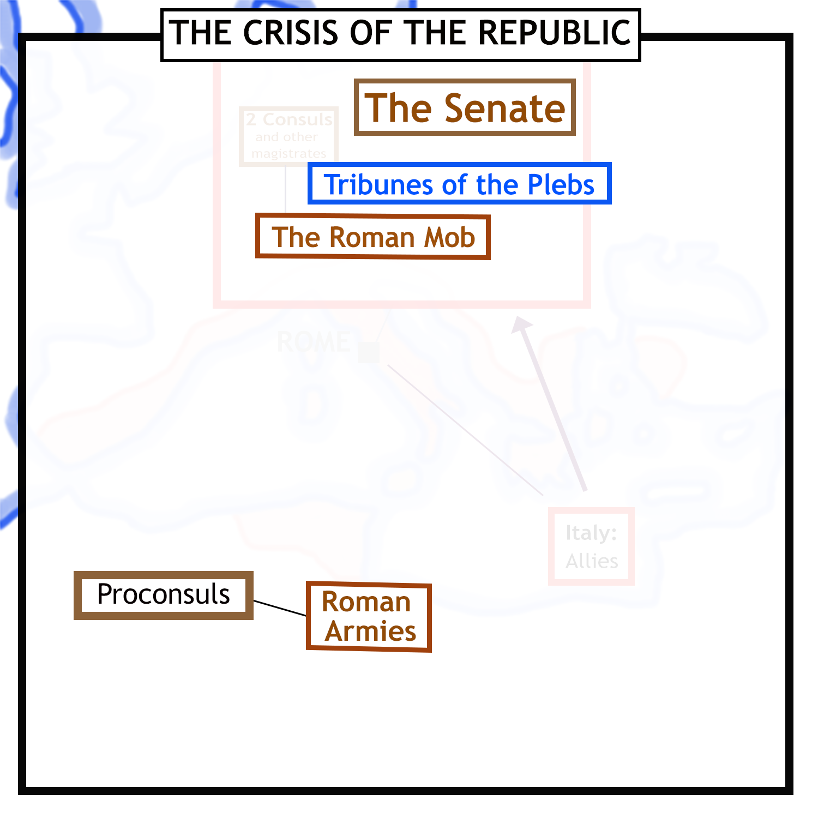
In the 1st century BCE, the Roman state fell into a major crisis. The main actors are shown here.
The senate was
faction-ridden
and unable
to act decisively.
The tribunes were the agents of
different factions and blocked change.
The Roman mob could be bribed to support one
faction or another, and fuelled organised
crime. This was heavily involved in politics.
Proconsuls with loyal and powerful armies under their command
became a major threat, launching a series of civil wars.

Slide 11
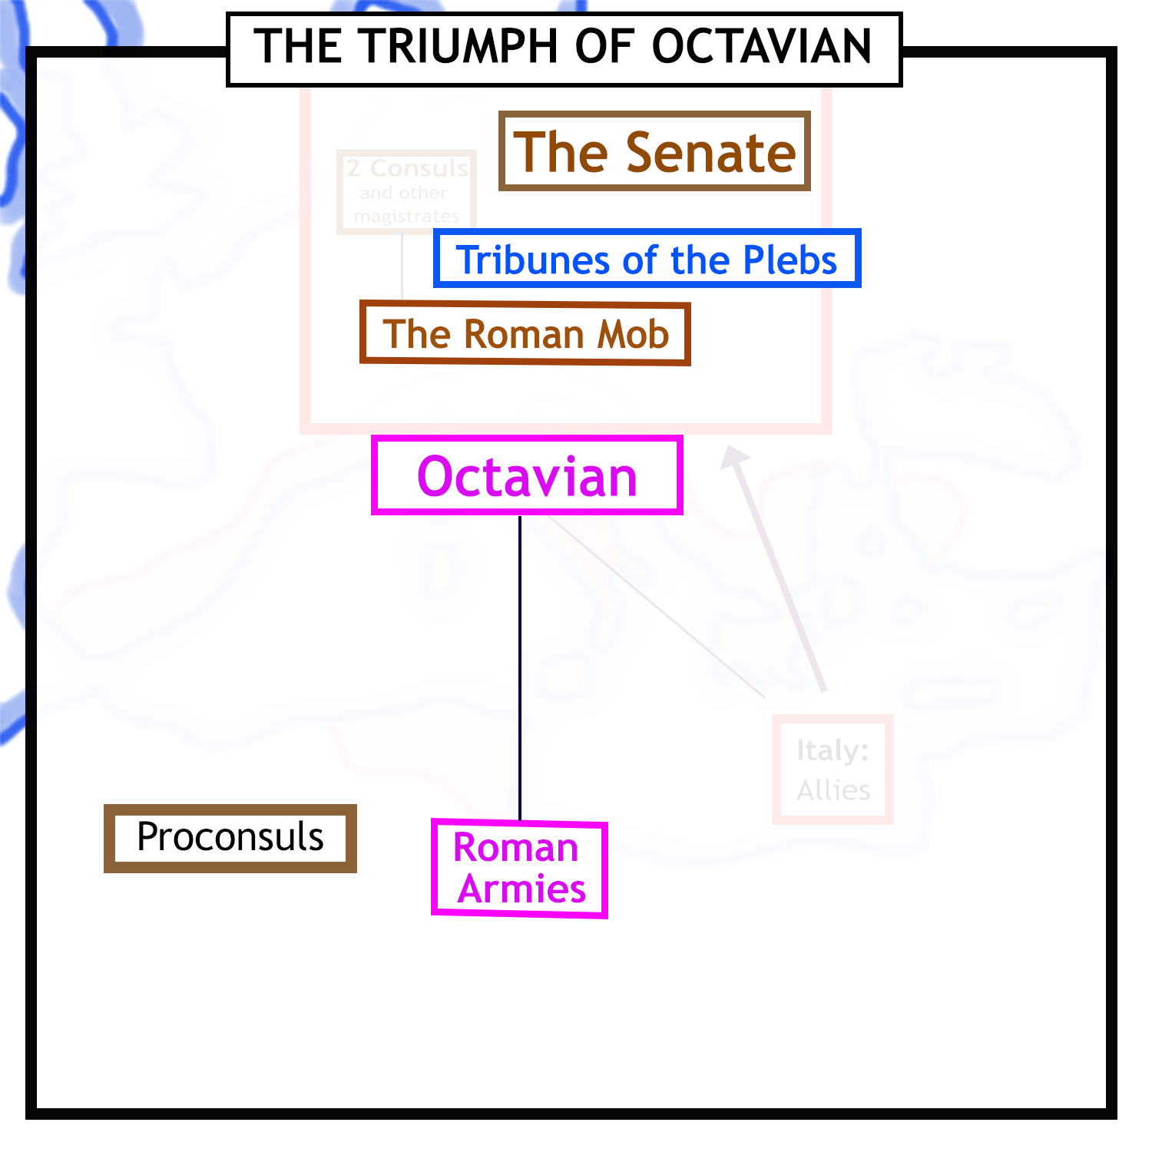
In 31 BCE, the Roman civil wars ended when a man called Octavian emerged as the sole master of the Roman world.
Octavian was the adopted son and heir of the
famous general and dictator Julius Caesar.
His defeat of his rival Mark Antony
left him in effective control of all the
Roman armies.

Slide 12
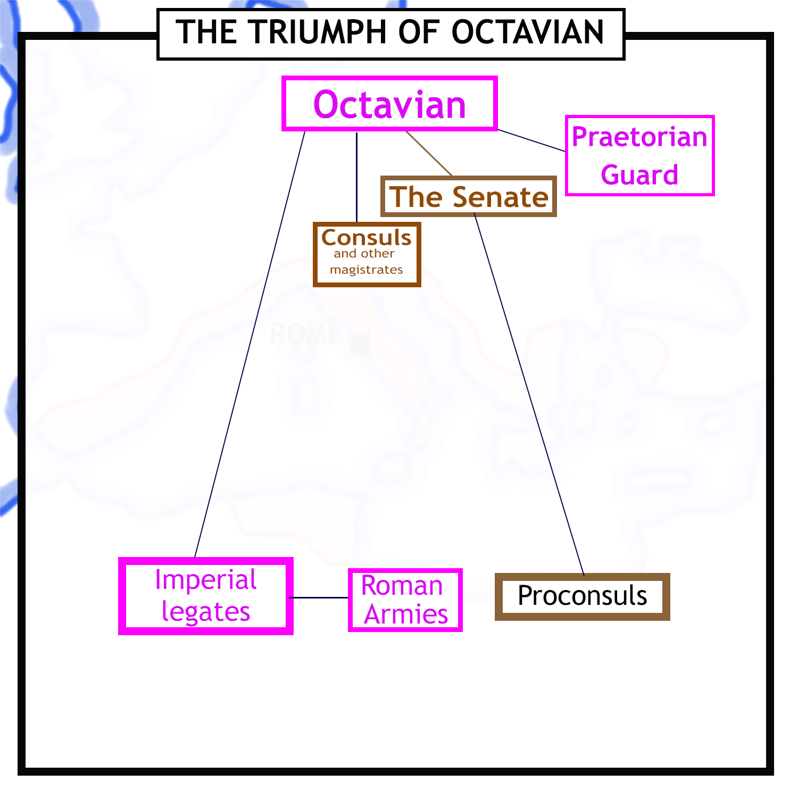
But how would Octavian place his rule on sound foundations, and so restore stability to the Roman world?
He showed respect for the old institutions of the Roman Republic, the senate and the traditional magistrates. But he limited their power.
He created the Praetorian
Guard to act as his bodyguard, and to help keep the Roman mob under control.
He allocated half the provinces to the senate, but kept all the provinces with armies in them under his own control.
He appointed men loyal to
himself to run the provinces and
armies under his control.

Slide 13
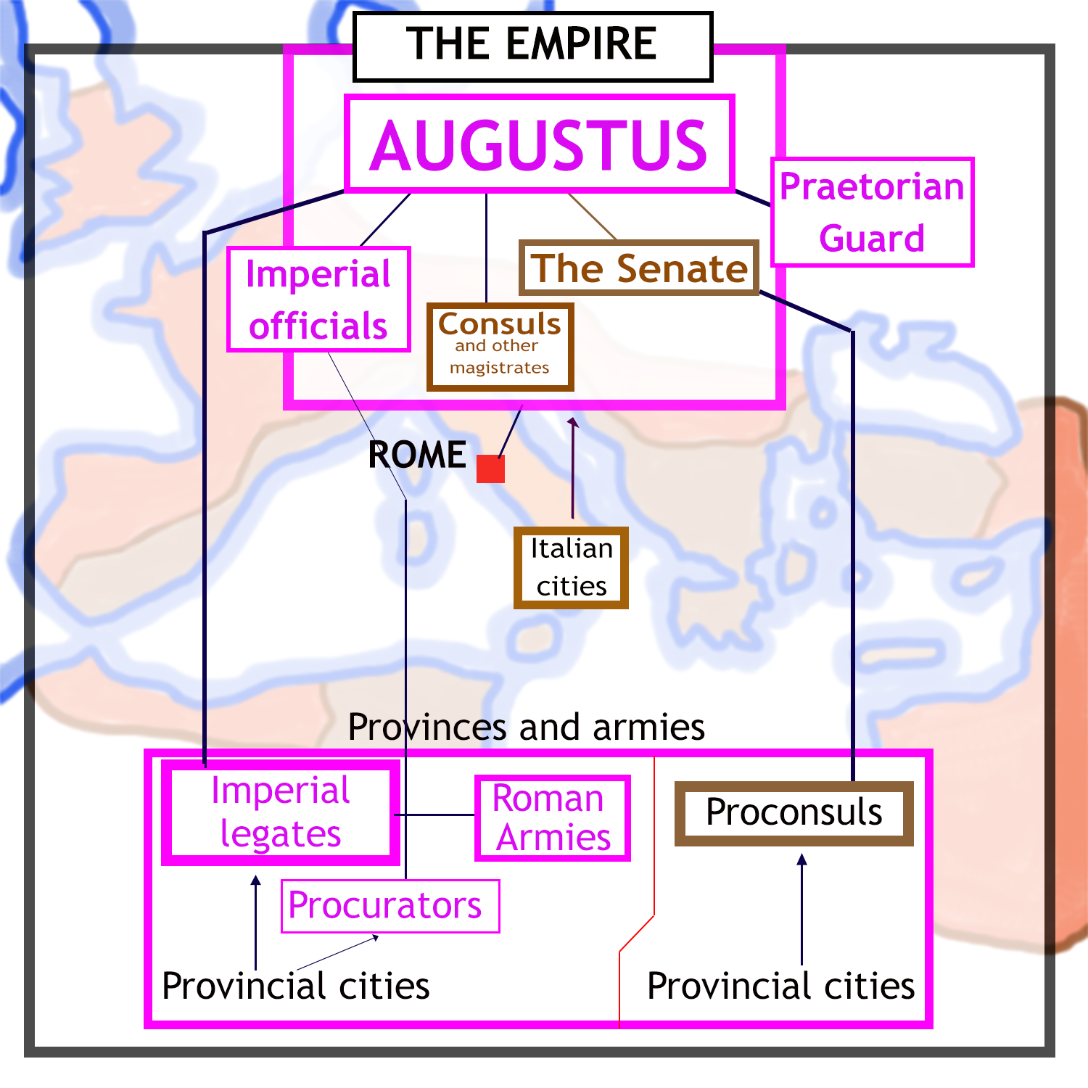
In 27 BCE Octavian took the name Augustus, “revered one”.
He appointed officials
responsible only to himself to help him govern the empire.
Augustus restored stability to the Roman world, and was
succeeded by a long line of emperors.

