Slide 1
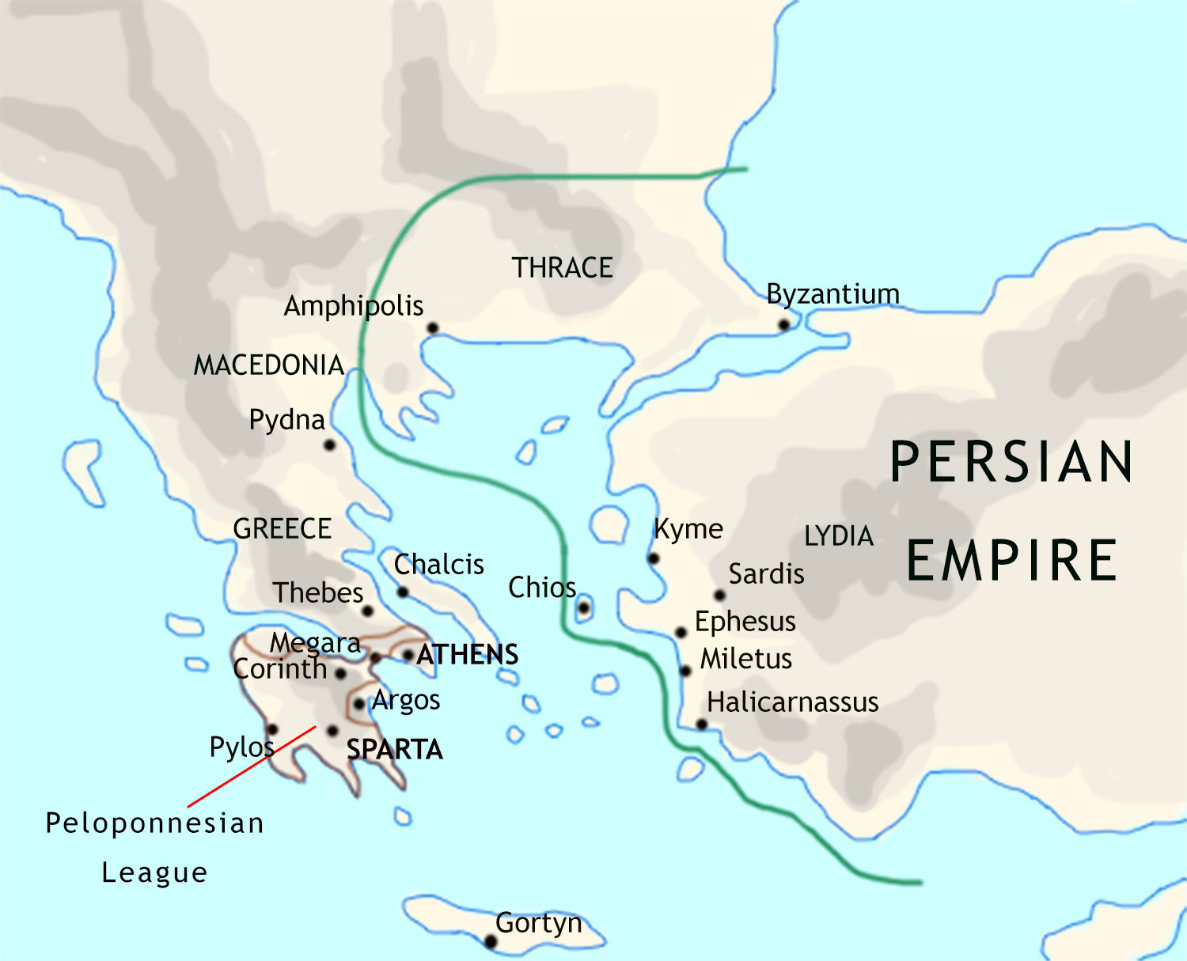
The Persian Wars: 500 BCE
This map of Greece and the Aegean Sea shows the leading Greek city states….
… and the western parts of the huge Persian Empire.
By this date, most of southern Greece
is under the leadership of Sparta.

Slide 2
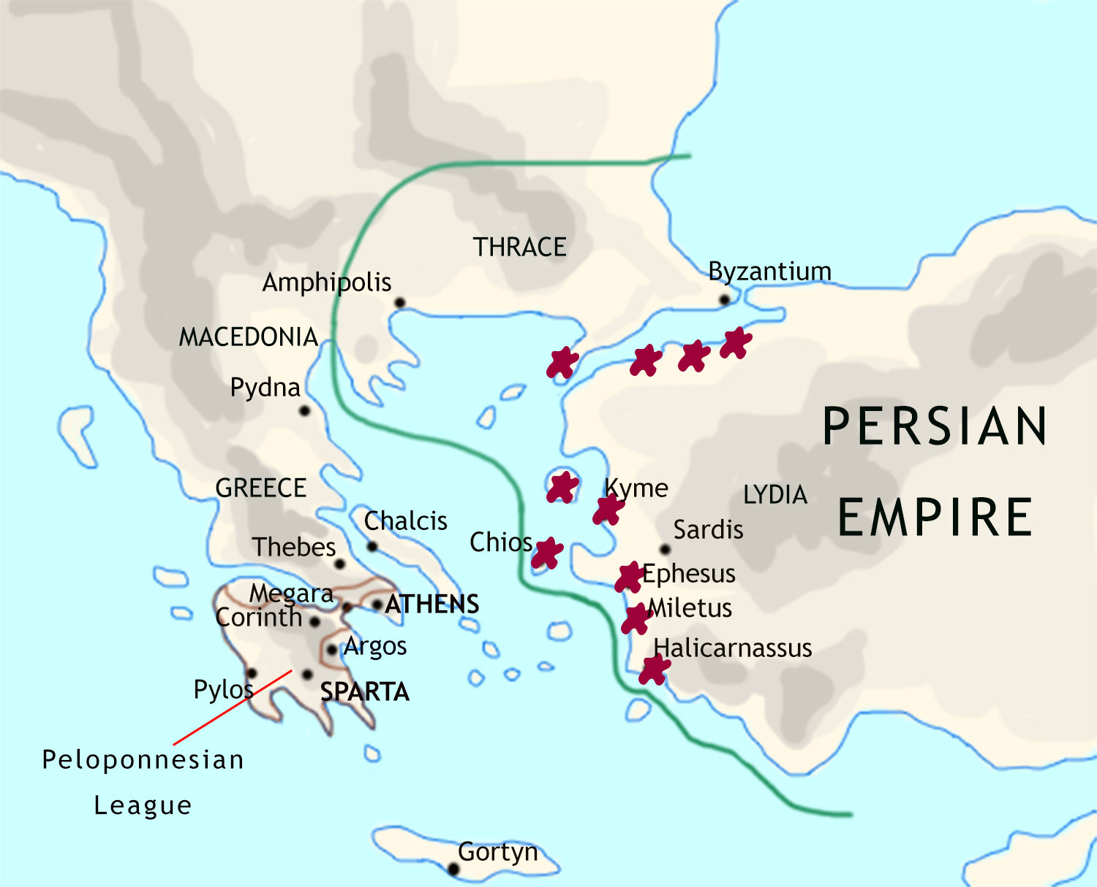
The Persian Wars
The Persian Wars: 499 BCE
In 499 BCE, the Greek cities in
the Persian Empire revolt…

Slide 3
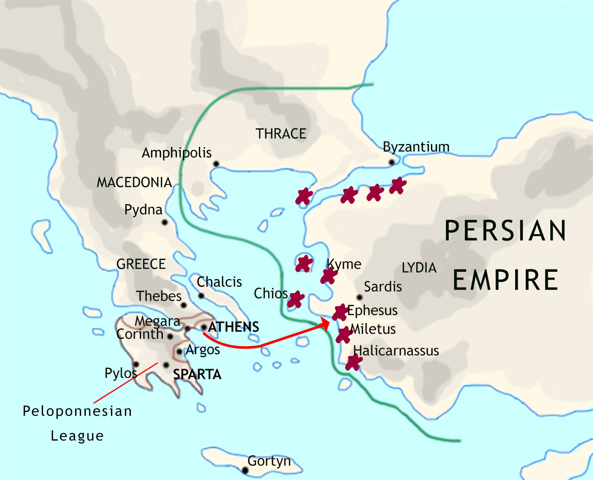
The Persian Wars: 499 BCE
…and Athens sends an expedition to help them.

Slide 4
The Persian Wars: 492 BCE
The Persians have defeated the rebels by
492 BCE, and then plot revenge on Athens.

Slide 5
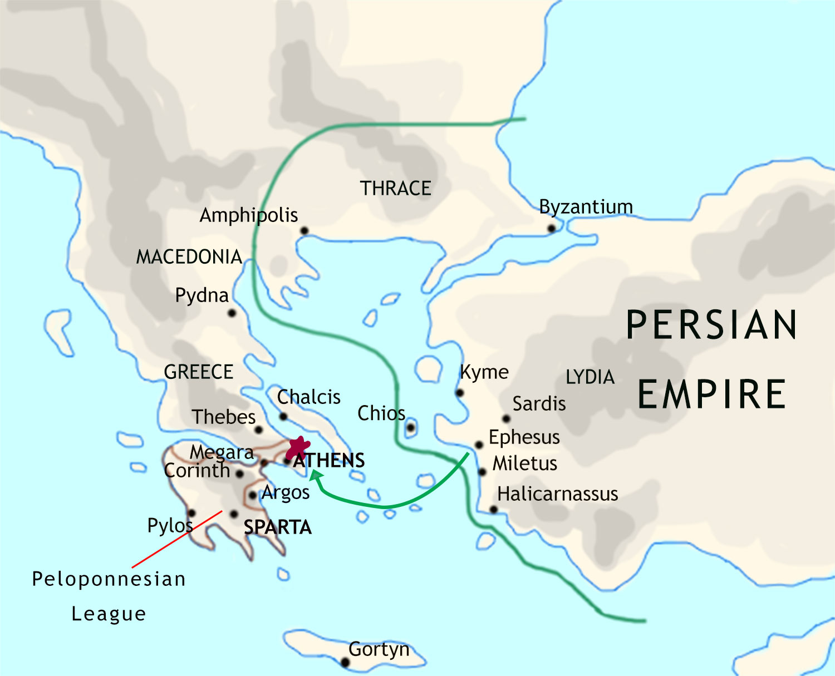
The Persian Wars: 490 BCE
The Persians send an expedition
to attack Athens, but are defeated
at the battle of Marathon.

Slide 6
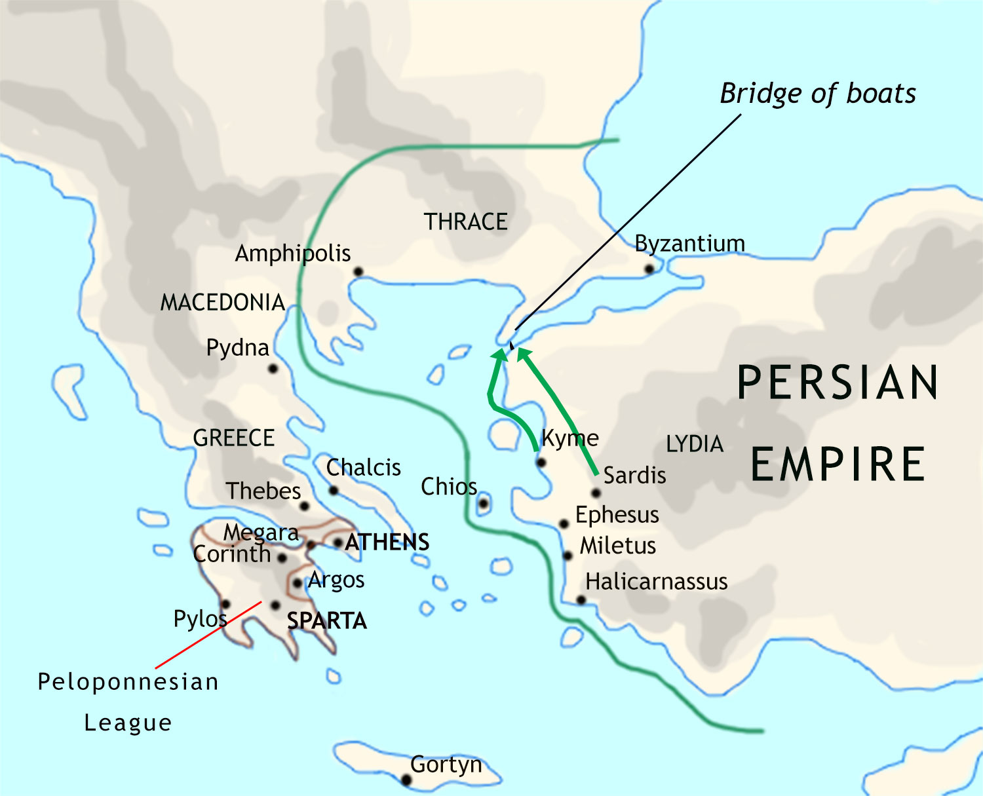
The Persian Wars: 480 BCE
Ten years later, the Persians try again. In 480 BCE they launch a
huge land and sea expedition to
conquer Greece.

Slide 7
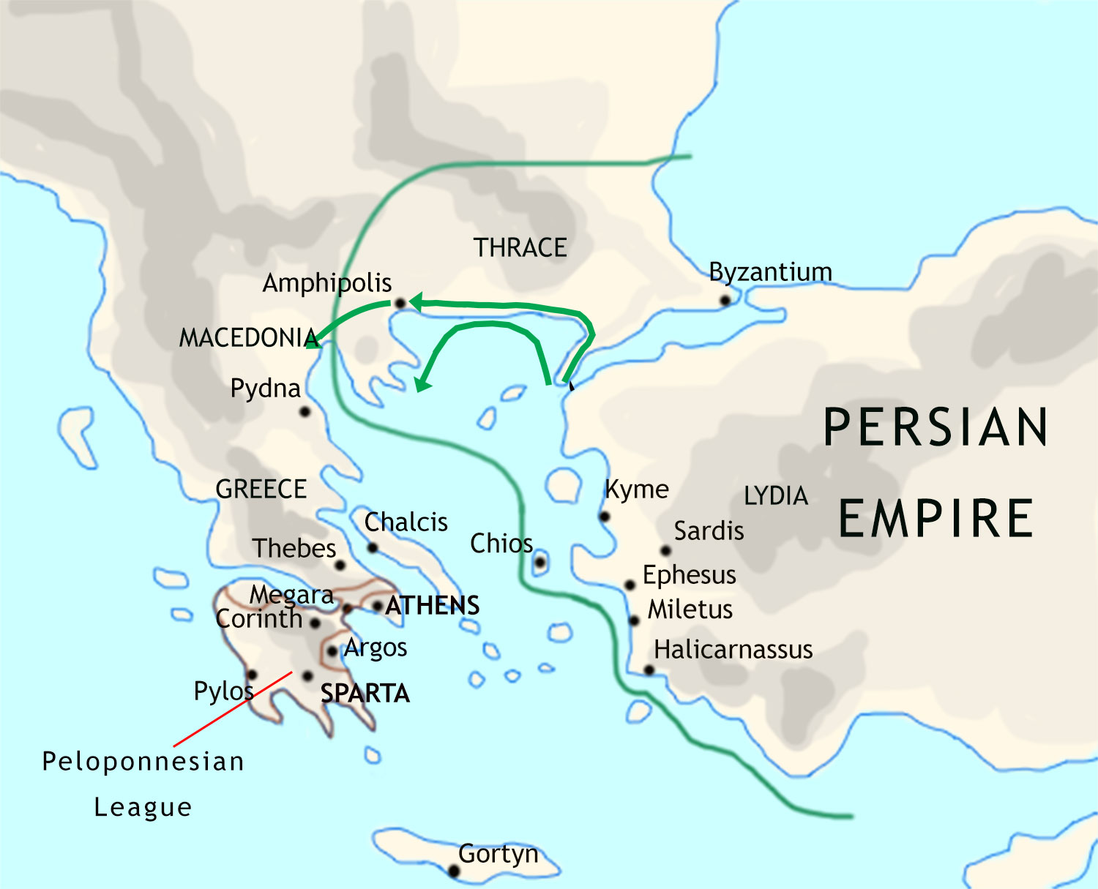
The Persian Wars: 480 BCE
The Greeks become aware of the threat to their independence…
…and, choosing Sparta and Athens as their leaders, prepare for the Persian invasion.

Slide 8
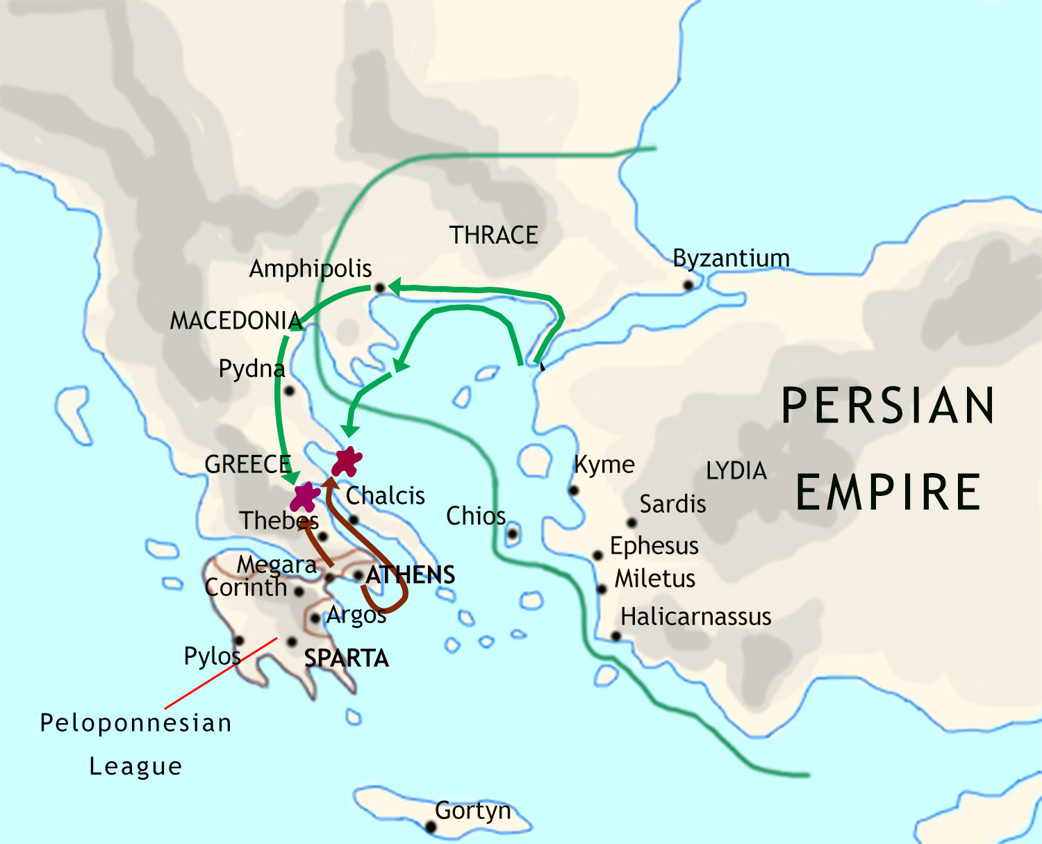
The Persian Wars: 480 BCE
At the Battle of Thermopylae,
300 Spartans stand in the way
of the Persian army, and are
massacred.
At the Battle of Artemisium,
the Athenian navy is defeated.

Slide 9
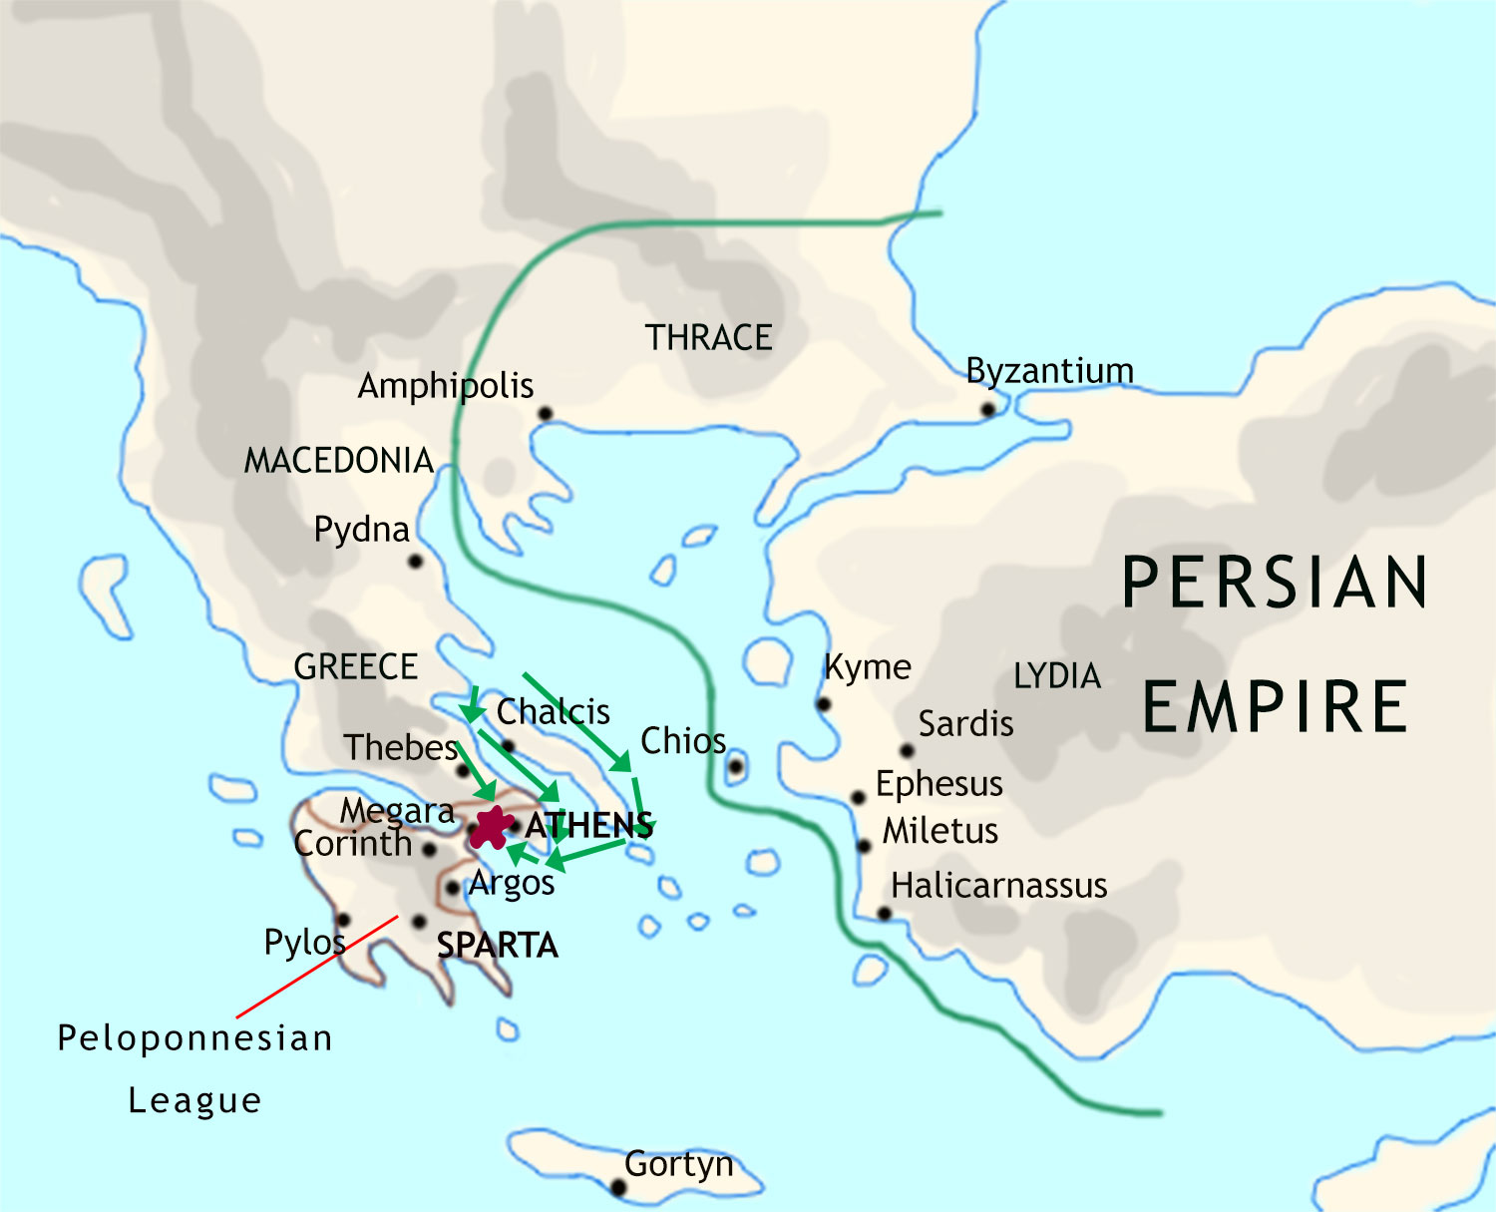
The Persian Wars: 480 BCE
The Persian army and navy
then approach Athens…
…but at the Battle of Salamis the Persian fleet
is routed by the Athenian navy.

Slide 10
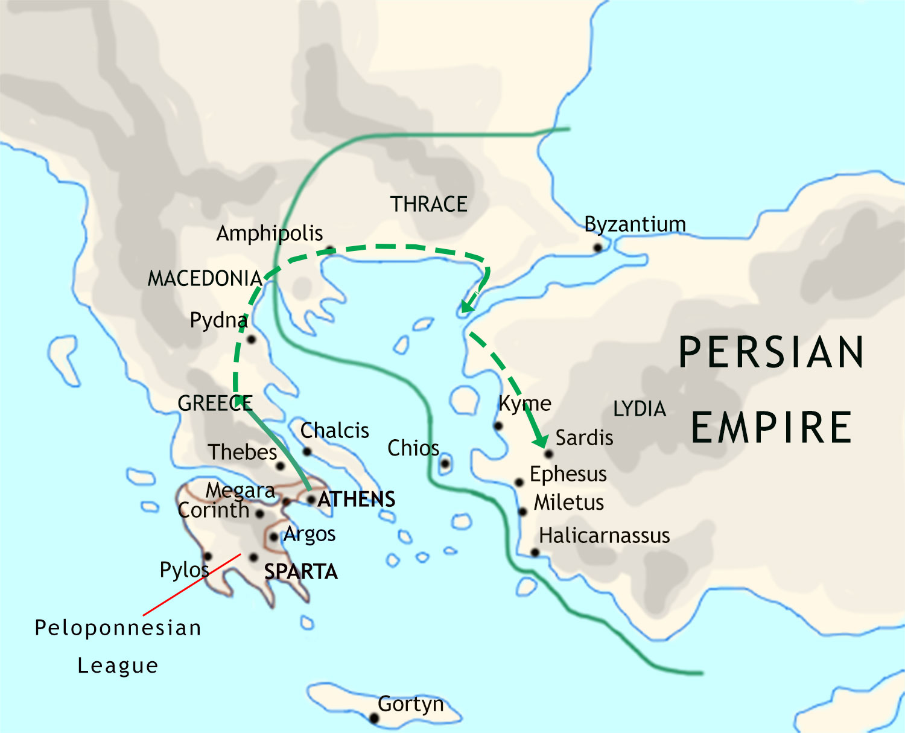
The Persian Wars: 480 BCE
The Persian army withdraws northwards,…
…and the Persian king, Xerxes, heads for home
with much of the Persian army. He leaves the remaining
troops in Greece under one of his commanders.

Slide 11
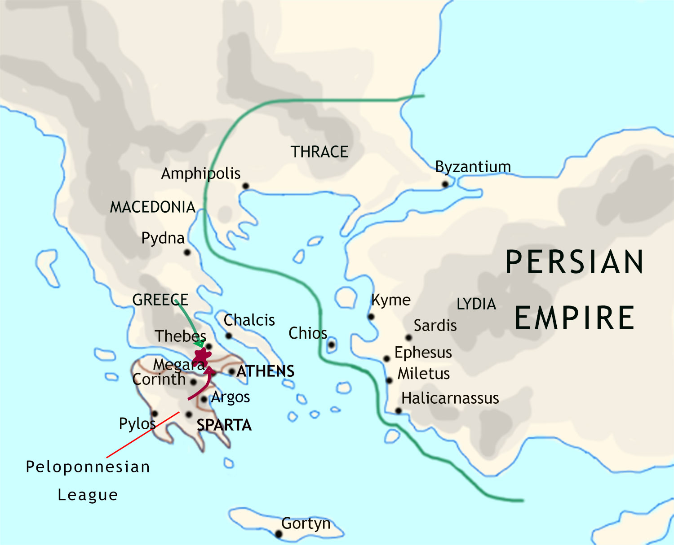
The Persian Wars: 479 BCE
The next year the Greeks soundly defeat the
Persian army in Greece at the Battle of Plataea…

Slide 12
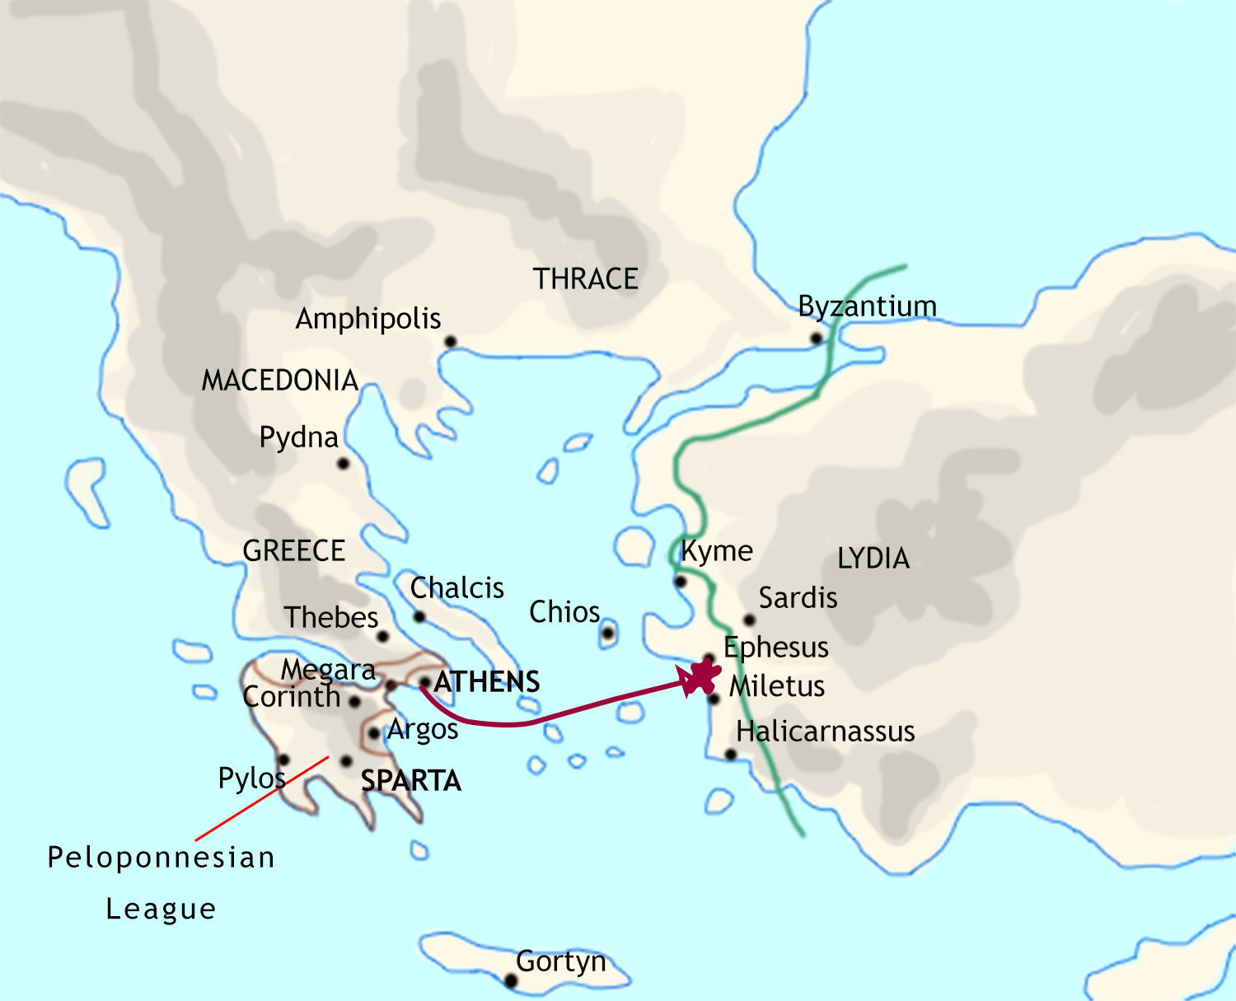
The Persian Wars: 479 BCE
…and at the Battle of Mycale the Greek fleet
destroys what remains of the Persian fleet.
The Persian forces withdraw from
western Asia Minor, and the Greek cities
there regain their independence.

Slide 13
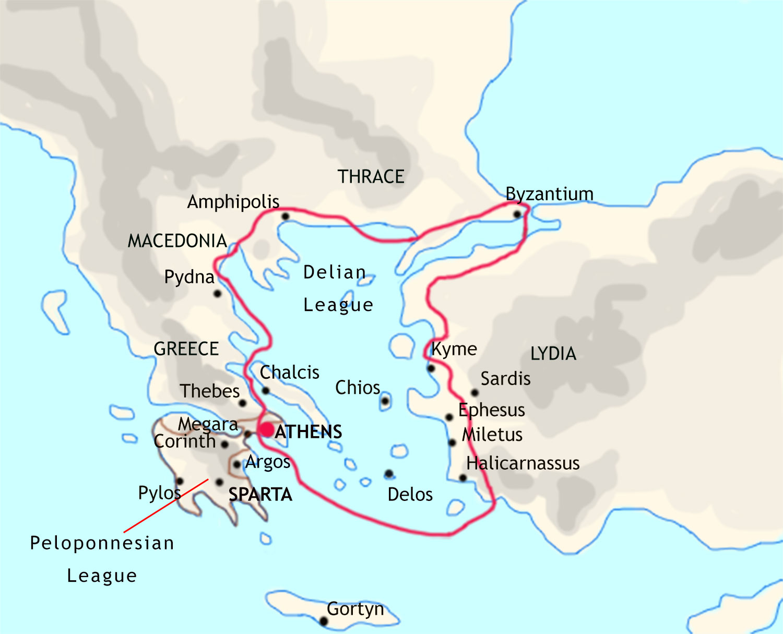
The Persian Wars: 478 BCE
The Athenians organize an alliance (the Delian League) with other city-states to defend against future Persian attack.

