Slide 1
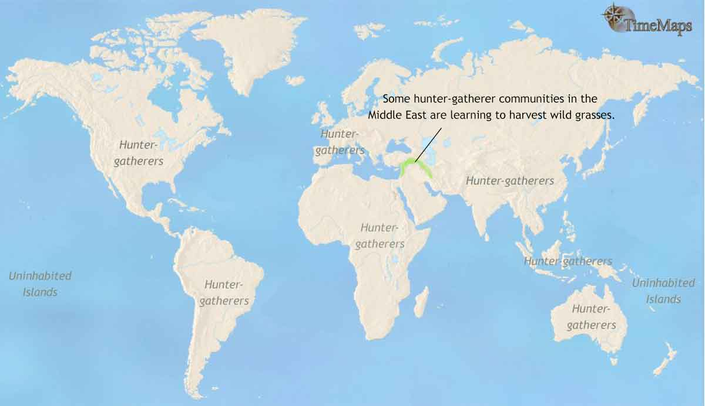
10000 BCE
The Rise of Farming
10000 BCE

Slide 2
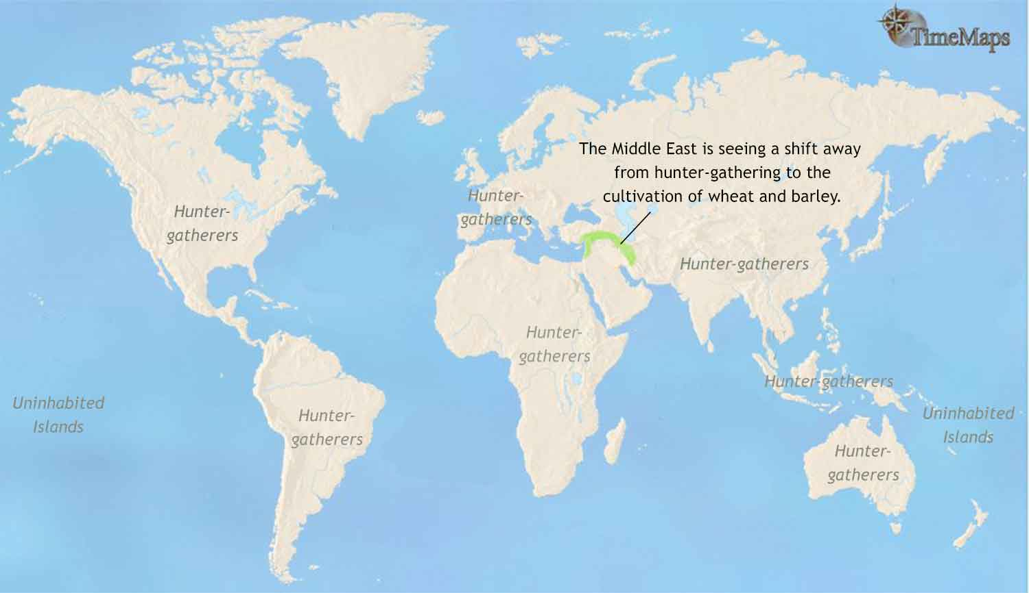
9000 BCE
The Rise of Farming
9000 BCE

Slide 3
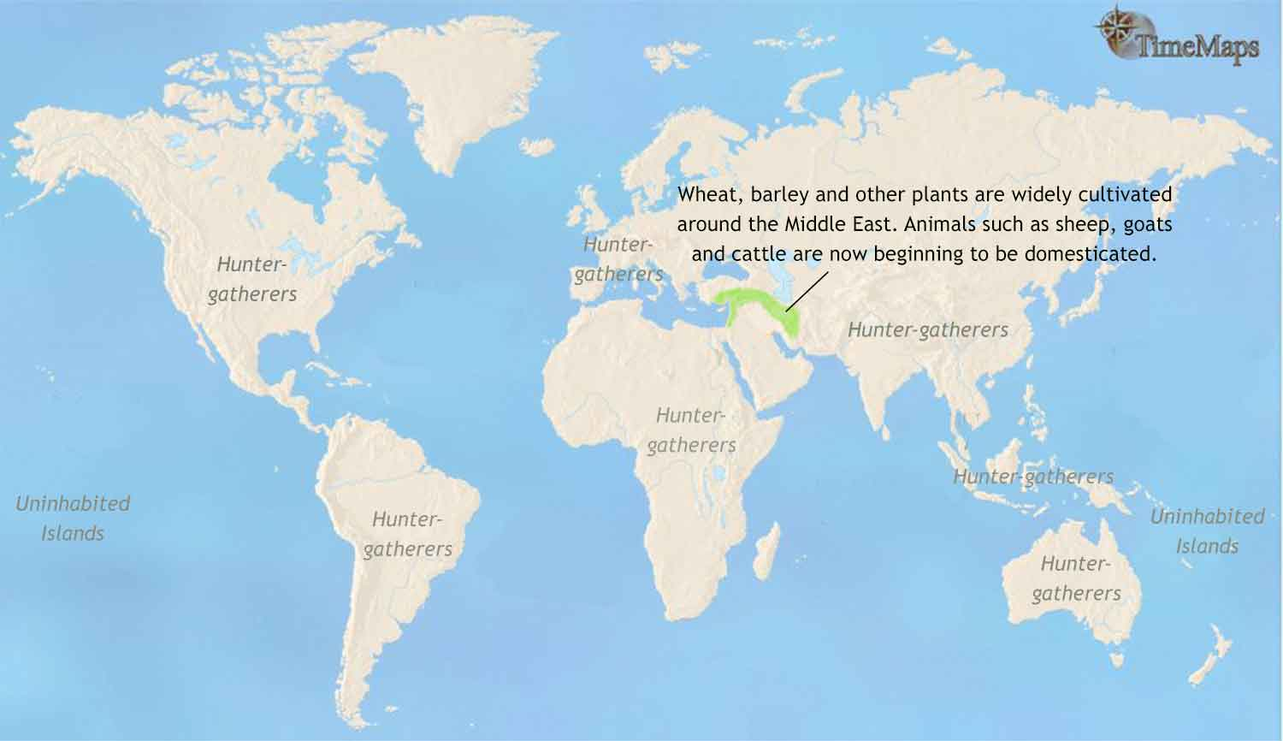
8000 BCE
The Rise of Farming
8000 BCE

Slide 4
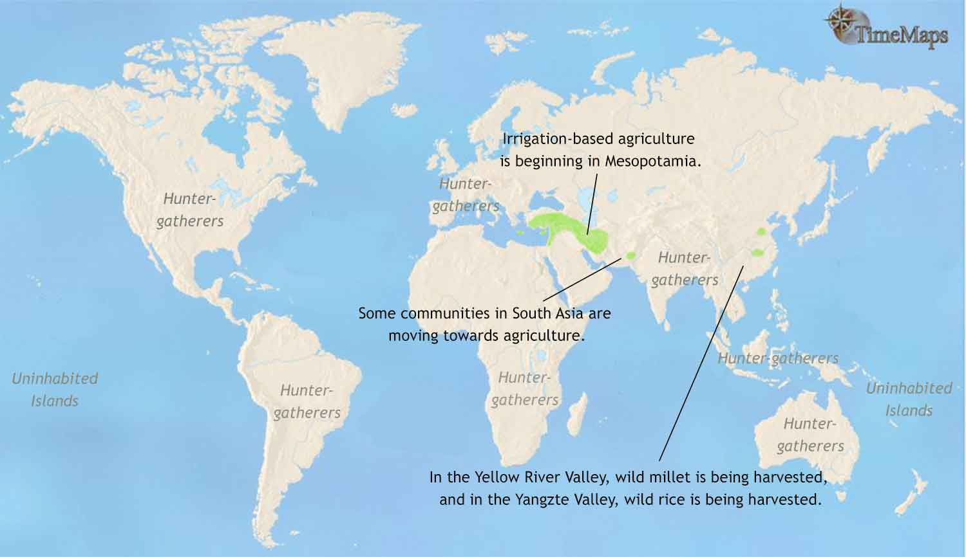
7000 BCE
The Rise of Farming
7000 BCE

Slide 5
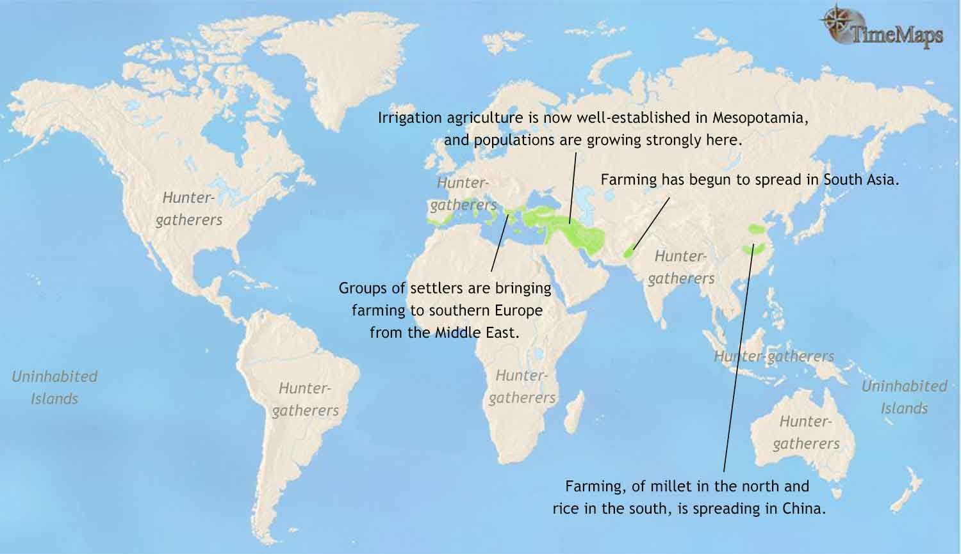
6000 BCE
The Rise of Farming
6000 BCE

Slide 6
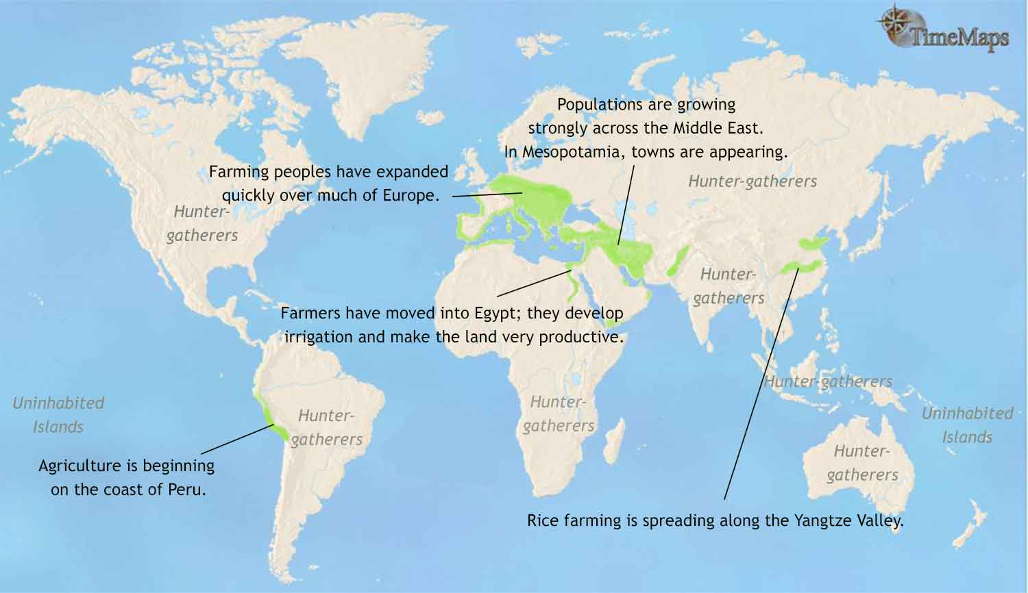
5000 BCE
The Rise of Farming
5000 BCE

Slide 7
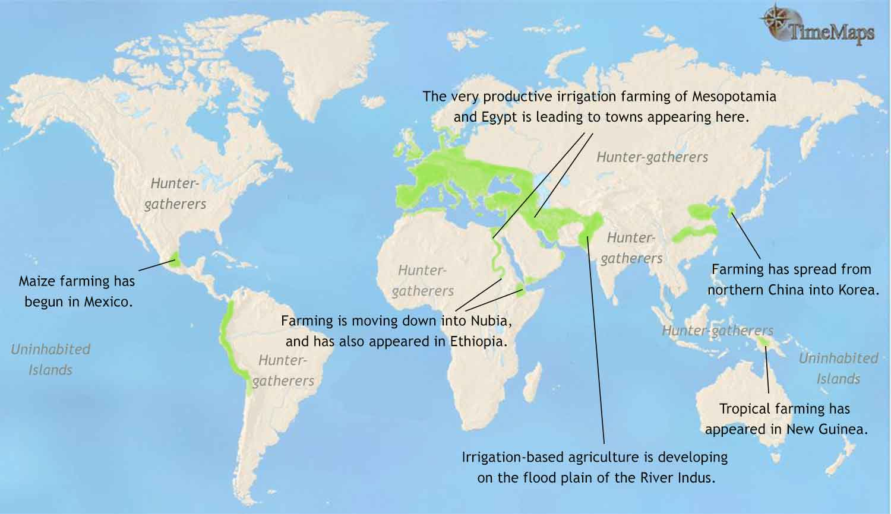
5000 BCE
The Rise of Farming
5000 BCE

Slide 8
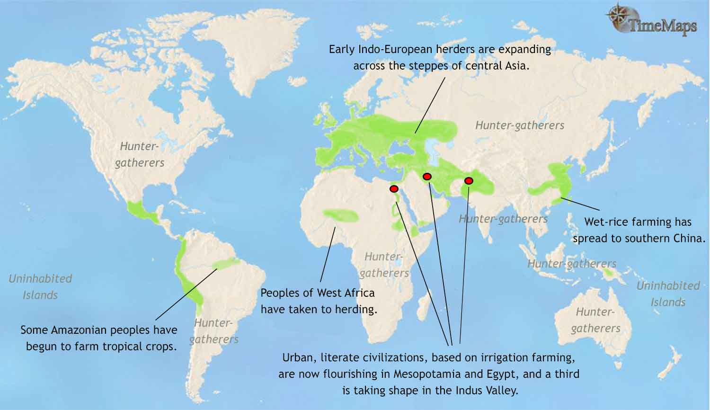
3000 BCE
The Rise of Farming
3000 BCE

